Slide 1

Preparing for an Academic Career in Geosciences Workshop: Summer 2011
Incorporating Data Analysis into Undergraduate Courses
Rachel O’Brien, Allegheny College

Slide 2
Data sets are flexible
Data and assignments can be tailored to reach a broad range of student groups
  K-12 Graduate
  courses
  • Can be used in one class/lab session or throughout an entire course

Slide 3
Data sets are cost-effective
Majority of online sources are now free
Simple, low-cost field and lab work
Data sets are concept-effective
Allow for compare/contrast work at a range of spatial & temporal scales
Single or multi-concept patterns

Slide 4
Data sets are engaging
Allow students the opportunity to practice science and promote active learning
Data sets are real
Require students to grapple with issues of complexity, uncertainty, and outliers

Slide 5
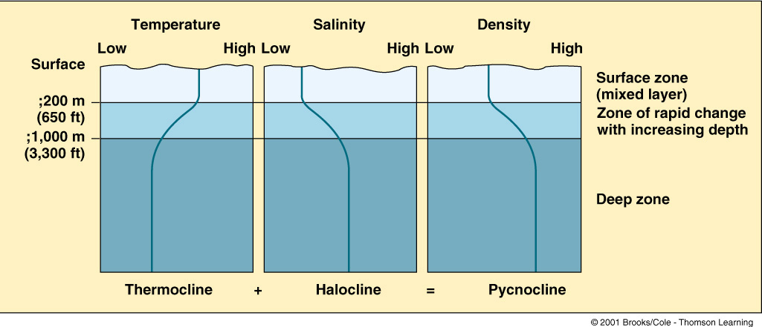
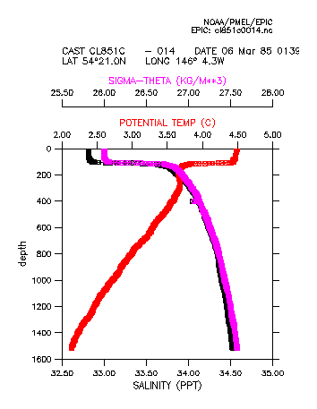
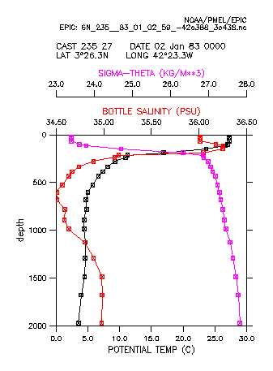
Ocean Circulation
Profiles
Classic textbook
Pacific
high
latitude
Atlantic
low
latitude
http://www.epic.noaa.gov/epic/ewb/

Slide 6
Data sets are diverse in topic , scope, and format
Hands-on data
  Field work and/or lab work in your course
  A genuine research experiment
Published literature
  Journal articles, government documents, NGO reports
Online datasets
  Teach particular concepts and/or skills
  Recreate research, test hypotheses

Slide 7
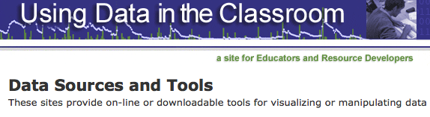
A great place to start
http://serc.carleton.edu/usingdata/resources

Slide 8
Data sets are not stand alone resources
Design how you’ll use data
  Identify clear learning outcomes for content, concepts, and/or skills
  What steps in the process are most important for your students to practice? (collection and reduction vs. analysis and reporting)
  How will you address uncertainty, outliers, etc.?

Slide 9
Data sets are not foolproof
Logistics
  Work through all steps of the process ahead of time
  Envision and create “Plan B”
• Evaluation
  Did the use of data help student learning? How will you know?

Slide 10
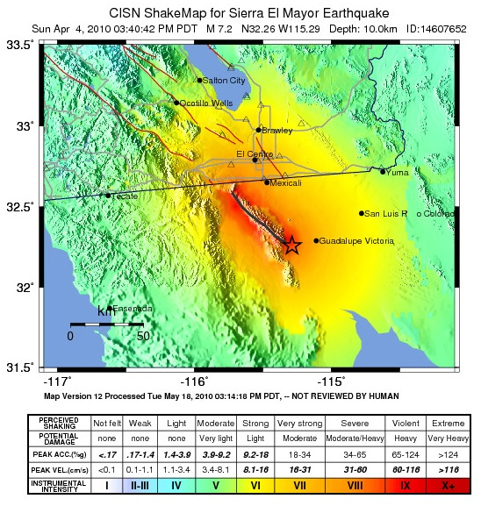
Selected
Web Sites with Earth Science Data
EPA
GEOROC
IPCC
LDEO
NCAR
NOAA
NSIDC
UNAVCO
USDA
USGS

Slide 11
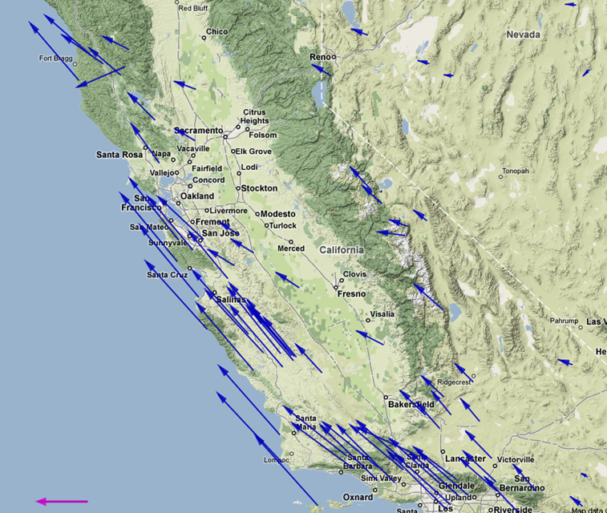
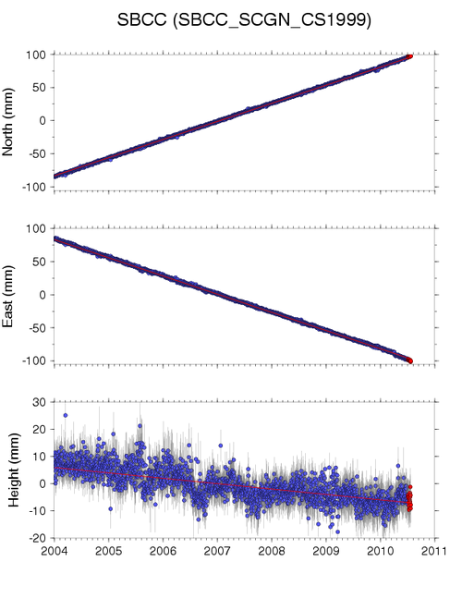
Geodetic Data
UNAVCO
EarthScope
Plate Boundary Observatory

Slide 12
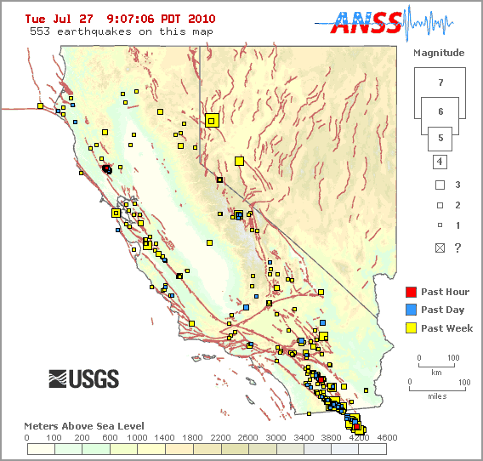
Earthquake Data
USGS
Earthquake Hazards Program
&
SCEC
So. California
Earthquake Center

Slide 13
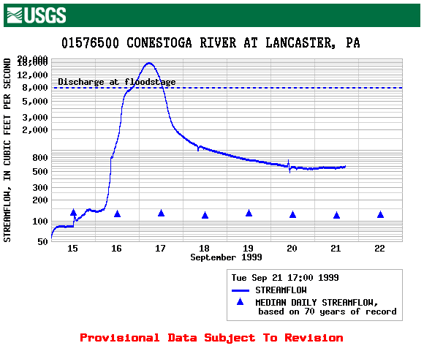
Hydrologic Data
USGS
Water Resources Division

Slide 14
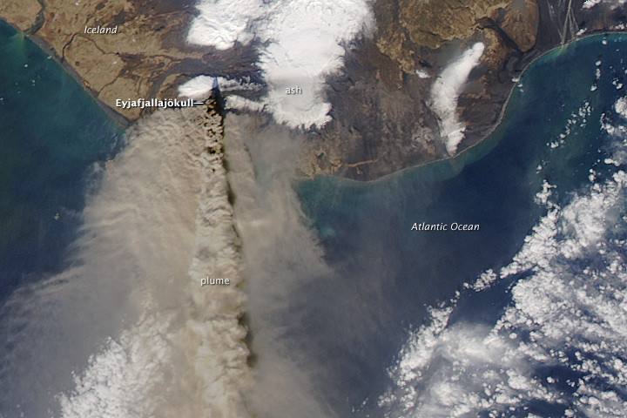
Satellite Imagery
NASA Earth Observatory

Slide 15
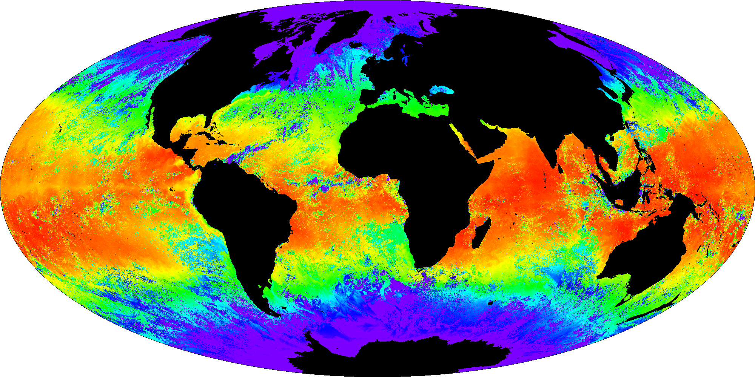
Earth, Ocean, & Climate Data
NASA Eyes on the Earth 3D

Slide 16
Exploration activity
Choose a course: Introductory level
or advanced course (grad or undergrad)
Identify a website with datasets that could be used in the course
What concepts(s) and/or skill(s) can students practice by using the data?

