Slide 1


Teaching for Learning:
What Research Tells Us
“A paradigm shift is taking hold in American higher education.”
From: “A college is an institution that exists to provide instruction.”
To: “A college is an institution that exists to produce learning.”
from Barr & Tagg, 1995
Robyn Wright Dunbar
Center for Teaching and Learning: Stanford University

Slide 2
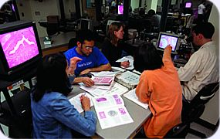
“What professors do in their classes matters far less than what they ask students to do.”
D. Halpern and M. Hakel, Change, 2003

Slide 3
Teaching Science:
What Research Tells Us
Students’ prior knowledge can help or hinder learning.
How students organize knowledge influences how they learn and apply what they know.
Students’ motivation determines, directs, and sustains what they do to learn.
To develop mastery, students must acquire component skills, practice integrating them, and know when to apply what they have learned.
from Ambrose, et al, 2010

Slide 4
Teaching Science:
What Research Tells Us
Goal-directed practice coupled with targeted feedback enhances the quality of students’ learning.
Students’ current level of development interacts with the social, emotional, and intellectual climate of the course to impact learning.
To become self-directed learners, students must learn to monitor and adjust their approaches to learning.
from Ambrose, et al, 2010

Slide 5
How do Students Construct
Knowledge?
Students’ prior knowledge can help or hinder learning.
[Fish is Fish image content has been omitted for copyright/resuse reasons]
Fish is Fish by Leo Lionni, 1970

Slide 6
[Fish is Fish image content has been omitted for copyright/resuse reasons]

Slide 7
[Fish is Fish image content has been omitted for copyright/resuse reasons]

Slide 8
[Fish is Fish image content has been omitted for copyright/resuse reasons]

Slide 9
[Fish is Fish image content has been omitted for copyright/resuse reasons]

Slide 10
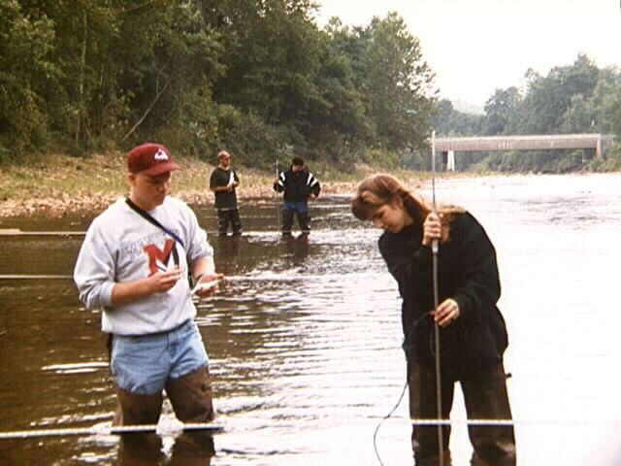
Teaching Science:
What Research Tells Us
To develop mastery, students must acquire component skills, practice integrating them, and know when to apply what they have learned.

Slide 11
How do Students Construct
Knowledge?
Teaching science as we do science involves Inquiry Based Learning!
ENGAGE
APPLY
EXPLORE
EXPLAIN

Slide 12
Inquiry Based Learning?
In the interest of time we may skip the “Explore” stage in teaching…but this undermines inquiry!
ENGAGE
APPLY
EXPLORE
EXPLAIN
The Learning Cycle

Slide 13
How do Students Construct
Knowledge?
Teaching science as we do science is Inquiry Based Learning!
ENGAGE
APPLY
EXPLORE
EXPLAIN
Notes:
This maps onto what Ken Bain (CHE, April 9, 2004 “What Makes Great Teachers Great?”) calls the “Natural Critical Learning Environment.”
“Natural” because what matters most is for students to tackle questions and tasks that they naturally find of interest, make decisions, defend their choices, etc. “Critical” because by thinking critically, students learn to reason from evidence and to examine the quality of their reasoning, to make improvements while thinking, and to ask probing and insightful questions.

Slide 14
Inquiry Based Learning?
Even worse, we may focus on “Explain-Apply” at the expense of engagement and exploration.
ENGAGE
APPLY
EXPLORE
EXPLAIN
The Learning Cycle

Slide 15
Basic Information-Processing Model of Human Cognition
We, as instructors, support this process

Slide 16
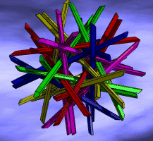
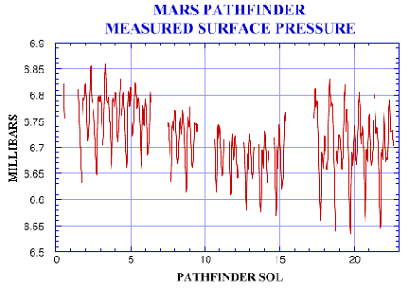
Teaching Science:
What Research Tells Us
To become self-directed learners, students must…
… monitor and adjust their approaches to learning.

Slide 17

Learning Styles
Felder-Silverman Model
How does the student prefer to process information?
Actively: through engagement in physical activity or discussion
60%
Or Reflectively: through introspection
40%

Slide 18
Active Reflective

Slide 19
Learning Styles
Felder-Silverman Model
What type of information does the student preferentially perceive?
Sensory: sights, sounds, physical sensations, data…
65%
Intuitive: memories, ideas, models, abstract…
35%

Slide 20
Sensing Intuitive

Slide 21
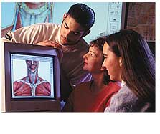
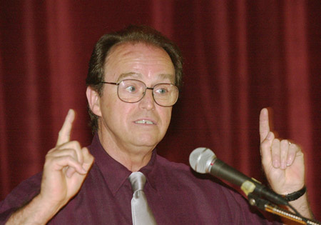
Learning Styles
Felder-Silverman Model
Through which modality is sensory information most effectively perceived?
Visual: pictures, diagrams, graphs, demonstrations, field trips
80%
or Verbal: sounds, written and spoken words, formulas
20%

Slide 22
Verbal Visual

Slide 23
Learning Styles
Felder-Silverman Model
How does the student progress toward understanding?
Sequentially: in a logical progression of small incremental steps ...
60%
Or Globally: in large jumps, holistically ...
40%

Slide 24
Sequential Global

Slide 25
Teaching Science:
What Research Tells Us
To become self-directed learners, students must…
… monitor and adjust their approaches to learning.

Slide 26
Teaching Science:
What Research Tells Us
To develop mastery, students must acquire component skills, practice integrating them, and know when to apply what they have learned.

Slide 27
Teaching Science:
What Research Tells Us
Prior knowledge can help or hinder learning.
[Fish is Fish image content has been omitted for copyright/resuse reasons]

Slide 28
Teaching takes Time and Energy
[Fish is Fish image content has been omitted for copyright/resuse reasons]
Will you use
your own precious resources to
provide instruction? or produce learning?

Slide 29
References
Ambrose, S.A., et al., How Learning Works: 7 Research-Based Principles for Smart Teaching, (2010) Jossey-Bass Publ., San Francisco, 301p.
Barr, R.D. and Tagg, J., From teaching to learning – A new paradigm for undergraduate education, (1995) Change, Nov./Dec., p. 13-25.
Richard M. Felder, Reaching the Second Tier - Teaching and Learning Styles in College Science Education (1993) Journal of College Science Teaching, v. 23, p. 286-290.
Halpern, D.F. and Hakel, M.D., Applying the Science of Learning to the University and Beyond (2003) Change, July/Aug., p.36-41.
Lionni, L. Fish is Fish (1970) Random House Publ.
National Research Council, Science Teaching Reconsidered: A Handbook (1997), National Academy Press, Washington, D.C. 88p.

