Slide 1

Preparing for an Academic Career in Geosciences Workshop: Summer 2011
Incorporating Data Analysis into Undergraduate Courses: A Case Study in Three Acts
Rachel O’Brien, Allegheny College

Slide 2
Case study: Freshman seminar
Title: Water and the Earth
Organized into three units, each based on a research question.
H₂0 & N budgets: increasing spatial scale; increasing complexity in each unit
Combination of hands-on and online data sources used in the course

Slide 3
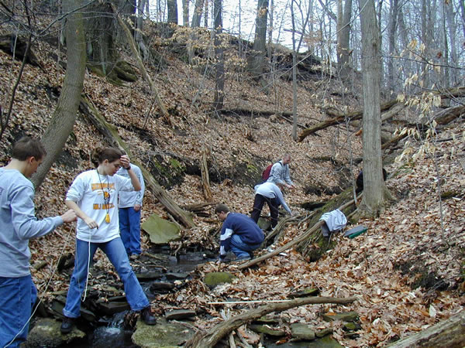
Unit #1:What is a water budget?
Local watershed (10⁻¹ km²)

Slide 4
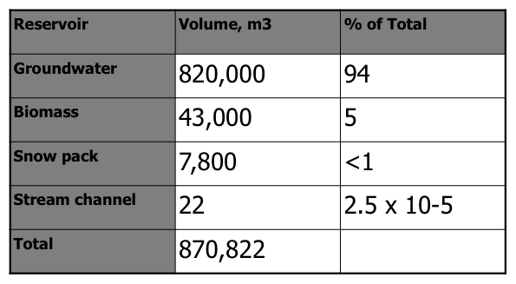
What is a water budget?

Slide 5
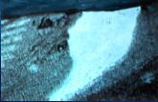
Unit #2: What happens to water and N budgets when a forest is clear cut?
NH watershed (10 km²)

Slide 6
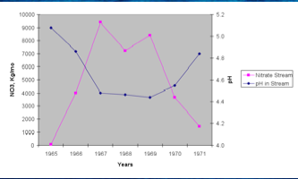
What happens to water and N budgets when a forest is clear cut?

Slide 7
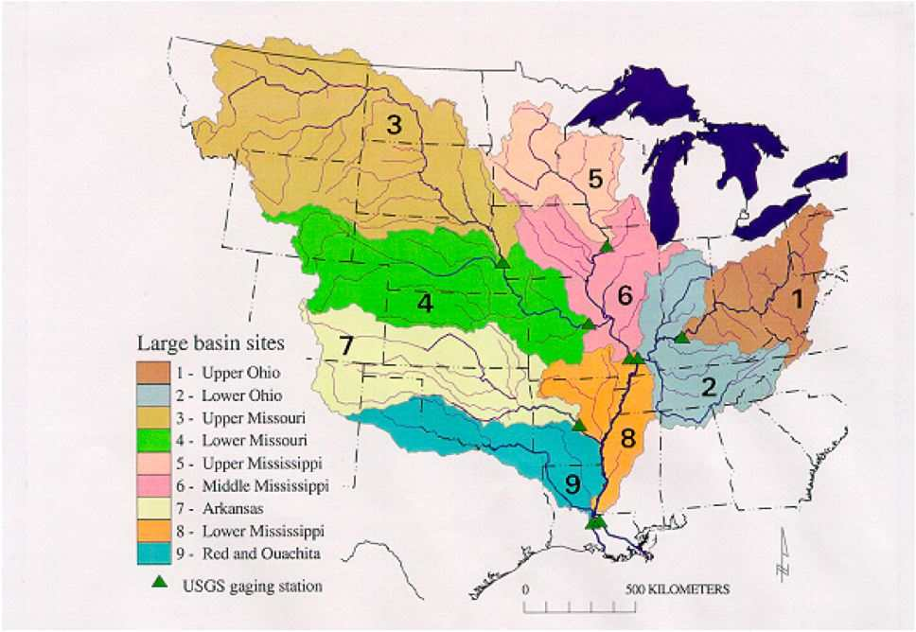
Unit #3: What is causing the “Dead Zone” in the Gulf of Mexico?
Mississippi River watershed (10⁶ km²)

Slide 8
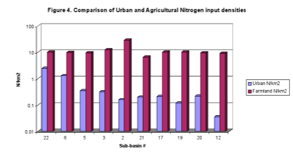
What is causing the “Dead Zone” in the Gulf of Mexico?

