Slide 1
The Academic Job Search:
Applications, Interviews, Teaching Demonstrations, and Job Talks
Ed Harvey, Rachel O’Brien, Devin Castendyk, Francisca Oboh-Ikuenobe, Barbara Tewksbury, Katryn Wiese, and Michael Williams
Preparing for an Academic Career Workshop 2011
University of Nebraska, Lincoln

Slide 2
When to start?
Learning about jobs, getting organized, & asking for recommendations
Once a week: check web pages
Available all the time
Job posting: August, September, October
Deadlines: October, November, December

Slide 3
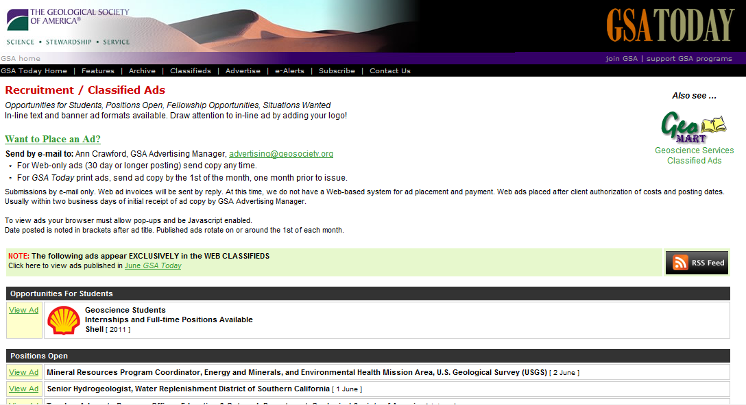
Geological Society of America: GSA Today Classified Ads: www.geosociety.org/classiads/

Slide 4
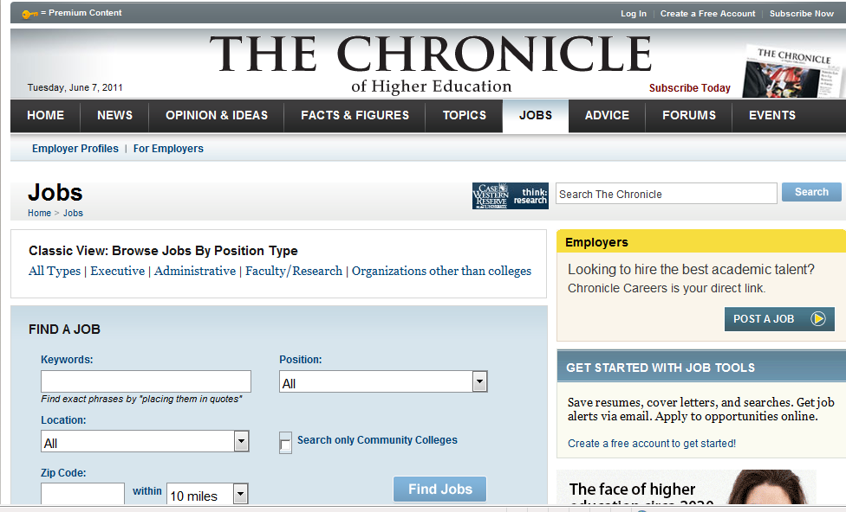
Chronicle of Higher Education, Jobs: chronicle.com/section/Jobs/61/

Slide 5
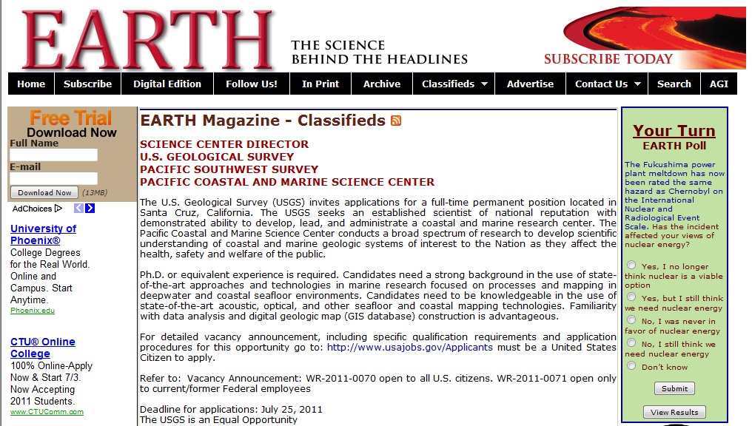
EARTH Magazine Classified Ads: www.earthmagazine.org/earth/section/classifieds/all

Slide 6

American Geophysical Union: EOS Job Listings: www.agu.org/pubs/eos-news/

Slide 7
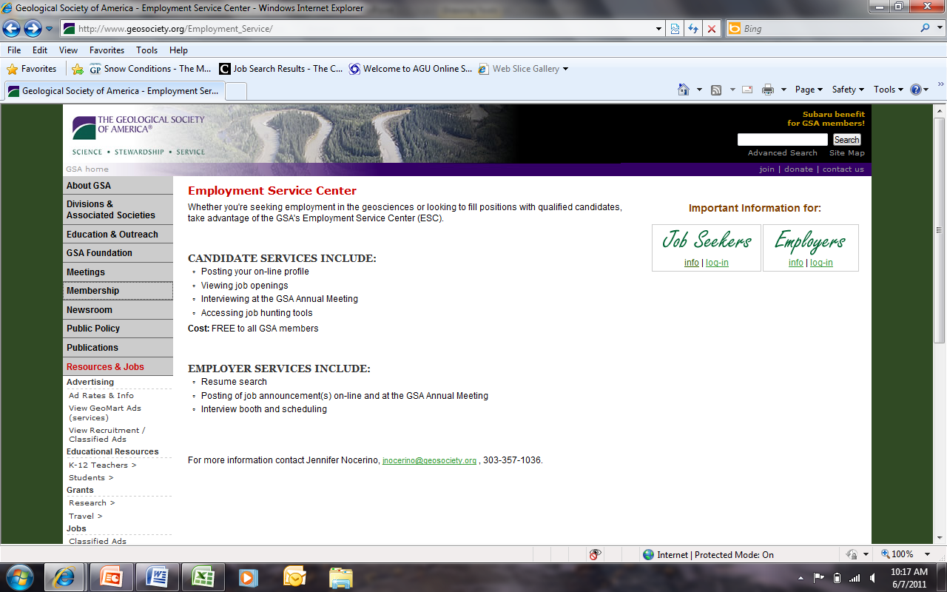
GSA Employment Service Center: www.geosociety.org/Employment_Service/

Slide 8
Meetings
Geological Society of America (October)
  Employment Services Area
    Flyers!!
    Interviews (must sign up in advance and be invited)
    Informal meetings (must contact people in advance)
American Geophysical Union (December)

Slide 9
Manage These Data
Don’t miss deadlines
Address each part of the job announcement
Make sure you name the right school
Make sure you give them right info

Slide 10
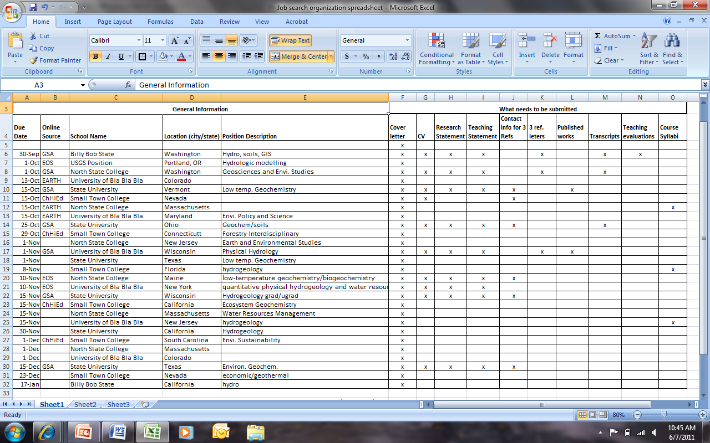
Organization Spreadsheet

Slide 11
References: Who to ask?
Observed you teach
Worked with you in the field/lab
Coauthored or reviewed your paper
“Can you write me a positive recommendation?”
Established: not a fellow graduate student

Slide 12
References: Instructions
You can ask people to focus on a particular strength or aspect of you (this helps)
You many ask to a reference to explain special circumstances:
  Gaps in your CV
  Changes of jobs
  Complications with advisors
Make sure they know the type of job, especially if you are being diverse in your search
Give plenty of time (2 weeks or more) and check with prior to the deadline

Slide 13
Tailoring your application to each advertised position
Additional time and effort
Provides competitive advantage
Use your research skills to learn about
each institution & Department
Read the description carefully and
follow the instructions for what to
submit (more ≠ better!)

Slide 14
Tailoring your application to each advertised position
Specific reference to individuals, the
Department/program, and the
institution when appropriate
More substantive customized
statements in the cover letter,
teaching statement and/or research
statement
Identify how you’d complement their
research, their curriculum, or other
needs

Slide 15
The Phone Interview:
What happens before
Search committee evaluation and ranking of the application material
May request additional information
  Syllabi
  References

Slide 17
The Email
“Are you free Tuesday at 10:00 a.m. or Wednesday at 4:00 p.m. to speak with our committee?”
Length: 20 minutes to 40 minutes
What you might ask in response to the email?
  Who will be on the phone call?
  How long?

Slide 18
How to prepare
Re-read the job advertisement
Visit department web page
  Colleagues you might do research with
  What could you add to the department
Visit college web page
  Institutional distinctiveness
Research/Teaching ideas
Questions
  Standard: Tenure, Load, Research expectations
  Unique: K-12 outreach, Student Research Projects

Slide 19
Where to make the call
NO: Cell phone, outdoors, in a distraction-loaded environment
YES: Land line in your cerebral environment (office) with the door shut
KEY: Comfortable with a working phone

Slide 20
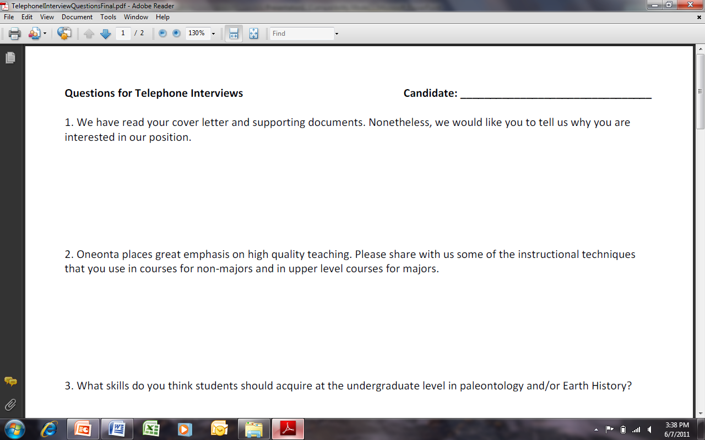

Slide 22
Some thoughts
Be engaging and enthusiastic
Avoid spending too much time answering a question (you have 20 minutes total)
Speak slowly and clearly
Provide specific examples (on-campus labs; field trips; student-based research projects) at that school
Have juicy questions prepared

Slide 23
Generalized Timeline
Decide what you want
Search job ads
Submit application
Short interview
Campus interview
Negotiate
Job offer!
Negotiation
Campus interviews
Department decides
Department defines and advertises position
Search committee reviews applications, selects “short list”
Search committee or dept selects finalists
Professional meeting or phone interview
Follow EEO guidelines

Slide 24
The Campus Interview
Events
  Individual or small-group sessions
    Individual faculty
    Groups of faculty
    Students
    Chair of search committee
    Department Chair
    Dean, Provost, and/or other administrator
  Job talk (about your research)
  Teaching demonstration, teaching a class (depends on dept)
  Meals, social gathering
Be positive, interested, and professional
Everything is part of the interview
You are also interviewing them
Community college interviews are different

Slide 25
Effective Research Talk
Know your audience
  Who would be there?
  Their state of mind
  The audience should want to learn more about you and your research
Structure of research presentation
  Goal – tailor talk to meet this
  Beginning, middle & end
Talk outline
  What’s the problem?
  Motivation & goals
  Relevant state of knowledge; key contribution?
  Why approach is good/better/different
  What you just said and future plans

Slide 26
Effective Research Talk
Slides:
  Fonts – large, simple, consistency
  Use lots of clearly-labeled figures, simple graphs
  Less is more but slides should be self-contained
  Go easy on animations; use very few equations
  Prepare back up slides to answer questions
Preparing the presentation
  Practice, practice, practice
  Assume technology will fail you. Have backups
  Prepare handouts in case someone asks
Delivering the talk
  Speak slowly, confidently & clearly; don’t read your slides
  Point to the screen; talk to the audience
  Watch the time; allocate 2 minutes per slide; leave time for questions
Handling questions
  Repeat question before answering
  Be honest if you can’t answer it. Ask to discuss it further after the talk
  If someone picks a fight, decline and be polite
  You may take questions during the talk but don’t let them disrupt flow

Slide 27
Teaching demonstration
Much less standardized than research talks
What is the purpose?
  Are you confident in front of a class?
  Are you enthusiastic and engaging?
  Can you design a class session that has a clear goal, is well-paced, and targeted at the right audience?
  Can you engage students?
  Can you implement the teaching philosophy that you described in your teaching statement?
What do you need to know?
  What level? How many students? How long?
  Is it an actual class? If so, what course?
  Will you choose the topic, or will they?
  What is the classroom like (physical set-up, tech)?

Slide 28
Teaching demonstration
Choose what you will do
  Be yourself and KISS - choose something simple that you’re comfortable with and that lets you shine.
  Choose something that you know will work – a terrific lecture is better than an awkward “innovative” class.
  Choose something that can be done in the time allowed without rushing.
  Have a clear goal that goes beyond telling students about something.
  If you involve students, keep it low risk for both of you.
  Go “tech-lite” or have a “no-tech” alternative.
Go to the interview thoroughly prepared
  Prepare and copy handouts, if any.
  Be able to describe why you chose what you did.
  Practice, practice, and time it with real students!

Slide 29
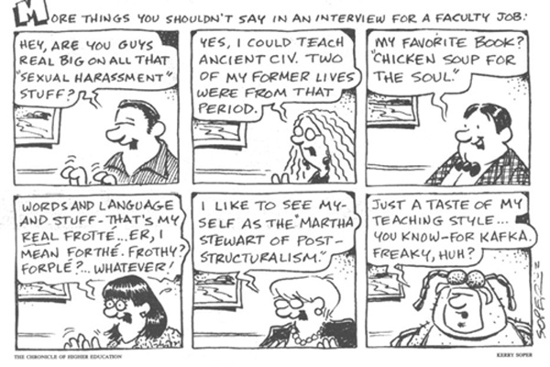
Couples Hiring
What to say…
What not to say…

Slide 30

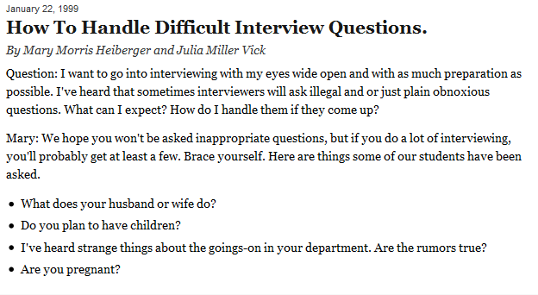
Cutting Edge Web Site

Slide 31
The Interview
What not to say…
What to say…
  And when to say it…

Slide 32

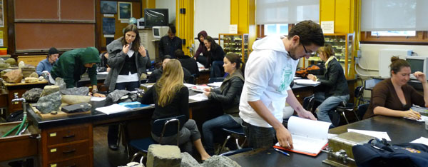
2-year college job process varies, but here are some thoughts...
Great chance to get experience
Finding jobs: OK to submit unsolicited cover letters and resumes – emergency hires
Read job description and talk/stick to that. No ranking allowed on anything not in job description
Everything prescribed ahead of time. Review process and keep to it to a T (outside information not allowed). Mistakes knock you out.
Teaching demo key – show yourself here!
Ranked by committee, some from other disciplines.
Chosen by Chancellor.
http://serc.carleton.edu/NAGTWorkshops/careerprep/jobsearch/2YCsearch.html

