Slide 1

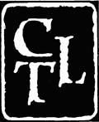
Teaching for Learning:
What Research Tells Us
“A paradigm shift is taking hold in American higher education.”
From: “A college is an institution that exists to provide instruction.”
To: “A college is an institution that exists to produce learning.”
from Barr & Tagg, 1995
Robyn Wright Dunbar
Center for Teaching and Learning: Stanford University

Slide 2
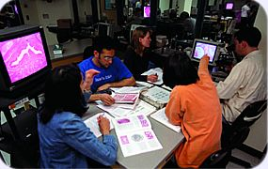
“What professors do in their classes matters far less than what they ask students to do.”
D. Halpern and M. Hakel, Change, 2003

Slide 3
Teaching Science:
What Research Tells Us
Prior knowledge can help or hinder learning.
Motivation generates, directs, and sustains learning behavior.
The way students organize knowledge determines how they use it.
Meaningful engagement is necessary for deeper learning.
Mastery involves developing component skills and knowledge, and synthesizing and applying them appropriately
from Ambrose, et al, 2010
Notes:
It wouldn’t be so bad if we were reinventing the wheel,,, but we reinvent the flat tire.

Slide 4
Teaching Science:
What Research Tells Us
Prior knowledge can help or hinder learning.
Motivation generates, directs, and sustains learning behavior.
The way students organize knowledge determines how they use it.
Meaningful engagement is necessary for deeper learning.
Mastery involves developing component skills and knowledge, and synthesizing and applying them appropriately
from Ambrose, et al, 2010
Notes:
It wouldn’t be so bad if we were reinventing the wheel,,, but we reinvent the flat tire.

Slide 5
Teaching Science:
What Research Tells Us
Goal-directed practice and targeted feedback are critical to learning.
Self-directed learning requires that students monitor, evaluate and adjust their approaches to learning.
Students develop holistically and are affected by the social and emotional aspects of the classroom climate
from Ambrose, et al, 2010
Notes:
It wouldn’t be so bad if we were reinventing the wheel,,, but we reinvent the flat tire.

Slide 6
Teaching Science:
What Research Tells Us
Goal-directed practice and targeted feedback are critical to learning.
Self-directed learning requires that students monitor, evaluate and adjust their approaches to learning.
Students develop holistically and are affected by the social and emotional aspects of the classroom climate
from Ambrose, et al, 2010
Notes:
It wouldn’t be so bad if we were reinventing the wheel,,, but we reinvent the flat tire.

Slide 7
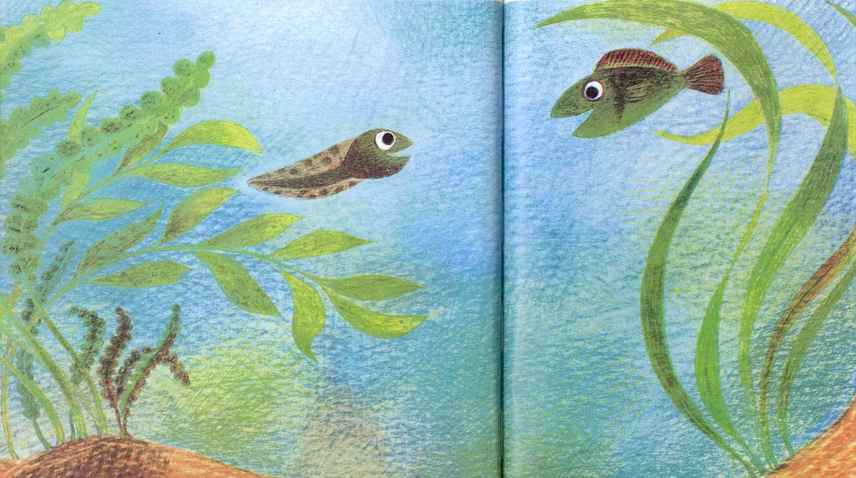
How do Students Construct
Knowledge?
Prior knowledge can help or hinder learning.
Fish is Fish by Leo Lionni, 1970

Slide 8
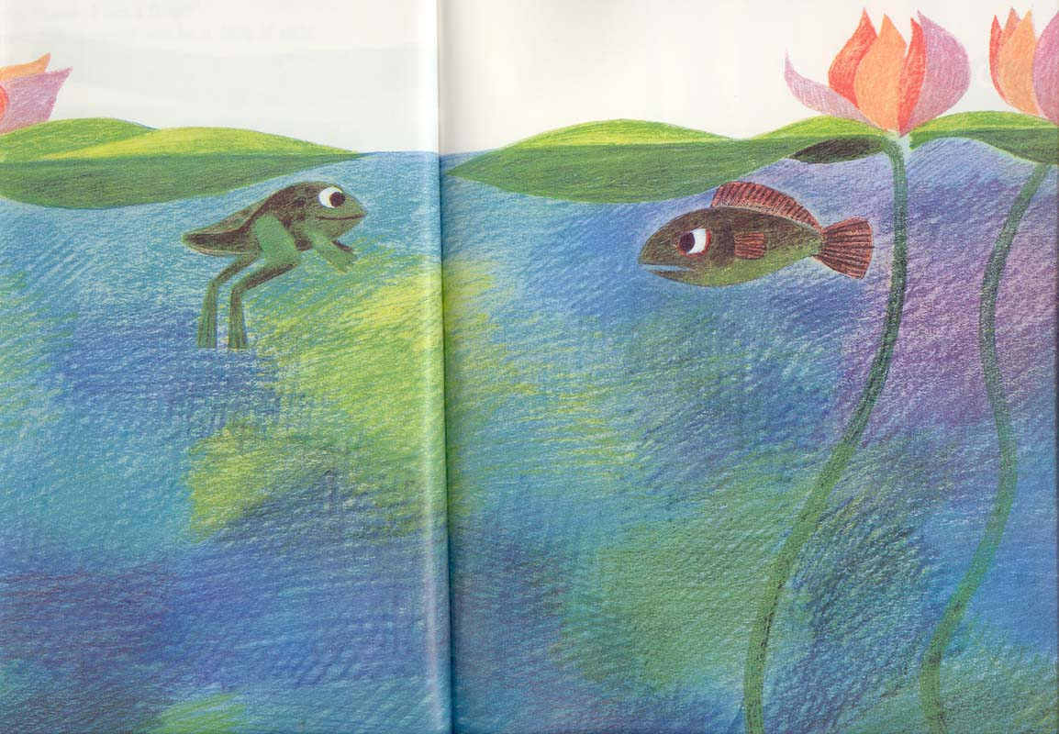

Slide 9
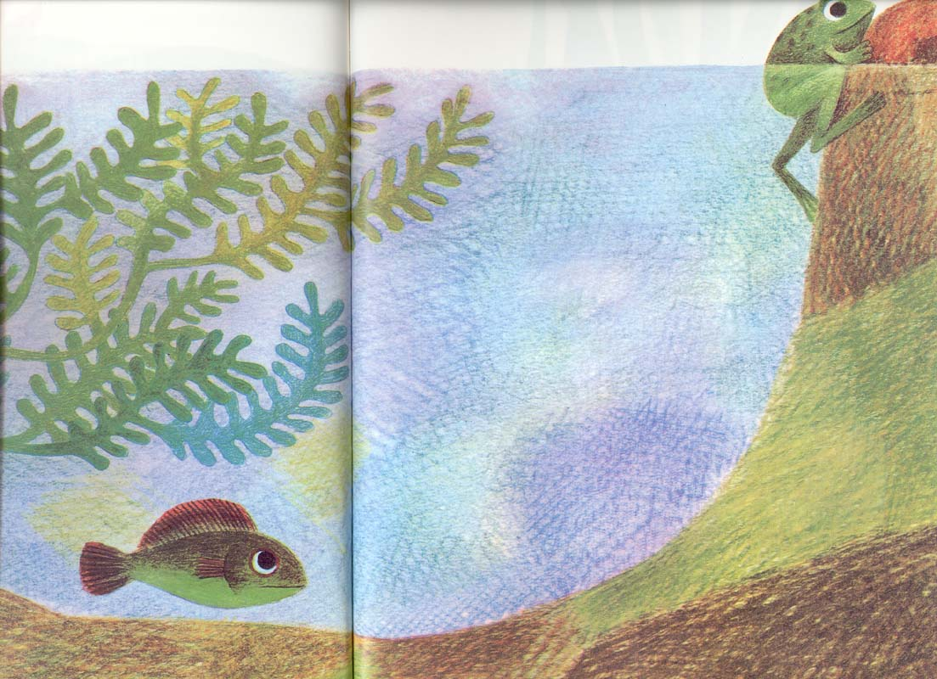

Slide 10
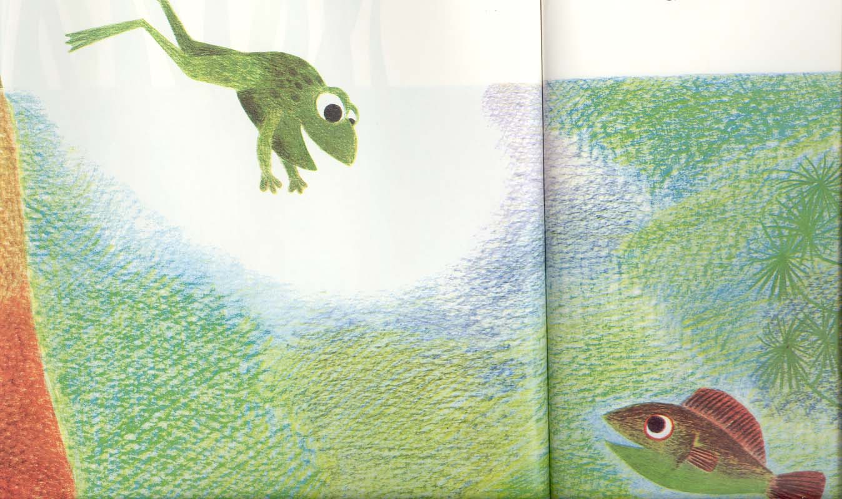

Slide 11
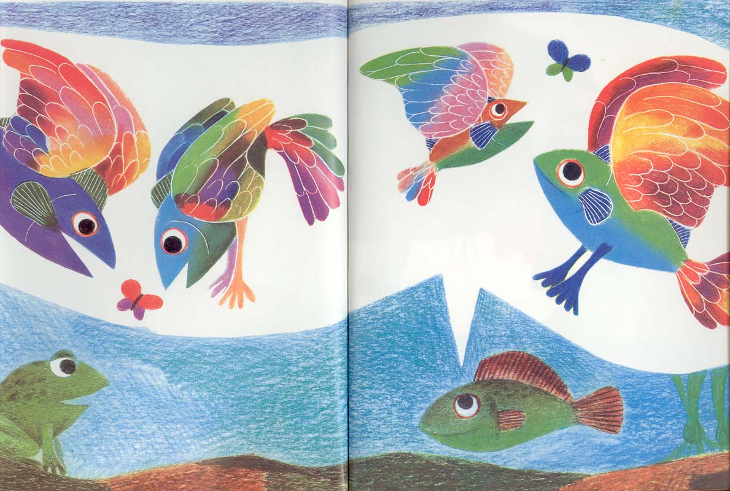

Slide 12
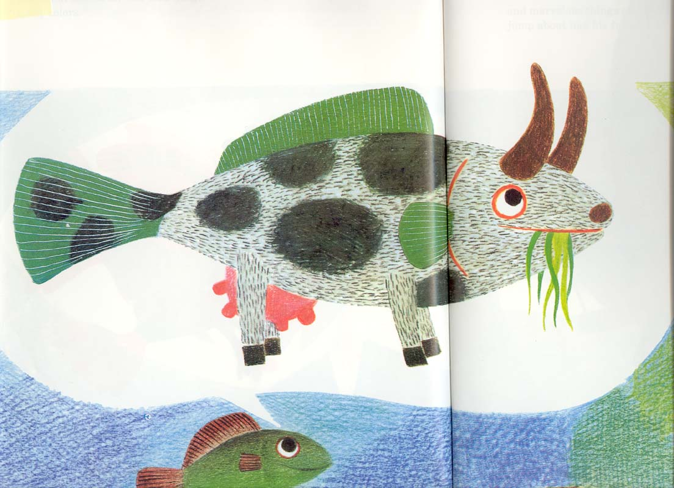
What are some examples from your field?

Slide 13
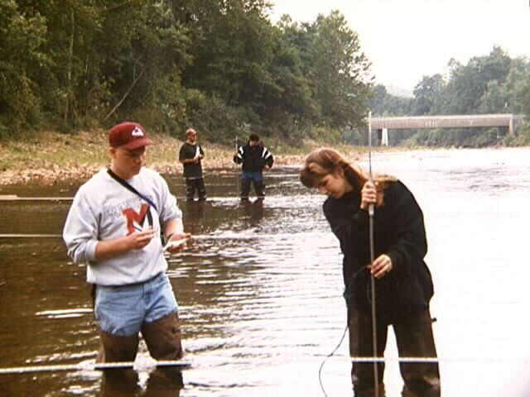
Teaching Science:
What Research Tells Us
Meaningful engagement is necessary for deeper learning.

Slide 14
How do Students Construct
Knowledge?
Teaching science as we do science involves Inquiry Based Learning!
ENGAGE
APPLY
EXPLORE
EXPLAIN

Slide 15
Inquiry Based Learning?
In the interest of time we may skip the “Explore” stage in teaching…but this undermines inquiry!
ENGAGE
APPLY
EXPLORE
EXPLAIN
The Learning Cycle

Slide 16
How do Students Construct
Knowledge?
Teaching science as we do science is Inquiry Based Learning!
ENGAGE
APPLY
EXPLORE
EXPLAIN
Notes:
This maps onto what Ken Bain (CHE, April 9, 2004 “What Makes Great Teachers Great?”) calls the “Natural Critical Learning Environment.”
“Natural” because what matters most is for students to tackle questions and tasks that they naturally find of interest, make decisions, defend their choices, etc. “Critical” because by thinking critically, students learn to reason from evidence and to examine the quality of their reasoning, to make improvements while thinking, and to ask probing and insightful questions.

Slide 17
Inquiry Based Learning?
Even worse, we may focus on “Explain-Apply” at the expense of engagement and exploration.
ENGAGE
APPLY
EXPLORE
EXPLAIN
The Learning Cycle

Slide 18
Basic Information-Processing Model of Human Cognition
We, as instructors, support this process

Slide 19
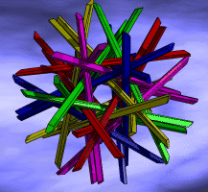
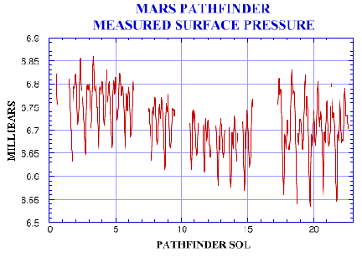
Teaching Science:
What Research Tells Us
Self-directed learning requires that students…
… monitor, evaluate, and adjust their approaches to learning.

Slide 20
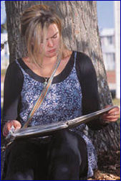
Learning Styles
Felder-Silverman Model
How does the student prefer to process information?
Actively: through engagement in physical activity or discussion
60%
Or Reflectively: through introspection
40%

Slide 21
Active Reflective

Slide 22
Learning Styles
Felder-Silverman Model
What type of information does the student preferentially perceive?
Sensory: sights, sounds, physical sensations, data…
65%
Intuitive: memories, ideas, models, abstract…
35%

Slide 23
Sensing Intuitive

Slide 24
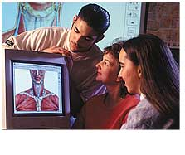
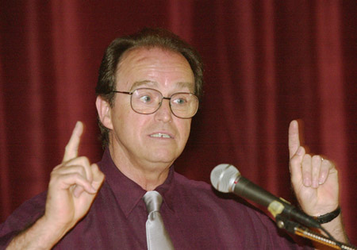
Learning Styles
Felder-Silverman Model
Through which modality is sensory information most effectively perceived?
Visual: pictures, diagrams, graphs, demonstrations, field trips
80%
or Verbal: sounds, written and spoken words, formulas
20%

Slide 25
Visual Verbal

Slide 26
Learning Styles
Felder-Silverman Model
How does the student progress toward understanding?
Sequentially: in a logical progression of small incremental steps ...
60%
Or Globally: in large jumps, holistically ...
40%

Slide 27
Sequential Global

Slide 28
Teaching Science:
What Research Tells Us
Self-directed learning requires that students…
… monitor, evaluate, and adjust their approaches to learning.

Slide 29
Teaching Science:
What Research Tells Us
Mastery involves developing component skills and knowledge, and synthesizing and applying them appropriately
Meaningful engagement is necessary for deeper learning.

Slide 30
Teaching Science:
What Research Tells Us
Prior knowledge can help or hinder learning.

Slide 31
Teaching takes Time and Energy
Will you use
your own precious resources to
provide instruction? or produce learning?

Slide 32
References
Ambrose, S.A., et al., How Learning Works: 7 Research-Based Principles for Smart Teaching, (2010) Jossey-Bass Publ., San Francisco, 301p.
Barr, R.D. and Tagg, J., From teaching to learning – A new paradigm for undergraduate education, (1995) Change, Nov./Dec., p. 13-25.
Richard M. Felder, Reaching the Second Tier - Teaching and Learning Styles in College Science Education (1993) Journal of College Science Teaching, v. 23, p. 286-290.
Halpern, D.F. and Hakel, M.D., Applying the Science of Learning to the University and Beyond (2003) Change, July/Aug., p.36-41.
National Research Council, Science Teaching Reconsidered: A Handbook (1997), National Academy Press, Washington, D.C. 88p.

