Slide 1
Preparing Now for Your Future Academic Career in the Geosciences
Heather Macdonald
College of William & Mary

Slide 2
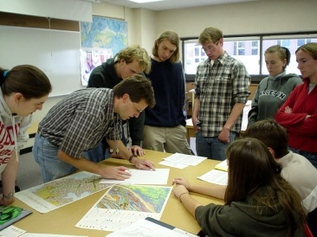
The Academic Enterprise
Teaching, research, service
Freedom and responsibility
Tenure or equivalent
Change
Choices!
From Cutting Edge website

Slide 3
The Academic Enterprise
The Carnegie Classification*
  Baccalaureate ~630
  Master’s granting ~530
  Doctorate ~110
  Research ~125
  Don’t forget two-year colleges
  Don’t forget other options
* From Richard Reis’s presentation for the 2006 Career Prep workshop

Slide 4
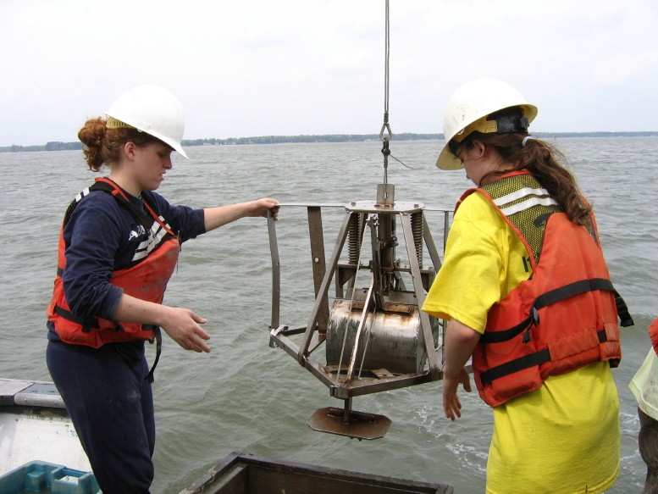
Preparing for an Academic Career
The Three-Way Stretch preparation strategy (Richard Reis)
  Breadth on top of depth
  Multiple options
  Next-stage
Photo by Rowan Lockwood

Slide 5
The Three-Way Stretch Preparation Strategy
Next-stage
  Enables you to think ahead, look ahead, and act ahead of the stage you currently occupy
  thus not only demonstrates your willingness, but also your readiness, to assume the position you are seeking
From Richard Reis’s presentation in 2006

Slide 6
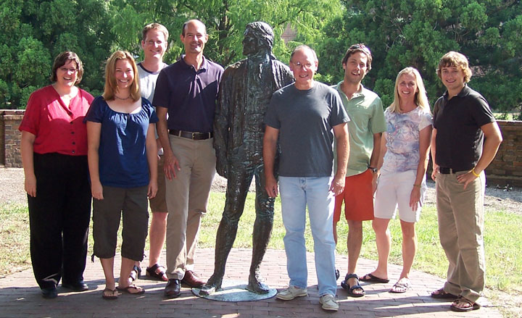
The Next-Stage Strategy 1
Look ahead, think ahead
  Ask questions
  Make observations
  What are characteristics of various options?
  What’s right for you (work/self/home)?

Slide 7
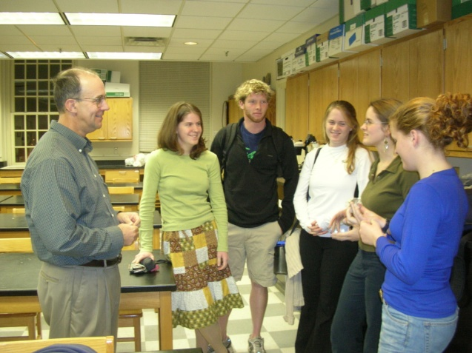
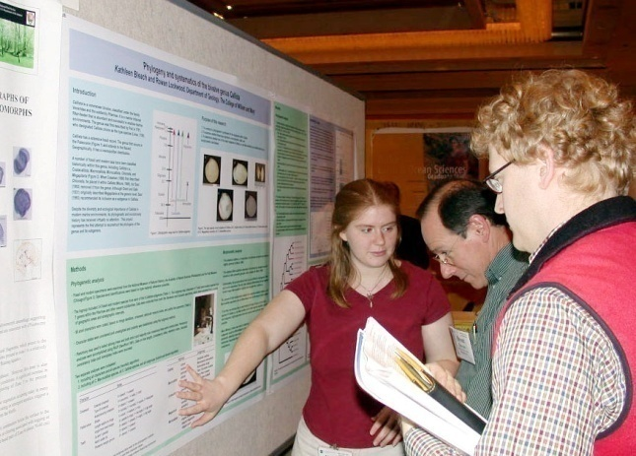
The Next-Stage Strategy 2
Act ahead
  Teaching and research
  Service?

Slide 8
The Next-Stage Strategy 2
Act ahead
  Write papers and give presentations
  Review manuscripts
  Submit grant proposals
  Get teaching experience – courses, guest lectures, outreach programs
  Mentor undergraduate research students
  Serve on committees (be careful though)

Slide 9
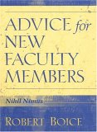
Advice for the Next Stage
Faculty who did well early in their career
  Published more
  Received better teaching evaluations
  Were happier than their stressed-out peers
These “Quick Starters”
  Avoided procrastination
  Developed regular writing habits
  Balanced teaching with other work activities
  Sought help from colleagues early
Results of research: 415 early career faculty from two institutions

Slide 10
Selected Resources
Tomorrow’s Professor: Preparing for Academic Careers in Science & Engineering (Richard Reis)
Tomorrow’s Professor Mailing List
  The academic job talk
  General principles for responding to job offers
  Improving student learning while saving faculty time
  Elements found in most successful proposals
  Tenure tips
http://ctl.stanford.edu/Tomprof/index.shtml

Slide 11
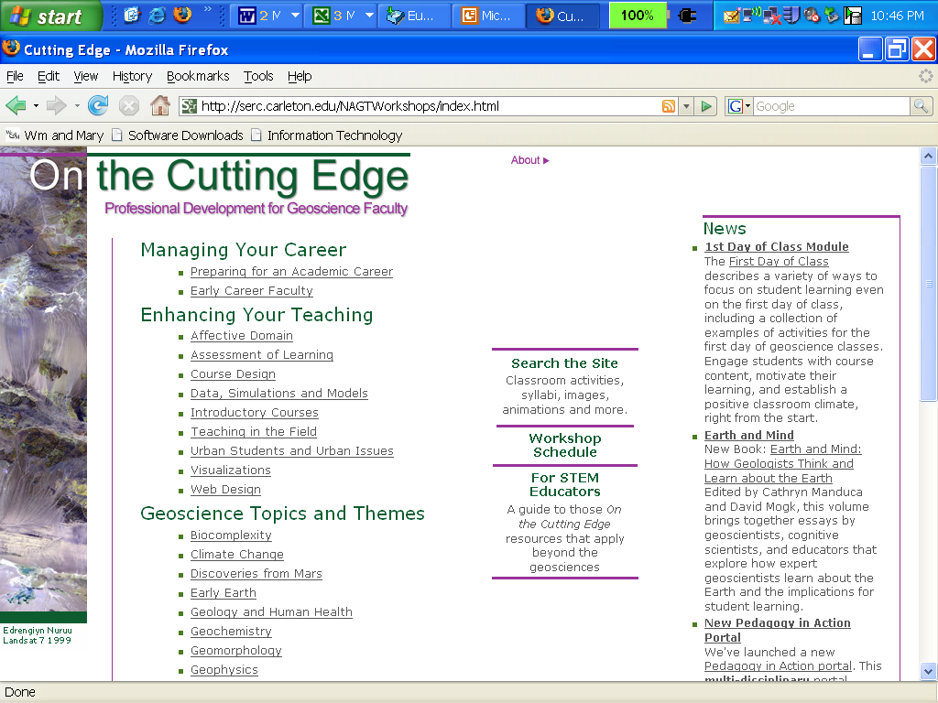
On the Cutting Edge
serc.carleton.edu/NAGTWorkshops And, other resources at SERC@carleton.edu

Slide 12
Finding and Getting an Academic Position That’s Right for You
What departments look for in new faculty
  Overall promise
  General teaching ability, ability to teach courses needed by the department
  Ability to do research, specific research area
  “Compatibility” with department and institution
  Potential for securing funding (depends on dept)
What are you looking for in a department
Modified from Richard Reis’s presentation in 2006

