Slide 1
Developing Interactive Lectures
Heather Macdonald
College of William and Mary
Katryn Wiese
City College of San Francisco
Preparing for an Academic Career Workshop
July 2010

Slide 2

What are “Interactive Lectures?

Slide 3
What are “Interactive Lectures?
Traditional Class
Passive students
Quiet
Instructor-focused
Information from instructor-to-student
Students work as individuals
Competitive learning environment
Limited assessment opportunities
Active Learning Class
Active students
Noisy
Student-focused
Information from instructor-to-student, student-to-student, student-to-instructor
Student collaboration
Supportive learning environment
Multiple assessment opportunities
http://serc.carleton.edu/introgeo/interactive/howto.html
Slide from D. Steer

Slide 4
The Value of Interactive Lectures
Students taught key concepts using one of four methods. Student learning assessed by proportion of correct answers to open ended questions on same concepts on final exam
Teaching method
% correct answers
No demonstration
Observation of demonstration w/explanation
Prediction prior to demo with a conceptest
Prediction prior to demonstration using discussion & a later conceptest
61
70*
77*
82*
n = 158-297; * = statistically significant result vs. no demonstration
Crouch, C.H., Fagen, A.P., Callan, J.P., & Mazur, E., 2004. American Journal of Physics, v.72 #6, p. 835-838.
Slide from David Steer

Slide 5
Interactive Lecture Techniques
Think-pair-share
ConcepTests
Demonstrations, predictive demonstrations
One-minute papers
  Muddiest point, most important point
Wall walk
Small group work
  Discussions, gallery walks, jigsaws
Lecture tutorials
Other
Fill your toolbox!

Slide 6
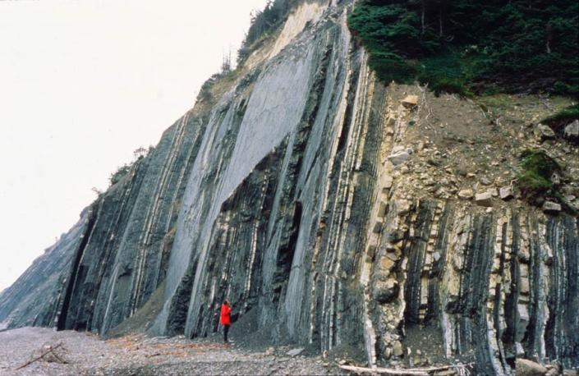
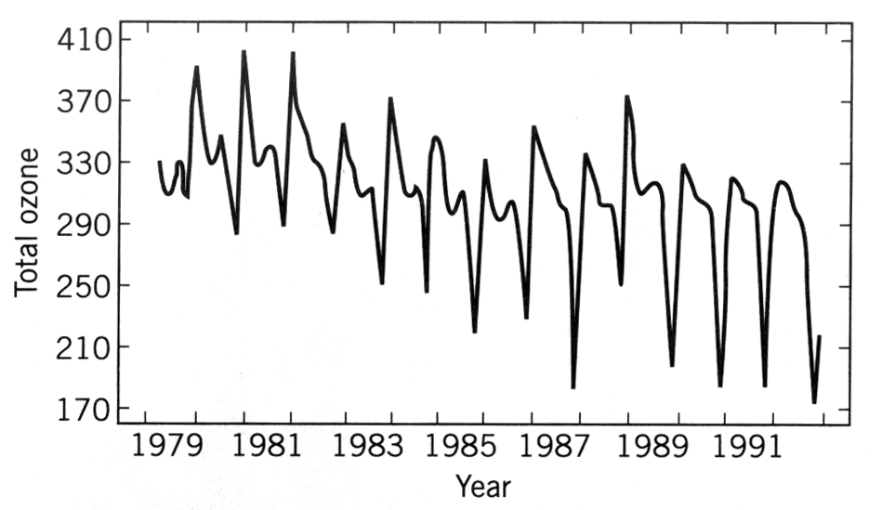
Think-Pair-Share
Instructor asks a question related to an image, graph, or prediction
Students think (write, calculate) a response
In pairs (or small groups), students discuss their responses
Solicit pair or group response
Instructor can use to guide instruction
Satellite measurements of ozone concentration above Antarctica, 1979-1992

Slide 7
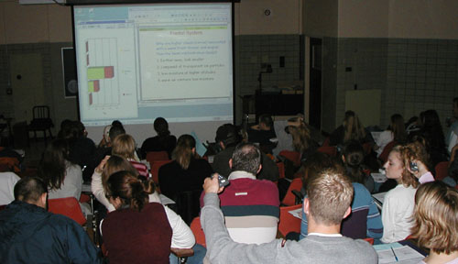
Conceptests
Multiple choice questions embedded in the lecture
Focus attention on key concepts
Frequently include peer instruction
Formative exercises during class used to assess student understanding and progress
Frequently used with an electronic Personal Response System (PRS) “clicker”
http://serc.carleton.edu/sp/library/interactive/conctest.html
McConnell, D.A., Steer, D.N., & Owens, K., 2003, Journal of Geoscience Education, v. 51, #2, p. 174-183.
Slide from David Steer

Slide 8
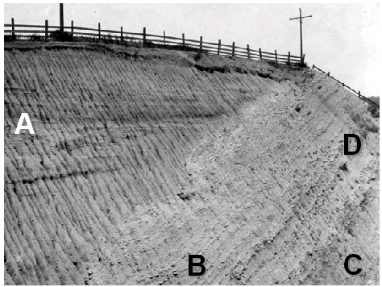
Conceptests: An Example
In what order were the layers formed (from oldest to youngest)?
C,D,B,A
C,B,D,A
B,C,D,A
B,C,D,A
Conceptest
http://serc.carleton.edu/introgeo/interactive/conctest.html
Slide from David Steer

Slide 9
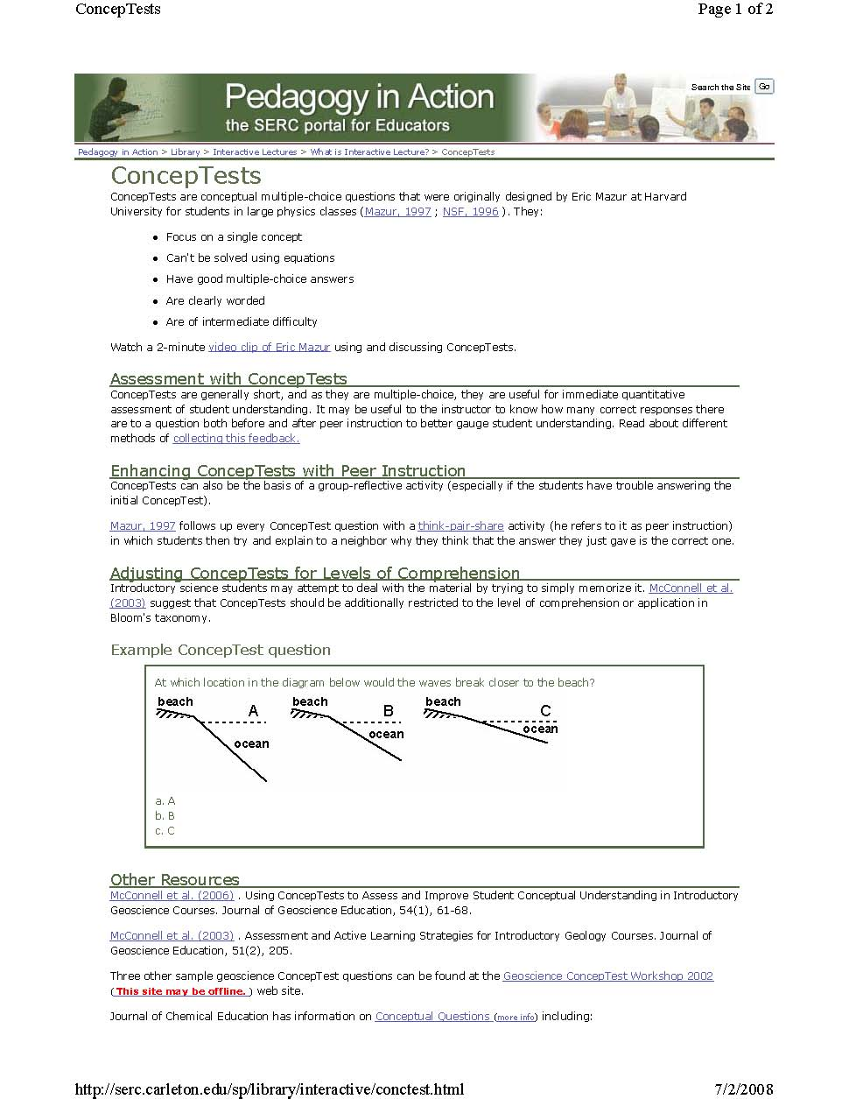
http://serc.carleton.edu/introgeo/interactive/conctest.html

Slide 10
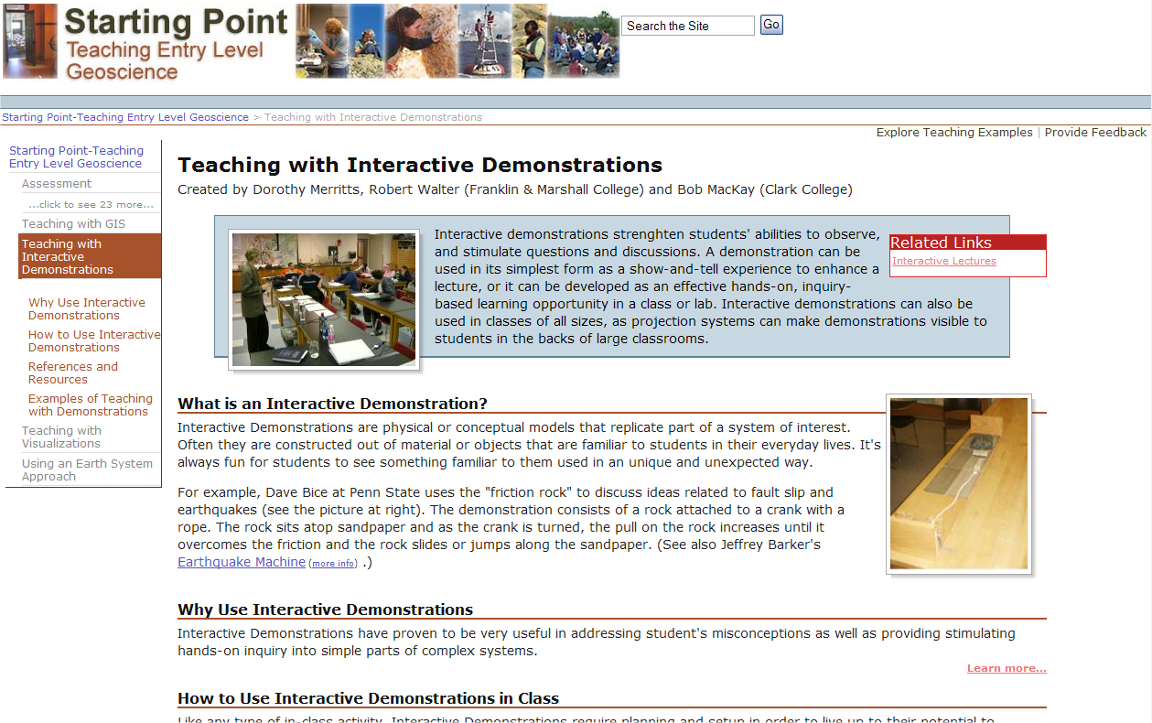
Demonstrations
http://serc.carleton.edu/introgeo/demonstrations/index.html

Slide 11
“One-minute” papers
Paper topics
  The muddiest point of today’s class
  The most important point(s) you learned from today’s class
A classroom assessment technique
  Involves students in their own learning, promotes metacognition
  Can show class-wide trends
  Makes a natural starting point for the next class

Slide 12
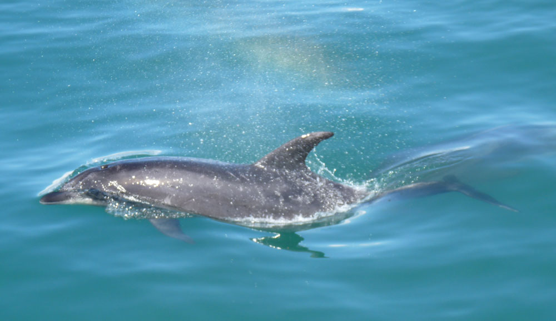
DEMONSTRATIONS
Ask first: What do you expect? Why?
RUN DEMONSTRATION / ACTIVTY
Review: Did it occur as you expected? Why or why not?
Notes:
EXAMPLES:
Taking water out of the air around us. How can we do this?
What happens to the freezing point of water as we add salt?
How could we confirm that the temperature of the water is below the freezing point without using a thermometer?

Slide 13

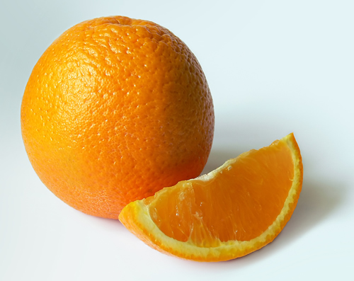
Which is denser:
Pepsi or Diet Pepsi?
Why?
Which is denser:
Orange or Peeled Orange?
Why?

Slide 14
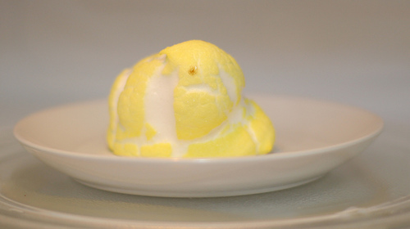
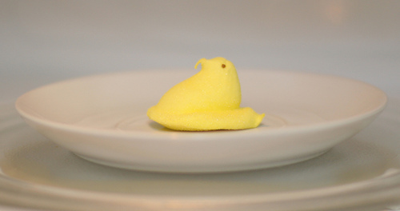
What happens to the volume of materials when you heat them up?
The density?

Slide 15
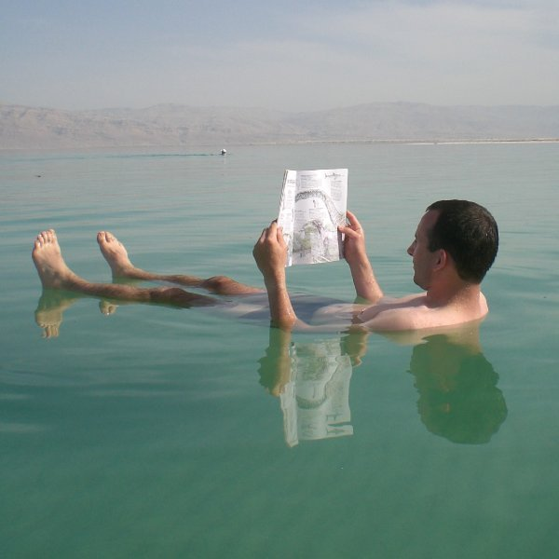
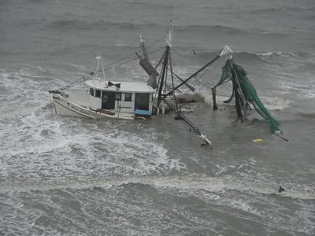
What is DENSITY?
How do you find out which items are denser than others?
What do dense things do around less dense things?
Vice versa?

Slide 16
Wall Walk
Focus attention on key concepts
Used to stimulate class discussions
On 4 walls of the class, place signs: Agree, Disagree, Strongly Agree, Strongly Disagree
Do not let students stand in the middle (make them “take a stand”)
Establish rules (can change where you are standing, be courteous, raise hand, will be called upon, etc…)
Project a (controversial) statement about a class topic
From Steer and Trujillo

Slide 17
It’s Your Turn
With a partner,
construct a think-pair-share question covering one key concept in each of your disciplines that could be used in an introductory class
construct a conceptest covering one key concept in each of your disciplines ……
outline one demonstration or predictive demonstration in each of your disciplines ……
Outline one short exercise or activity (5-10 minutes) in each of your disciplines ……

Slide 18
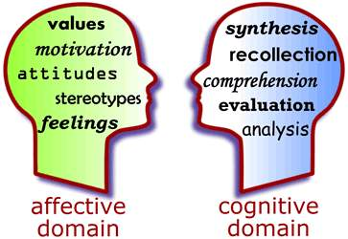
Interactive Lectures and the Affective Domain
From Karin Kirk

Slide 19
Immediacy
Behavior that brings instructor and students closer in terms of perceived distance
Non-verbal immediacy
smiling
appropriate gesturing
eye contact
relaxed body language
don’t always stand behind the podium
Verbal immediacy
call students by name
use humor
encourage student input and discussion
use terms like "we" and "us" to refer to the class
Be genuine!
Strike a balance between credible and professional
and approachable and fallible
From Karin Kirk

Slide 20
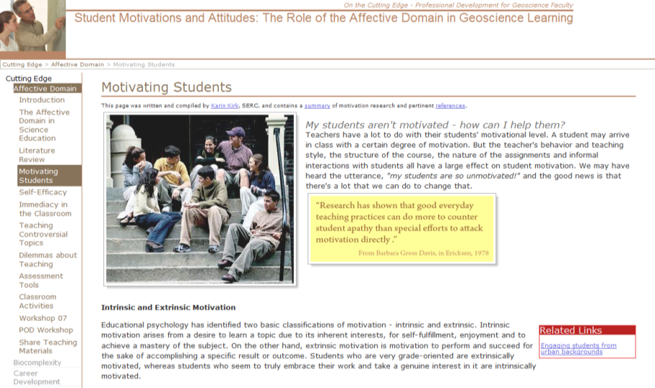
More about the Affective Domain
Improving motivation
Understanding self-efficacy (the belief in one's capabilities to achieve a goal or an outcome)
http://serc.carleton.edu/NAGTWorkshops/affective/index.html

Slide 21
Interactive Lectures
Simple, effective way to engage students
Provides time for everyone to develop answers; more students can be successful
Students can test answer with partner before giving it to the class (for think-pair-share)
Students talk/do science
Stimulates additional questions
Provides immediate feedback to instructor about student learning
Doesn’t take much additional prep time

Slide 22
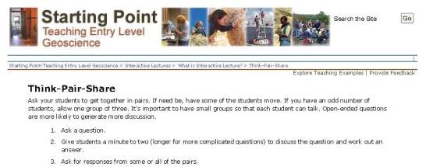
For More Information…
Think-Pair-Share:
http://serc.carleton.edu/introgeo/interactive/tpshare.html
Conceptest:
http://serc.carleton.edu/introgeo/interactive/conctest.html
Predictive/Interactive Demo:
http://serc.carleton.edu/introgeo/demonstrations/index.html

