Slide 1
Concept Sketches
Using Student- and Instructor-Generated Concept Sketches for Learning, Teaching, and Assessment in the Geosciences
Stephen J. Reynolds
Julia K. Johnson
Arizona State University

Slide 2
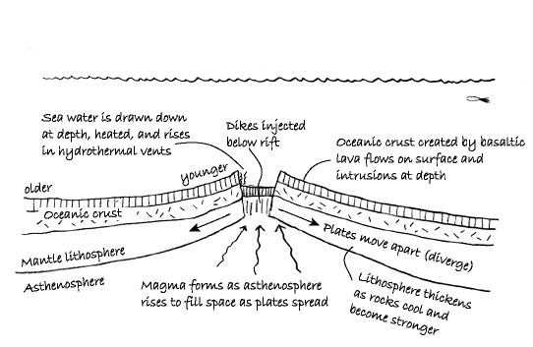
What Is a Concept Sketch?

Slide 3
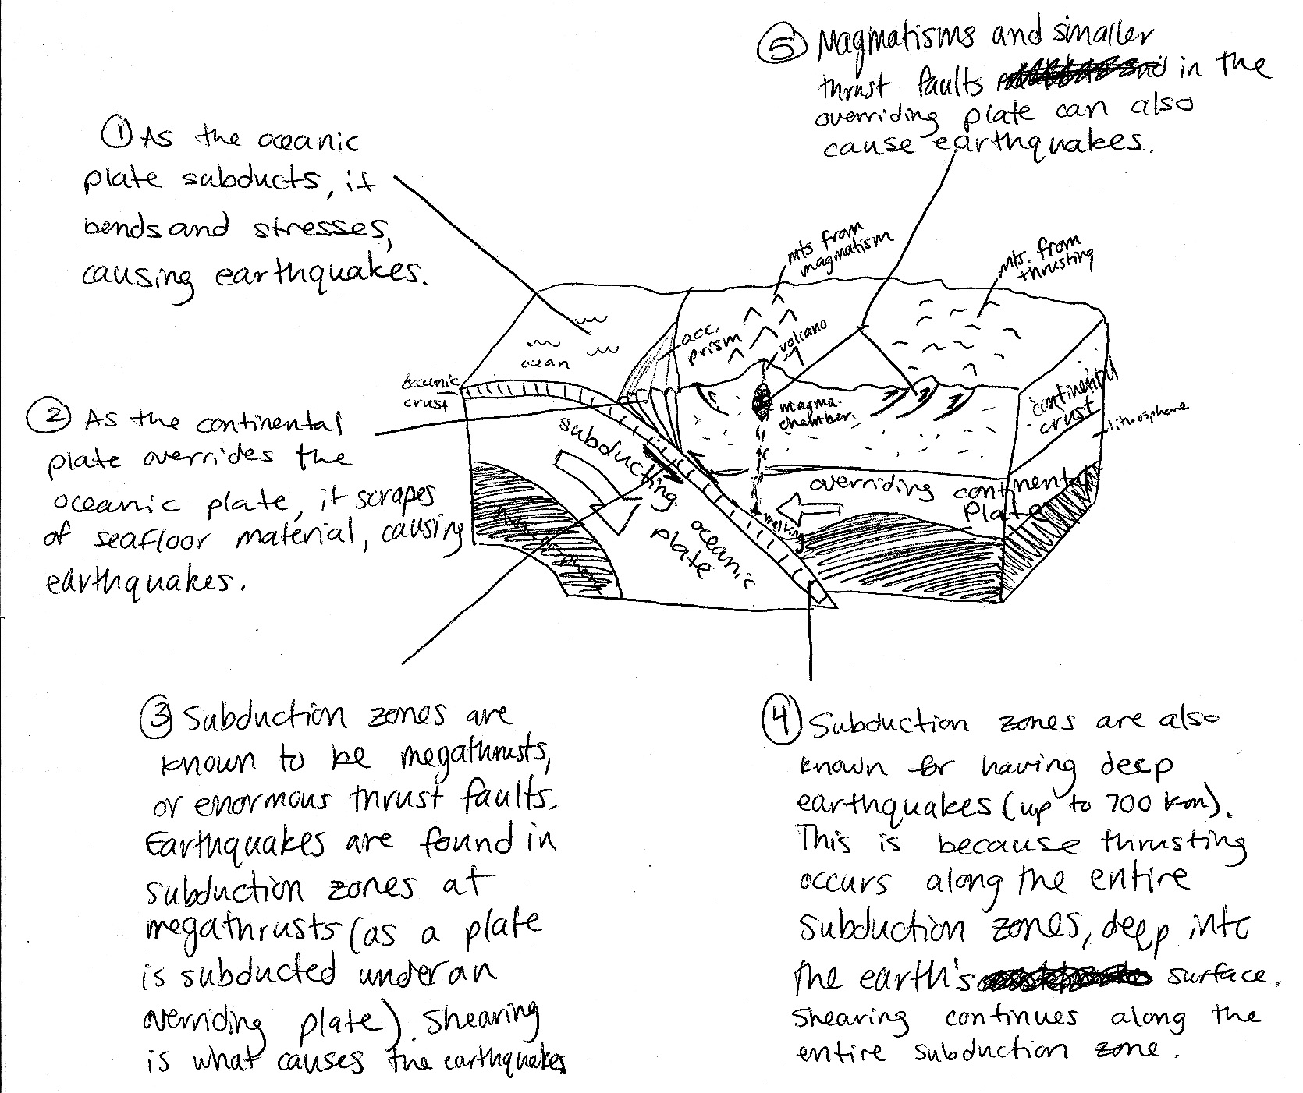
Student-generated
Concept Sketch

Slide 4
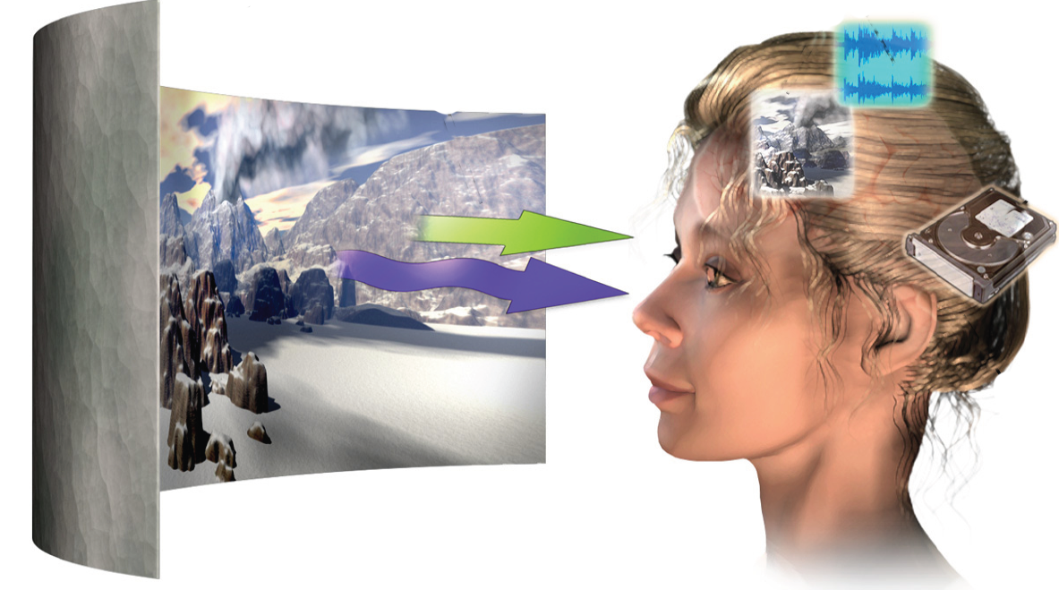
Concept Sketches Are Consistent with Cognitive Research
We have two processing systems, each with limited working memory
We use capacity to reconcile images & words

Slide 5
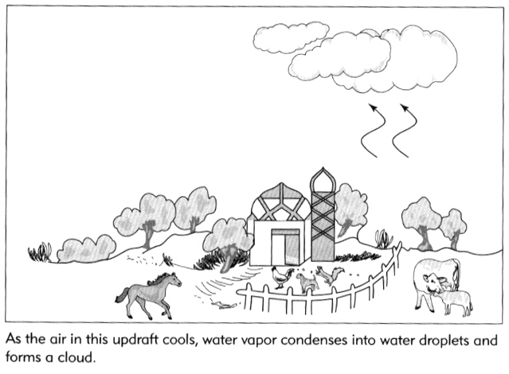
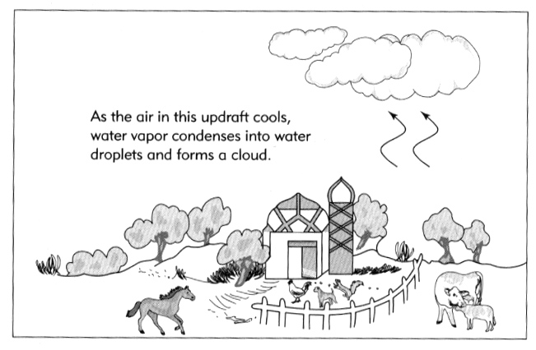
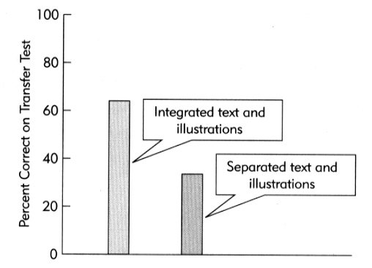
Research Support for Figure-
Text Integration
Two situations: students using integrated text and figures retained more and were better at applying knowledge

Slide 6
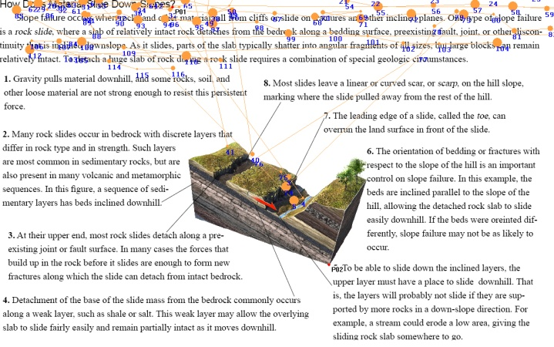
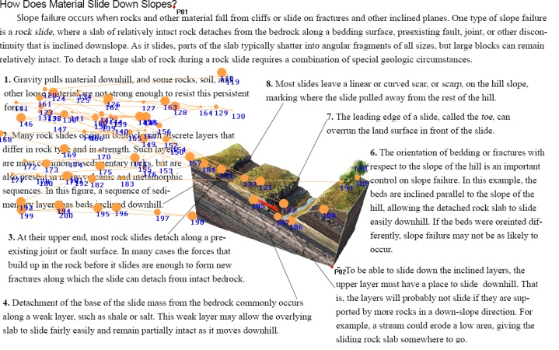
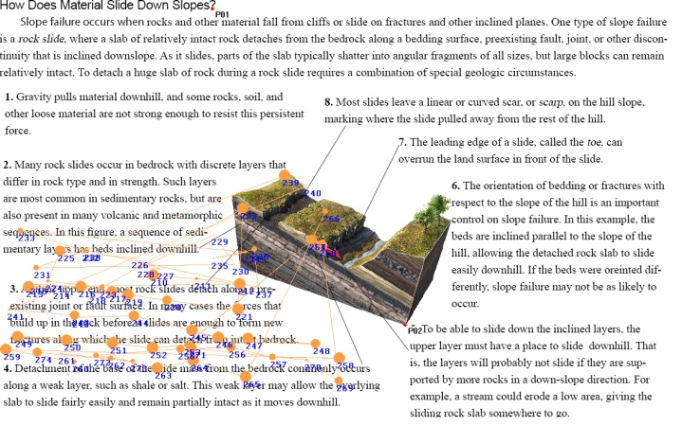
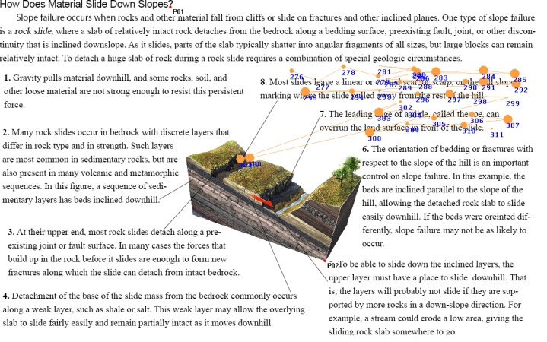
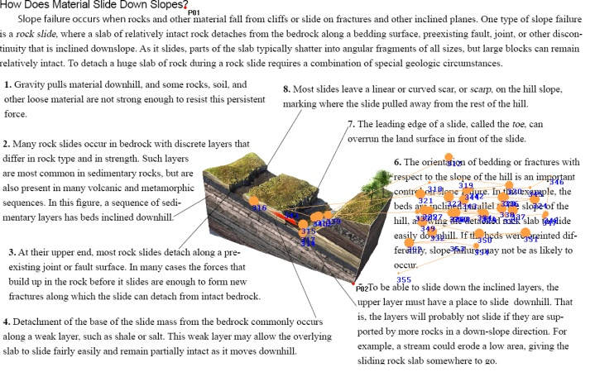
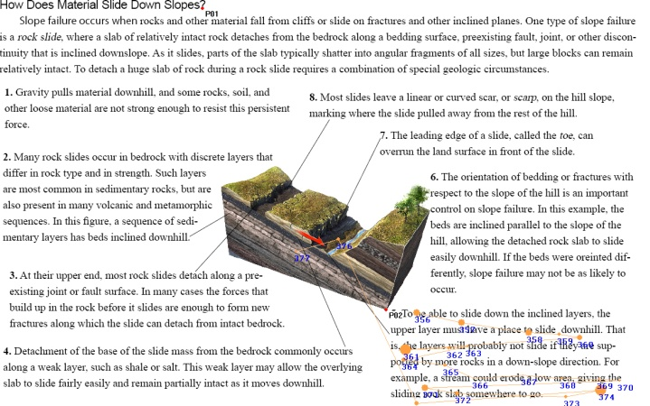
Eye-Tracking Studies
Student learning correlates with how often they examine associated figures (make it easy and model this approach)
Concept sketches encourage this behavior

Slide 7
Using Concept Sketches for Learning
Instructor-generated concept sketches on the fly
Students observe, draw, and explain the geologic system to one another
Students draw at start of topic to assess prior knowledge and identify misconceptions
Students do concept sketches on field trips
Students use for in-class presentations
Summary of readings/journal article

Slide 8
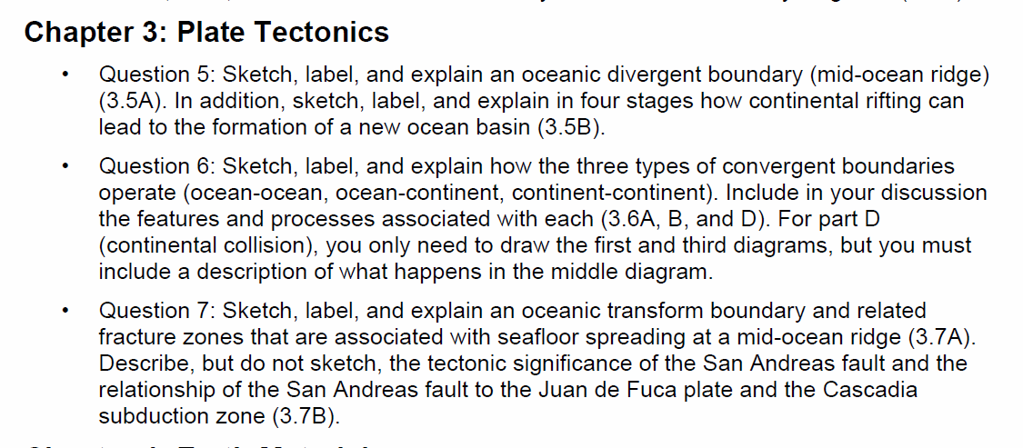
Using Concept Sketches For Assessment: Use a What-to-Know List

Slide 9
Using Concept Sketches for Assessment
In-class exams, based on What-to-Know List
  Preprinted like a normal exam
  Pass out colored paper and project two questions on screen (no photocopying costs!)
  Student gets choice or not about which to do
Online class – submission of scanned copy
Homework
Concept sketch as final product for a class project

Slide 10
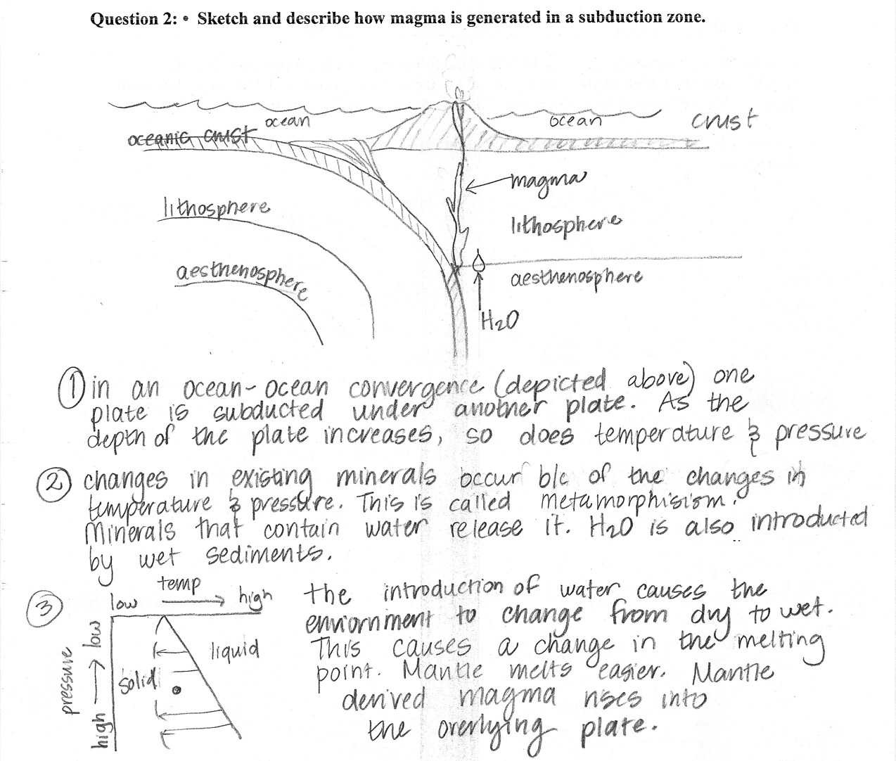
Examples of Student Concept Sketches

Slide 11
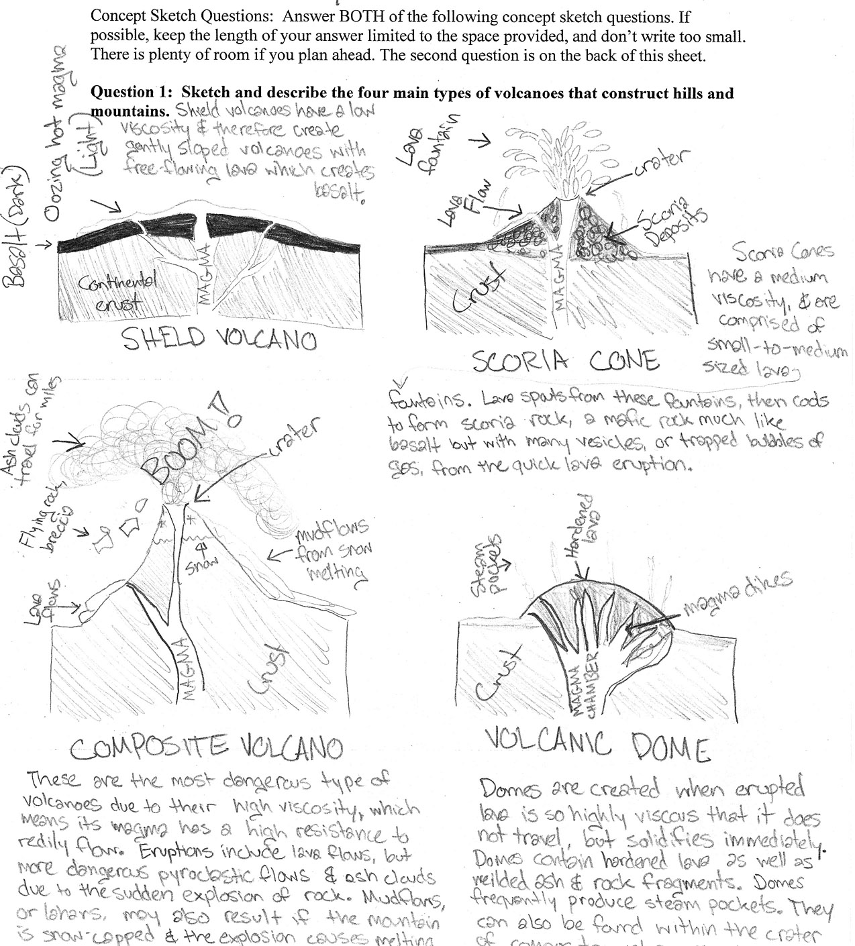

Slide 12
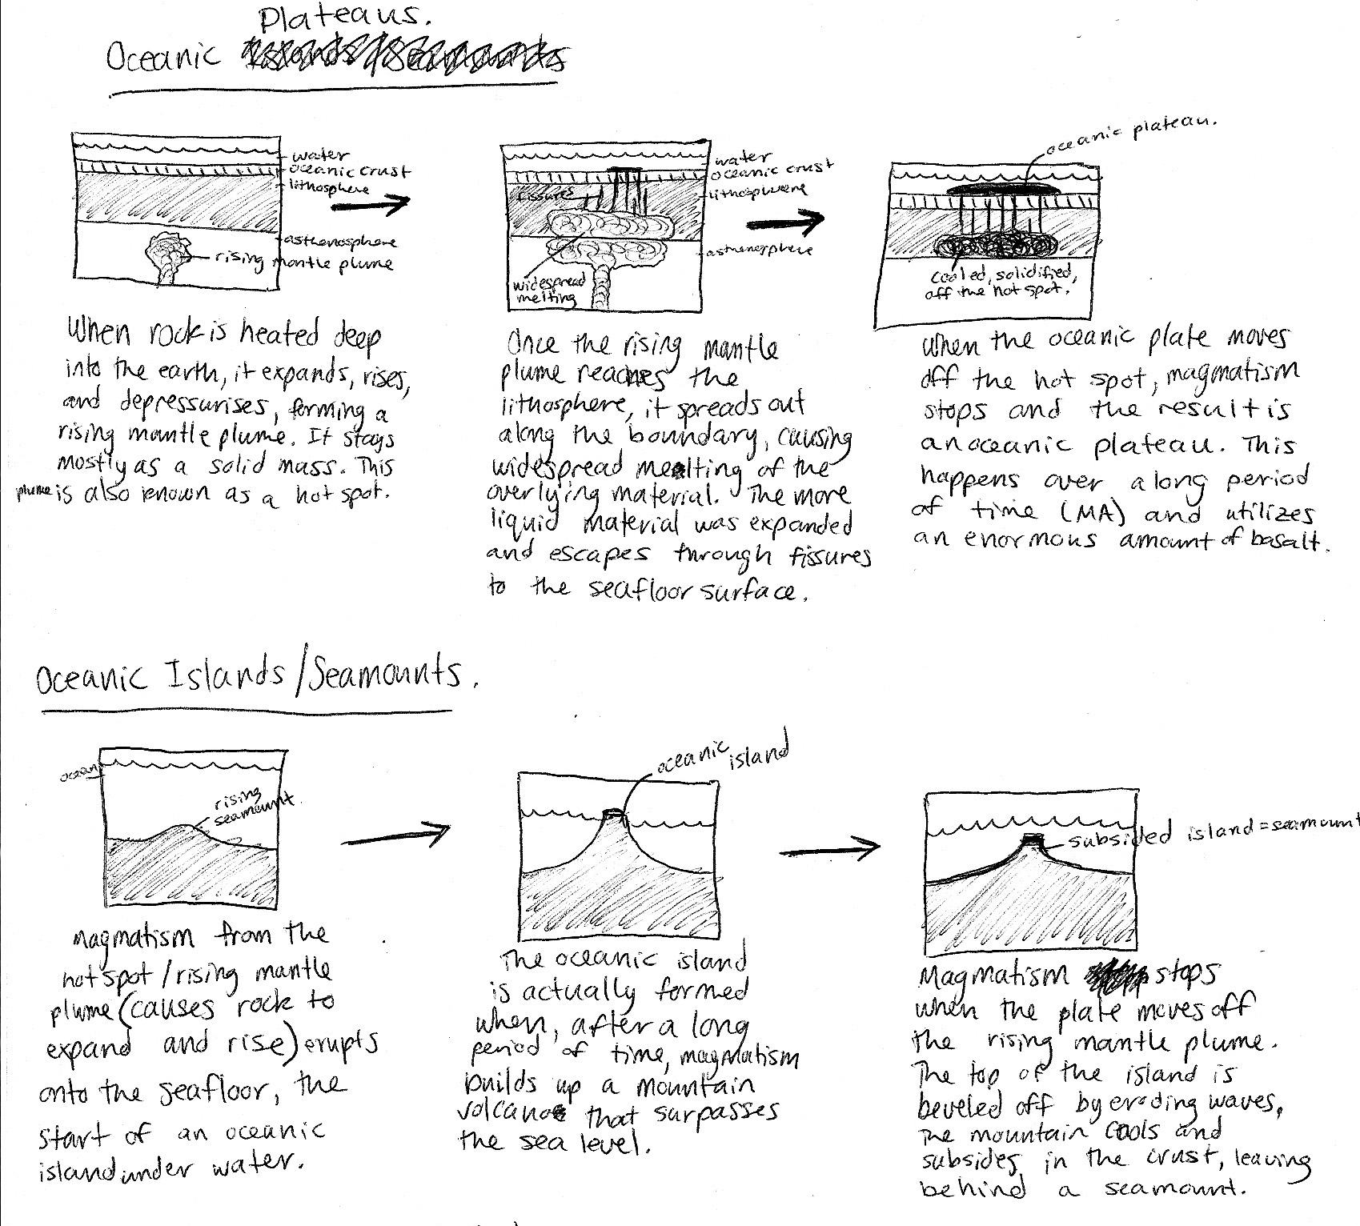

Slide 13
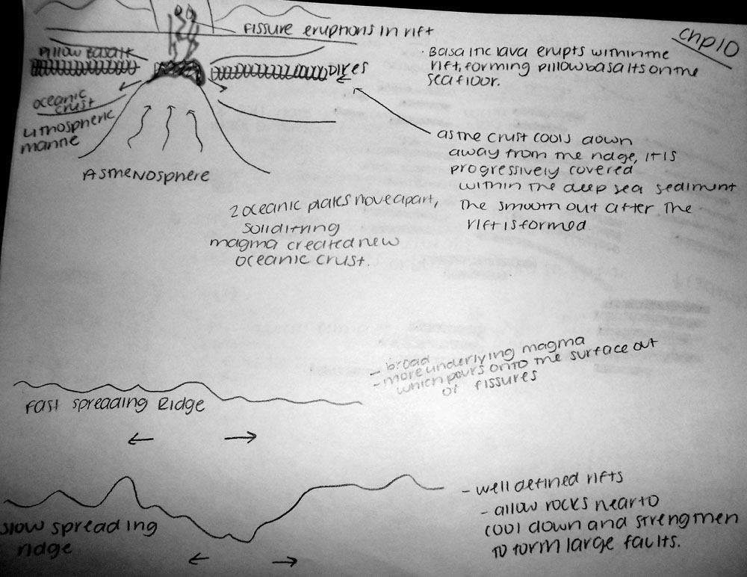
Example of Poorly Done Concept Sketch

Slide 14
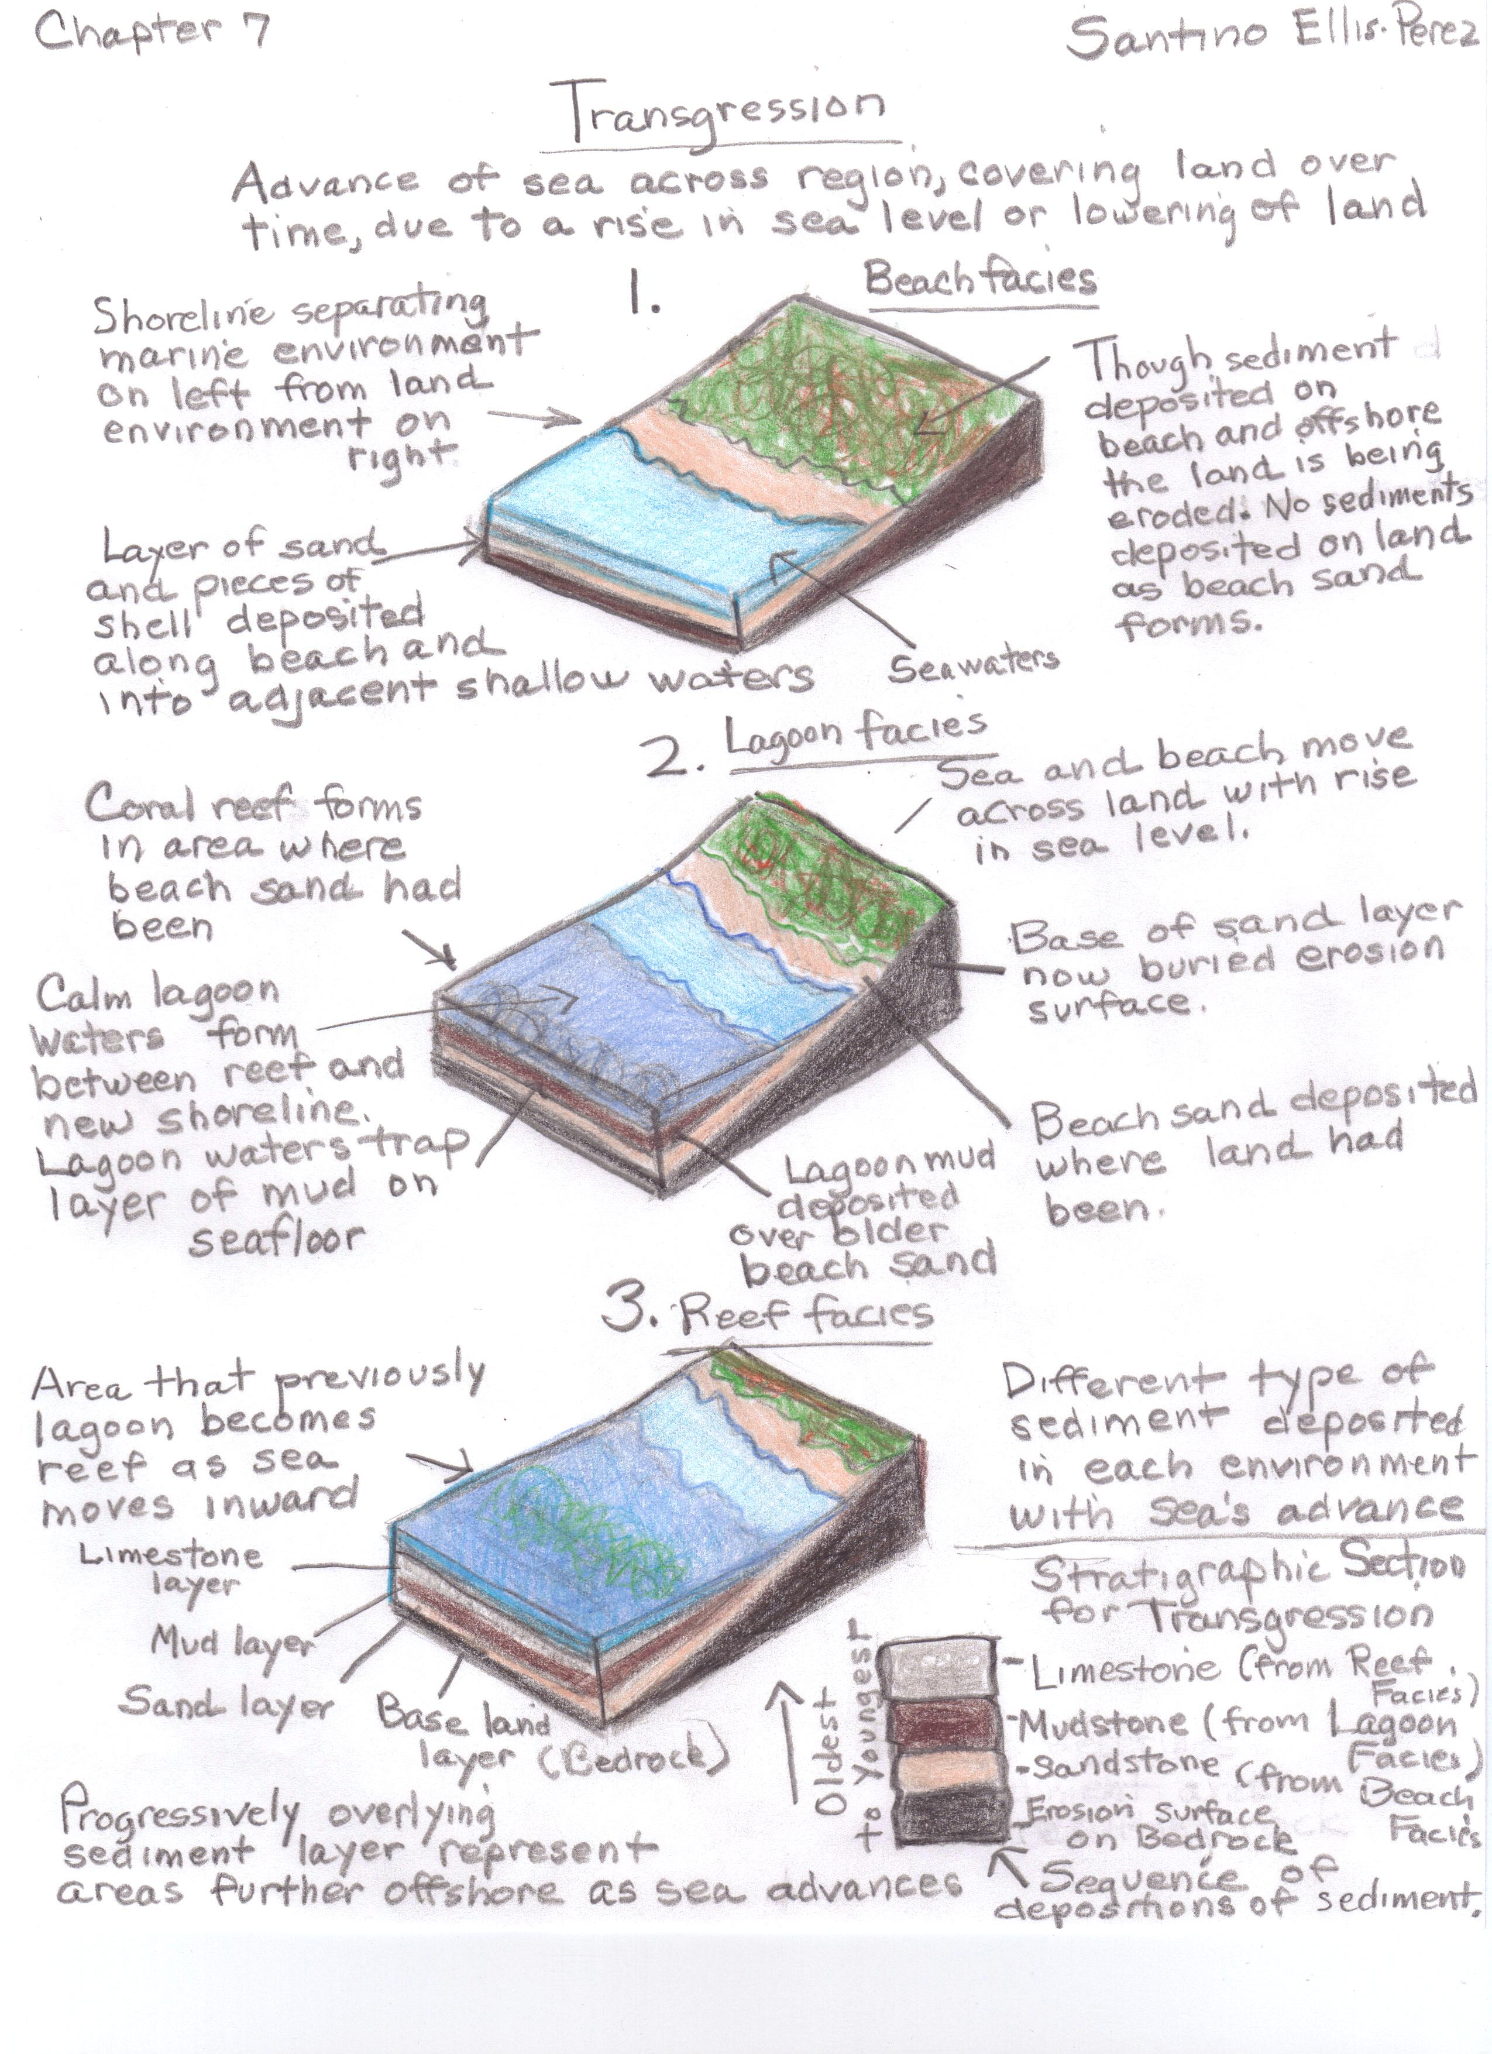
Example of Online Student Concept Sketch

Slide 15
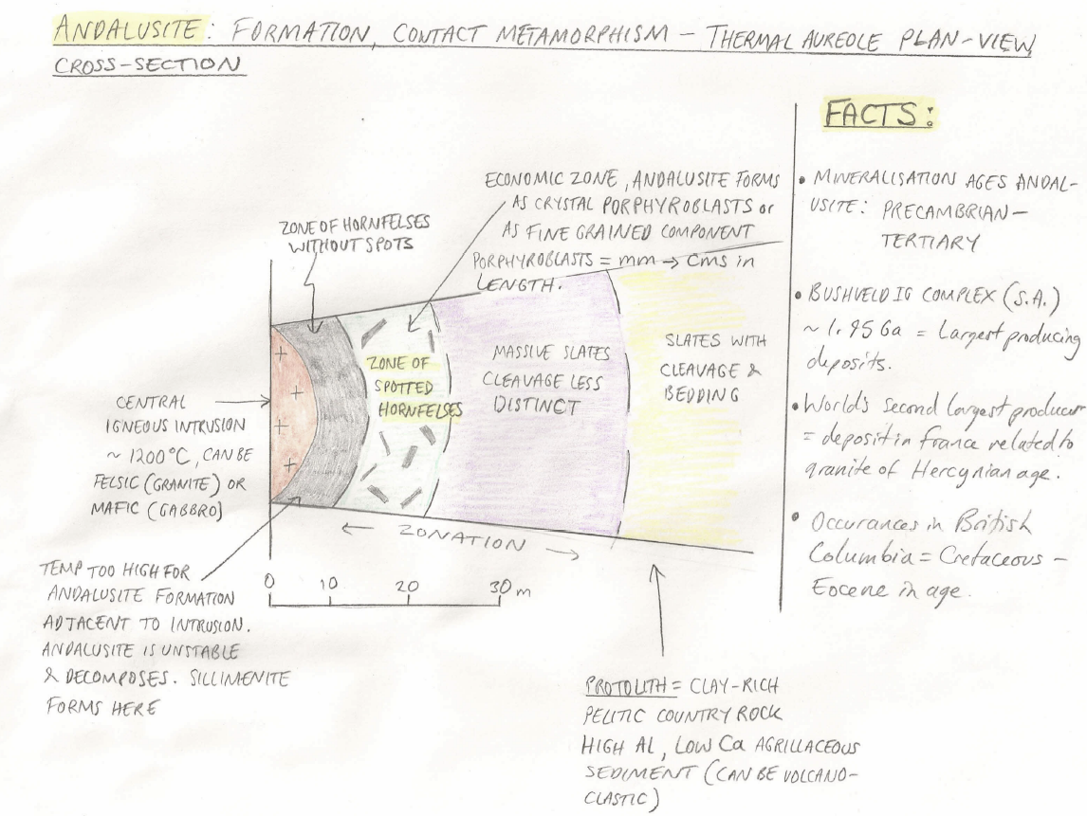
Example of Upper-division Student Concept Sketch for Presentation

Slide 16
Discussion about Using Concept Sketches
Take 2 to 3 minutes to jot down some notes about how you currently use or might use concept sketches
Enter an idea, question, or concern into the chat window or raise your electronic hand for a verbal discussion

Slide 17
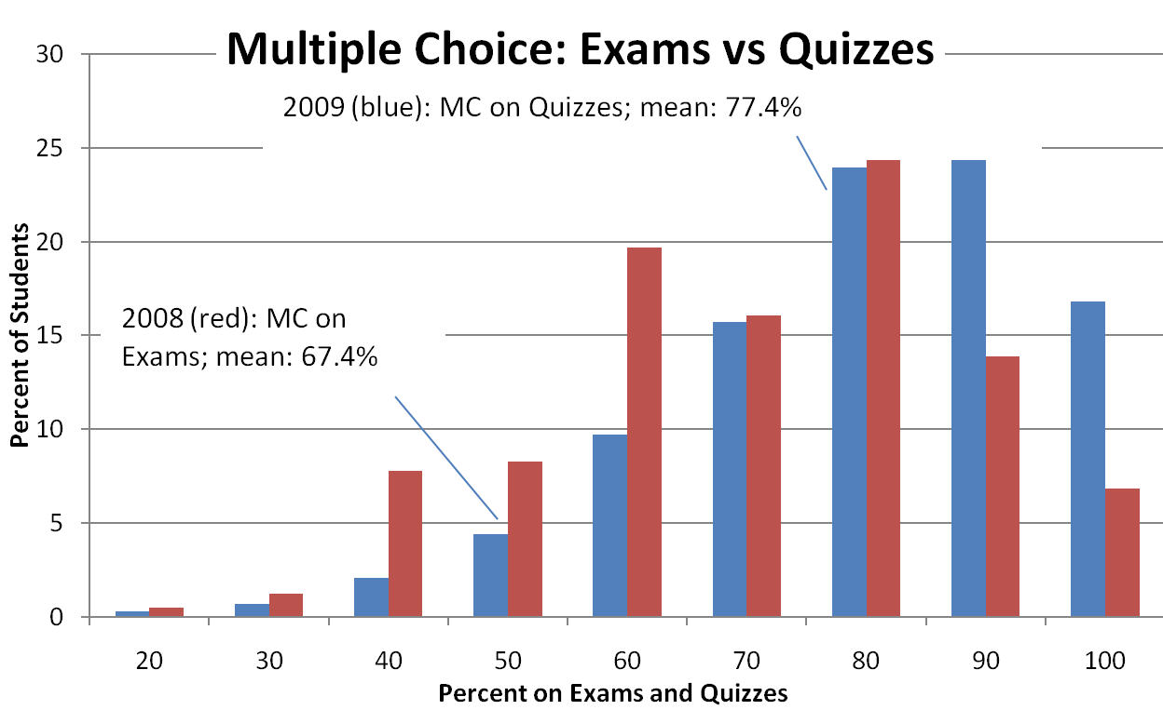
Role of Exam Type on Performance

Slide 18
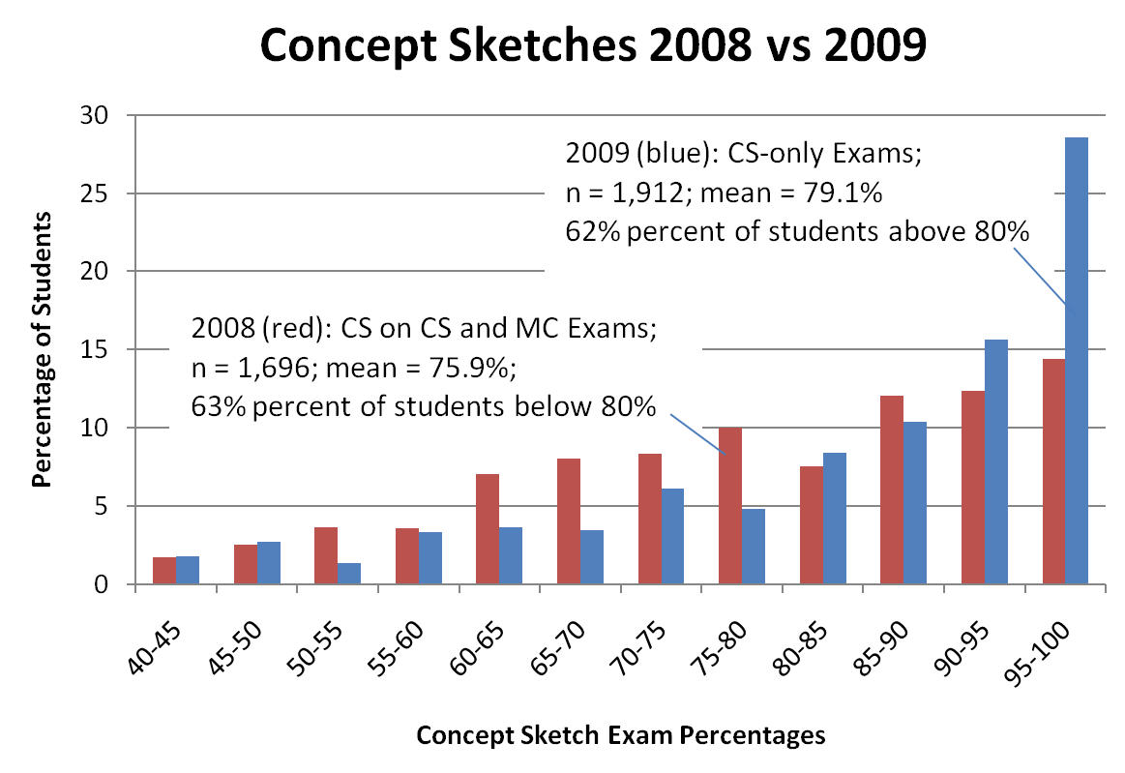
Role of Exam Type on Learning

Slide 19
Some References
Johnson, J.K., and Reynolds, S.J., 2005, Concept sketches – Using student- and instructor-generated annotated sketches for learning, teaching, and assessment in geology courses: JGE, v. 53, p. 85-95.
Reusser, L.J., Corbett, L.B., and Bierman, P.R., 2012, Incorporating concept sketching into teaching undergraduate geomorphology: JGE, v. 60, p. 3-9.

