Slide 1
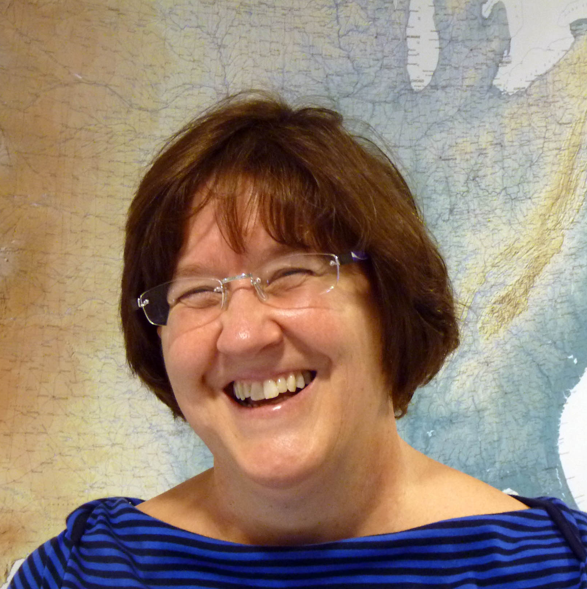



Effective Strategies for Undergraduate Geoscience Teaching Virtual Event Series
Series Conveners and Event Moderators
Heather Macdonald
College of William and Mary
David McConnell
North Carolina State University
Barbara Tewksbury
Hamilton College
Molly Kent
Science Education Resource Center (SERC)
Notes:
what does this mean for the classroom?

Slide 2
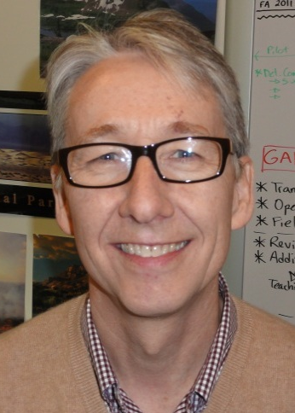



(Re)Designing Introductory Geoscience Labs to Promote Inquiry
David McConnell & Katherine Ryker
Marine, Earth and Atmospheric Sciences
North Carolina State University
February 20, 2013

Slide 3
Where are you teaching these labs? (Type of institution)
Two-year college
Four-year undergrad - private
Four-year undergrad - public
University with graduate program

Slide 4
Who is responsible for teaching the labs at your institution?
Faculty members
Graduate students
Undergraduate students
Mix of faculty and grad/undergrad students

Slide 5
What resources are you using to teach your labs?
Published lab manual
In-house lab materials/activities
Combination of lab manual and in-house materials

Slide 6
Learning Objectives
At the conclusion of the webinar you will be able to:
Describe the levels of inquiry that may be present in introductory geoscience lab activities
Analyze sample lab activities and characterize different levels of inquiry
Create examples of lab activities that are representative of multiple levels of inquiry
Discuss the training necessary for teaching assistants to teach inquiry labs appropriately

Slide 7
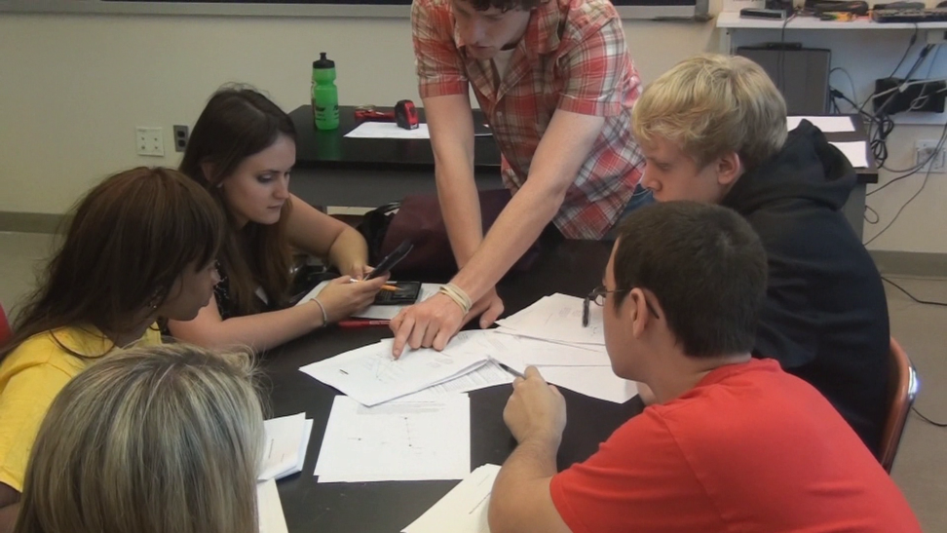
What is inquiry?
Diverse ways in which learners investigate the natural world, propose ideas, and explain and justify assertions on the basis of evidence
The nature of science
Requires identification of assumptions, use of critical and logical thinking, and consideration of alternative explanations.
Continuum of learner self-direction
Scientific process
Student role
A group of students working on a lab activity in the classroom
NRC 2000; Hofstein & Lunetta, 2003
Notes:
Emphasis on 1) the scientific method, and 2) the student role

Slide 8

Can we use inquiry to go from this…
Futurama (S1E3; “I, Roommate”)
“Some of the labs seemed as if they were made just to take up time.”
Notes:
Created inquiry-based lab materials to fundamentally revise our introductory geology labs

Slide 9
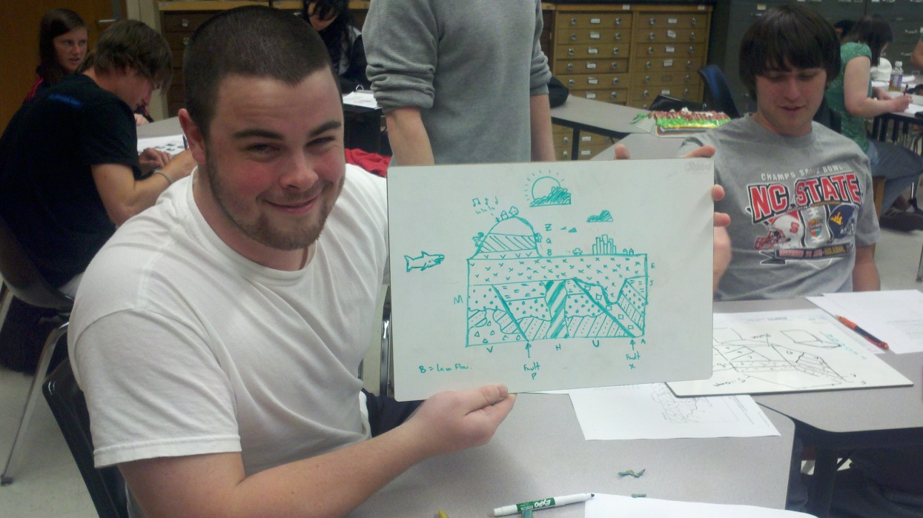
Can we use inquiry to go from this…
Futurama (S1E3; “I, Roommate”)
Student showing off his cross-section
“Some of the labs seemed as if they were made just to take up time.”
“This course included interesting labs that I enjoyed doing. They were challenging but I enjoyed getting to work hands on with what we were learning.”
…to this?
Notes:
Created inquiry-based lab materials to fundamentally revise our introductory geology labs

Slide 10
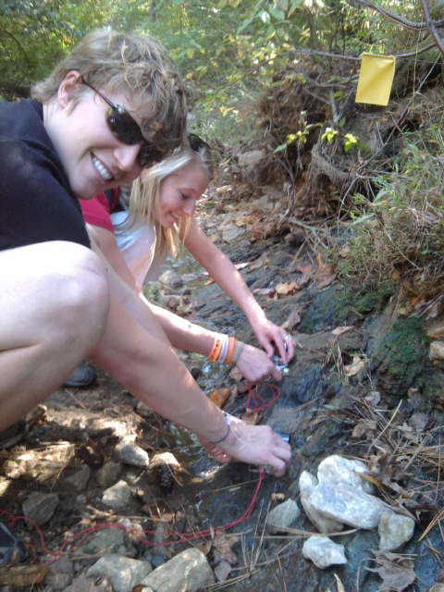
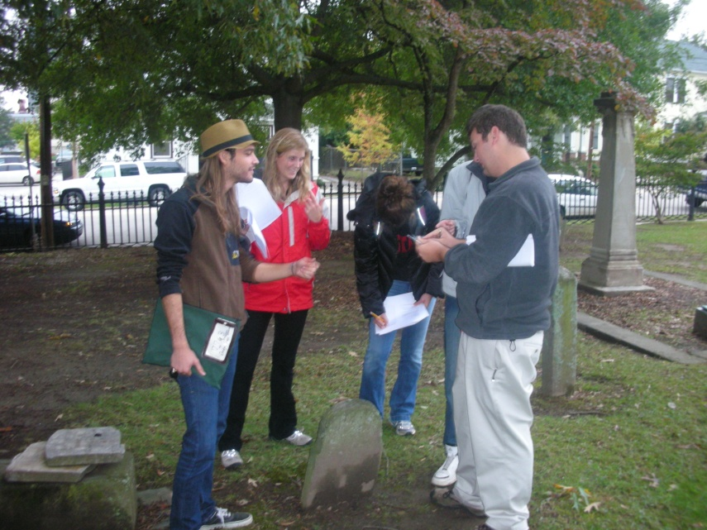
Course characteristics
Physical Geology lab (1 credit)
~30 sections of 15-20 students each semester
Taught by graduate teaching assistants
11 topical labs lasting 2 hours, 45 minutes
Most students are not science majors
Lab designed around hands-on, active-learning strategies
TAs taking strike and dip in preparation for a field lab
Students compare field notes with a TA during one of the active learning labs

Slide 11
Typical Lab Structure
Learning Objectives
Pre-lab Activity
  “Ticket” to lab – reading, web activity
Variety of activities and opportunities for interaction
  Emphasis on scientific method
  Connections with familiar real world phenomena (through personal experience OR previous labs)
  Open-ended questions require negotiation of meaning
Mastery quiz
Post-lab Assessment
Multiple scales of interaction
  Class, small groups, pairs

Slide 12
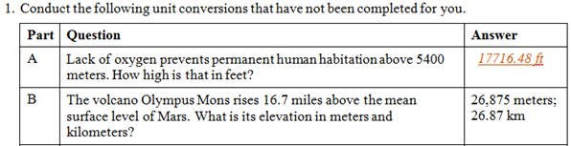
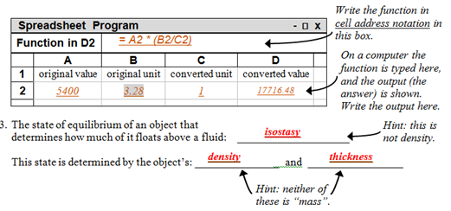
Lab 1: Intro to Physical Geology and the Scientific Method
Pre-lab Activity (4 pts)
  Gets students thinking about material
  Addresses common challenges or misconceptions
  Introduces a skill

Slide 13
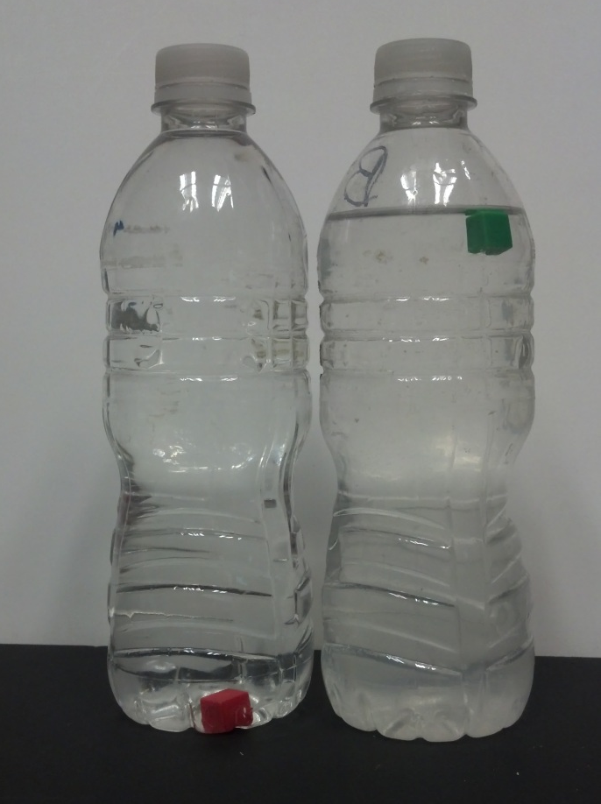
Lab 1: Intro to Physical Geology and the Scientific Method
Using scientific language
  Hypothesis
  Observations
  Predictions
Observations:
  What happens when a red cube is added to bottle A?
  What happens when a green cube is added to bottle B?
Suggest at least two hypotheses to explain these observations.
Describe experiments to test your hypotheses.
Predict what you think would happen if you were to conduct the tests.

Slide 14
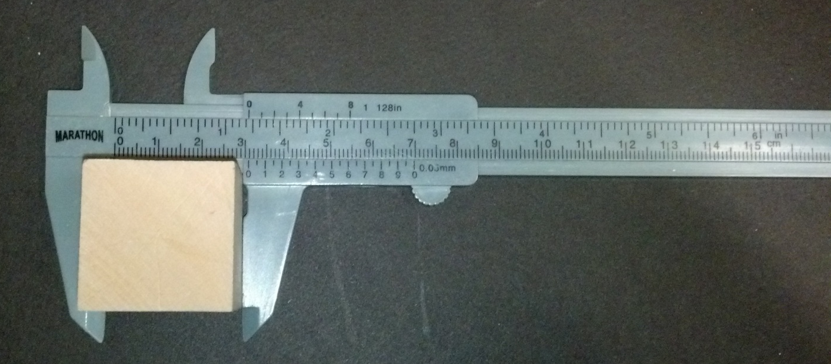
Lab 1: Intro to Physical Geology and the Scientific Method
Use accessible analogies
Take a wood block (this is beech wood). Use the tools at hand to calculate its density. Show your calculations below.
Place the wood block in a beaker of water. (Note: the block will not float evenly in the water.) Approximately, what proportion of the block lies above/below the water’s surface?

Slide 15
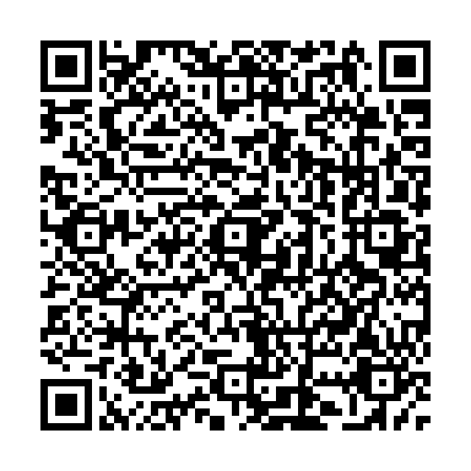
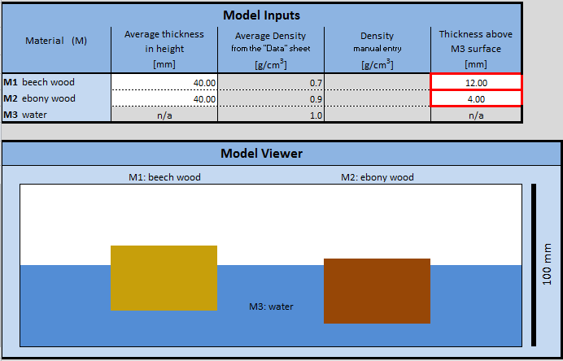
Lab 1: Intro to Physical Geology and the Scientific Method
Isostasy model
To learn more or download the isostasy model, scan this!
Bonus: “Break the Model”. Enter values into the Isostasy Model that produce results that are not realistic. Indicate the values you used and describe why the results are not realistic.
Lyons, Ryker and McConnell, GSA November 2013

Slide 16
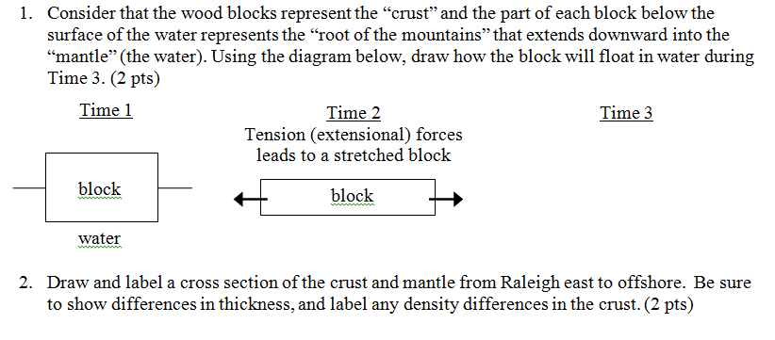
Lab 1: Intro to Physical Geology and the Scientific Method
Post-lab Assessment (5 pts)
Notes:
Discussion: What are other ways that you could incorporate some more inquiry (or different ways) to include inquiry into this lab?

Slide 17
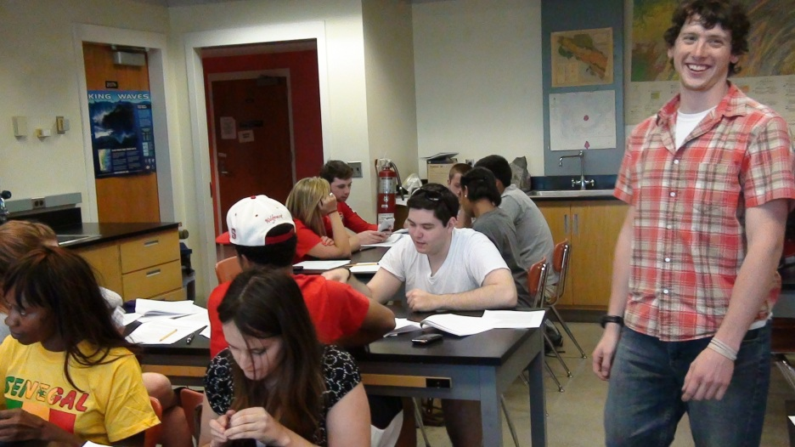
Lab 1: Intro to Physical Geology and the Scientific Method
Little or no lecture and informal discussion throughout
Assess and acknowledge students’ ideas
Incorporate these ideas into the lesson
“How did you get to that answer?” (Reflection)
“Do you agree or disagree? Why?” (Justification)

Slide 18
What do students say?
Learning Objective: I can explain the relationship between oceanic trenches, oceanic ridges and island arcs and plate tectonic processes.
“I swear, if the lab portion of this class hasn't about comprehensively beat this horse to death, then I really don't know what I've been missing. Until the day I die, I will have the properties of tectonic plate boundaries engraved into my frontal lobe, and that's a promise.”
Notes:
How one of my students responded when asked how confident they were with this learning objective

Slide 19
Levels of Inquiry
Identify varying degrees of student independence
Buck, Lowery Bretz and Towns, Journal of College Science Teaching, Sept/Oct, 2008, p.52-58.

Slide 20
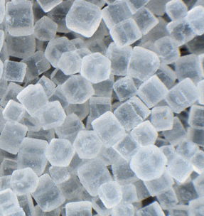
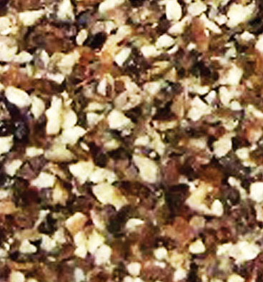
Sample Inquiry Lab Activities: Confirmation
Confirmation - The problem, procedure, analysis, and correct interpretations of the data are immediately obvious from statements and questions in the laboratory manual.
Minerals Lab: Introduction to cleavage - Take a magnifying glass and compare common table salt (a mineral) to pepper (a ground seed). Sketch and describe what you see.

Slide 21
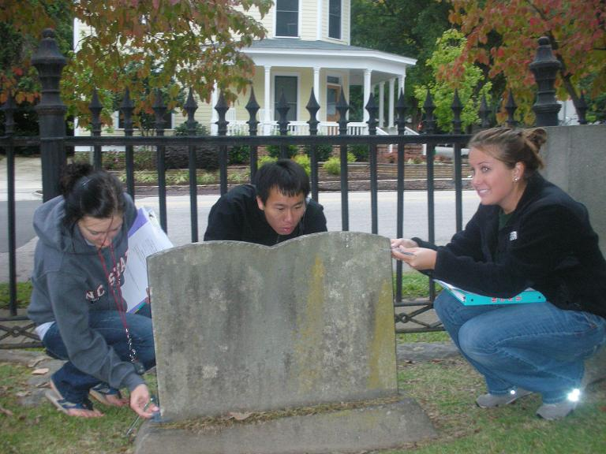
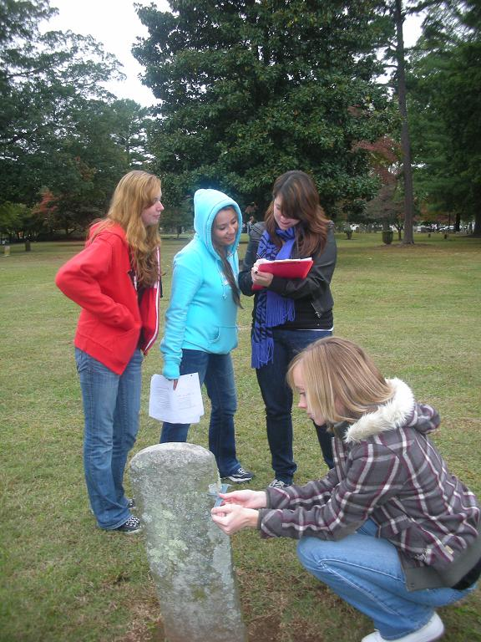
Sample Inquiry Lab Activities: Structured
Structured – The lab provides the problem, procedures, and analysis by which students can discover relationships or reach conclusions that are not already known from the manual.
Weathering Lab: Record the following data for each tabular marble tombstone you identify;
  Date of death on the stone;
  Visual weathering class for tombstone inscriptions (see attached scale);
  Average thickness of the stone at the top and bottom (in mm) measured with calipers

Slide 22
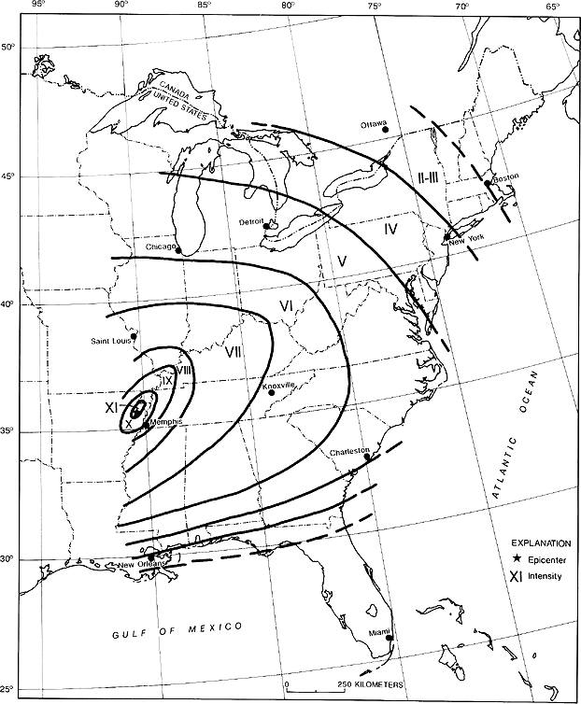
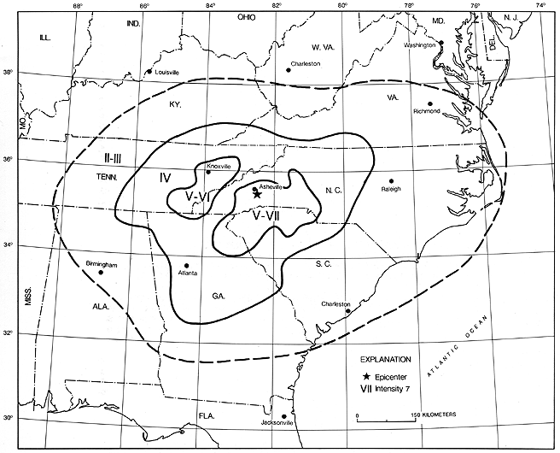
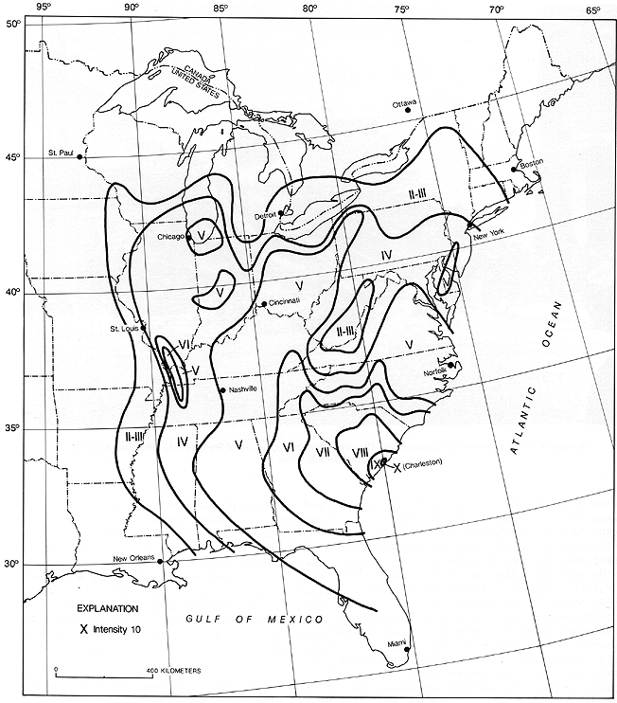
Sample Inquiry Lab Activities: Guided
Guided – The laboratory manual provides the problem and procedures, but the methods of analysis, communication, and conclusions are for the student to design.
Examine the maps to determine . .
If earthquakes of similar magnitudes occurred at the same locations today, what differences would you expect in the resulting damage in Raleigh, Asheville, and Charlotte?
Describe the potential effects of the three earthquakes on people and structures for each location.
If the state was going to give one of the cities $5,000,000 to protect key buildings from collapse, which city would you award the funds to?

Slide 23
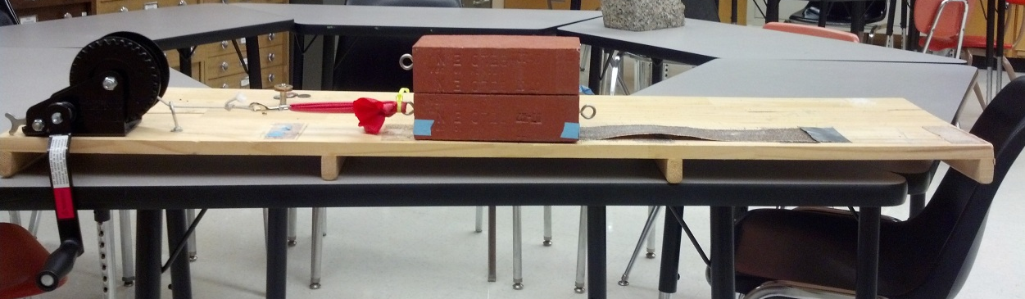
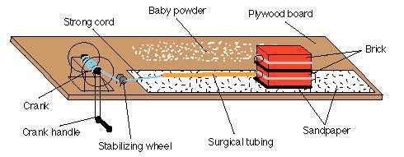
Sample Inquiry Lab Activities: Open
Open – The problem and background are provided, but the procedures/design/methodology are for the student to design, as are the analysis and conclusions.
Hypothesis 1: Earthquakes are periodic (are caused by the same slip, and all separated by the same amount of time).
Hypothesis 2: Earthquakes are 'time-predictable' (the larger the slip in the last earthquake, the longer the wait until the next one.)
Hypothesis 3: Earthquakes occur randomly in time and have randomly varying size.
Earthquake Lab: During each modeled “earthquake”, the brick made a rapid change in position. Three hypotheses for fault movements are described. Design an experiment to determine which best represents the movements that occur with the earthquake machine model.

Slide 24
Levels of Inquiry Activity
Not all types of inquiry are equal. Examine the pdf document that contains activities from four Physical Geology labs taught at NCSU and rate the activities using the scale provided.
Level 1: Confirmation - The problem, procedure, analysis and correct interpretations of the data are immediately obvious from the statements and questions in the laboratory manual.
Level 2: Structured - The lab manual provides the problem, procedures, and analysis by which students discover relationships or reach conclusions not already known from the manual.
Level 3: Guided - The lab manual provides the problem and procedures, but the methods of analysis, communication, and conclusions are for the student to design.
Level 4: Open - The problem and background are provided, but the procedures/design/methodology are for the student to design, as are the analysis and conclusions.

Slide 25
Levels of Inquiry Activity
Not all types of inquiry are equal. Examine the pdf document that contains activities from four Physical Geology labs taught at NCSU and rate the activities using the scale provided.
Use the polling tool to indicate which of the labs you classified as confirmation inquiry.
Earthquake machine
Topographic maps
Groundwater consulting
Plate Tectonics

Slide 26
Levels of Inquiry Activity
Not all types of inquiry are equal. Examine the pdf document that contains activities from four Physical Geology labs taught at NCSU and rate the activities using the scale provided.
Use the polling tool to indicate which of the labs you classified as structured inquiry.
Earthquake machine
Topographic maps
Groundwater consulting
Plate Tectonics

Slide 27
Levels of Inquiry Activity
Not all types of inquiry are equal. Examine the pdf document that contains activities from four Physical Geology labs taught at NCSU and rate the activities using the scale provided.
Use the polling tool to indicate which of the labs you classified as open inquiry.
Earthquake machine
Topographic maps
Groundwater consulting
Plate Tectonics

Slide 28
Levels of Inquiry in Physical Geology Labs
All eleven physical geology labs have a combination of inquiry levels.

Slide 29
Levels of Inquiry in Physical Geology Labs
All eleven physical geology labs have a combination of inquiry levels. Three labs that have large proportions of structured inquiry are currently undergoing revision.

Slide 30
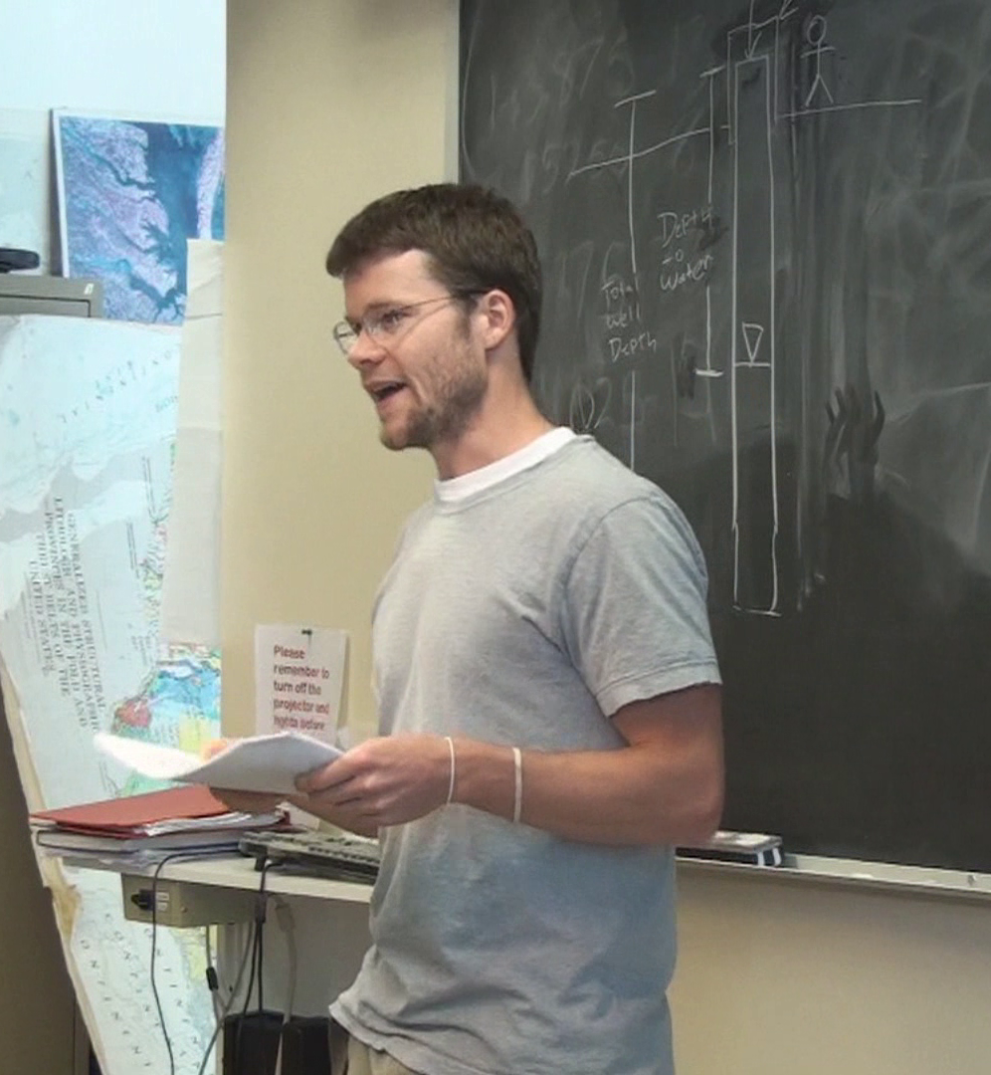
TA Training & Support
New TA orientation
Lab coordinator/head TA
Weekly meetings
  Leadership from old & new TAs
Suggestion Sheets:
  Lab management
  Illustrations
  Sample divergent questions
  Real world examples
  Common misconceptions
  Connections to other labs
TA using information from the Suggestion Sheet to cover key concepts at the beginning of lab
Notes:
“Big book of fun” coordinator notebook
TAs report that this has been very helpful
Consider that many students don’t have prior experience with teaching and need that support system to help them be successful
Suggestion sheets… Don’t have to incorporate all the suggestions, but helps promote variety in the classroom.
Most of us tend to teach the way we ourselves learned best, which may not reach all learners equally.
These are living documents just like all the lab components
Weekly lab meetings address the “essential goals”, discuss pedagogical strategies, discuss classroom experiences and exchange classroom management strategies
PD of graduate students: “helping them more effectively implement active-learning strategies”

Slide 31
Your Sample Lab Activities
Take a few minutes to review some of your favorite lab activities and classify them using the Buck et al. Inquiry Levels
(Confirmation – Structured – Guided – Open – Authentic)
Describe an activity and your interpretation of its level of inquiry by typing a brief summary of the activity in the chat box.

Slide 32
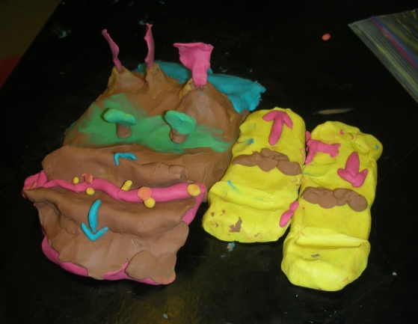
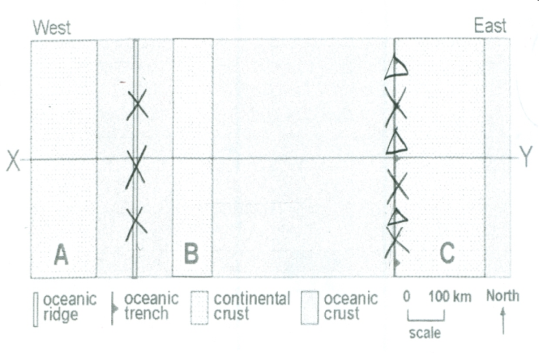
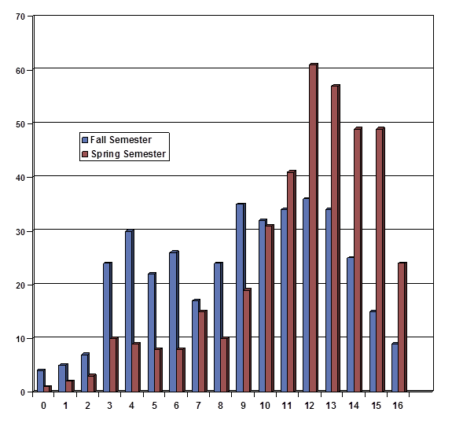
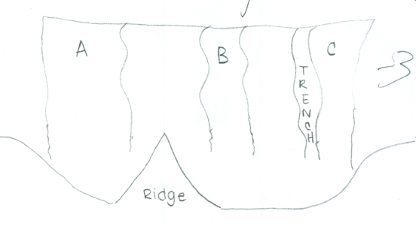
…but did they get it?
Instructions:
Identify how many plates are on the map.
Draw triangles where volcanoes would form and X’s where earthquake epicenters would be.
Draw a cross section.
During Plate Tectonics lab
Renn and McConnell, GSA November 2010

Slide 33
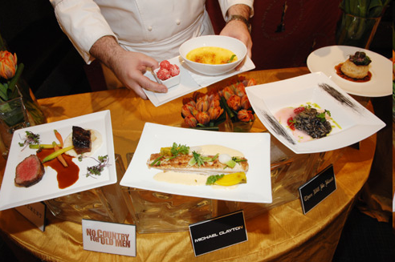
How is redesigning an introductory geoscience lab like…
preparing a five-course dinner?

Slide 34
Summary
We hope that you are now able to:
Describe the levels of inquiry that may be present in introductory geoscience lab activities
  (Confirmation, Structured, Guided, Open, Authentic)
Analyze sample lab activities and characterize different levels of inquiry
Create examples of lab activities that are representative of multiple levels of inquiry
Discuss the training necessary for teaching assistants to teach inquiry labs appropriately
  (TA training, lab coordinator, weekly meetings, suggestion sheets)

Slide 35

Questions?
Notes:
TAs report that this has been very helpful
Consider that many students don’t have prior experience with teaching and need that support system to help them be successful
Suggestion sheets… Don’t have to incorporate all the suggestions, but helps promote variety in the classroom.
Most of us tend to teach the way we ourselves learned best, which may not reach all learners equally.
These are living documents just like all the lab components

Slide 36
Effective Strategies for Undergraduate Geoscience Teaching
Virtual Event Series
March 27, 2013, (Wednesday): Teaching and assessing in-depth understanding of fundamental concepts using concept sketches, Leaders: Steve Reynolds and Julia Johnson, Arizona State University
April 10, 2013 (Wednesday): Energizing your class with ConcepTests: A simple technique to engage students and improve learning, Leaders: David Steer, University of Akron, Jeff Knott, California State University, Fullerton, and Karen Kortz, Community College of Rhode Island

Slide 37

Thank you!
We’re glad you were able to join us today.
Please help us by completing an evaluation form at:
http://nagt.org

