Slide 1
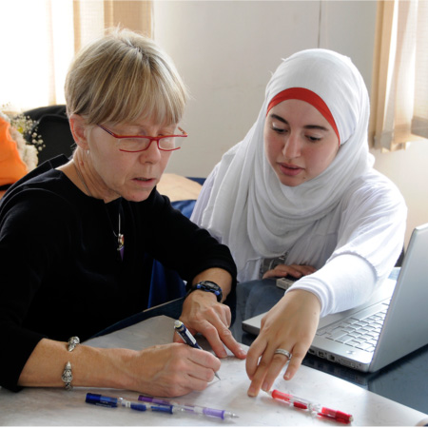
Jigsaws: Designing for Success
Effective Strategies for Undergraduate Geoscience Teaching Virtual Event Series
Presenter
Barbara Tewksbury
Hamilton College

Slide 2
A little about you
As I ask each of the following, please “raise your hand”
  Heard of jigsaw technique before?
  Used jigsaw?
  Interested in using jigsaw in a class of:
    < 25 students
    25-50 students
    >50 students
  Teach at
    4-year college or university
    2-year college

Slide 3
Purpose of the webinar
Provide enough info, plus online resources about jigsaw technique that you can successfully design and carry out your own jigsaw activity.

Slide 4

Is a one-hour webinar enough?
Discovering Plate Boundaries
  One of the best known geo jigsaws
  http://plateboundary.rice.edu/
  Dale Sawyer, Rice U.
Catalyst for development – a short talk that I gave at Rice University
So…yes!

Slide 5
Active engagement is a critical part of learning
We can’t do a student’s learning for him/her
Exposure does not guarantee learning
Students learn when they are actively engaged in practice, application, and problem-solving.
Notes:
Why are we doing this?

Slide 6
Importance of engaging students in the classroom
As you enter a classroom, ask yourself this question: “If there were no students in the classroom, could I do what I am planning to do?” If the answer to the question is yes, don’t do it.
General Ruben Cubero, Dean of the
Faculty, United States Air Force Academy
(Novak et al., 1999, Just-in-Time Teaching)
Notes:
what does this mean for the classroom?

Slide 7
Importance of having a teaching toolbox
If all you have is a hammer, everything looks like a nail.
Same goes for teaching. If the only tool in your teaching toolbox is lecturing, then….

Slide 8
Importance of having a teaching toolbox
Learn about successful student-active assignment/activity strategies
  think-pair-share, jigsaw, discussion, simulations, role-playing, concept mapping, concept sketches, check what later webinars are about, debates, long-term projects, research-like experiences….
  assignments involving writing, poster, oral presentation, service learning….
Make deliberate choices of the best strategy for the task.

Slide 9
Importance of having a teaching toolbox
Learn about successful student-active assignment/activity strategies
  think-pair-share, jigsaw, discussion, simulations, role-playing, concept mapping, concept sketches, check what later webinars are about, debates, long-term projects, research-like experiences….
  assignments involving writing, poster, oral presentation, service learning….
Make deliberate choices of the best strategy for the task.

Slide 10
Importance of having a teaching toolbox
Learn about successful student-active assignment/activity strategies
  think-pair-share, jigsaw, discussion, simulations, role-playing, concept mapping, concept sketches, check what later webinars are about, debates, long-term projects, research-like experiences….
  assignments involving writing, poster, oral presentation, service learning….
Make deliberate choices of the best strategy for the task.

Slide 11
Overview of webinar
This will be a “nuts-and-bolts” webinar
What is the jigsaw technique, and how does it work?
How to design a successful jigsaw
Questions
More examples
Individual work
Wrap-up discussion
Notes:
Not going to go into the history of jigsaw technique or the learning science behind it – post resources if you’re interested in following up

Slide 12
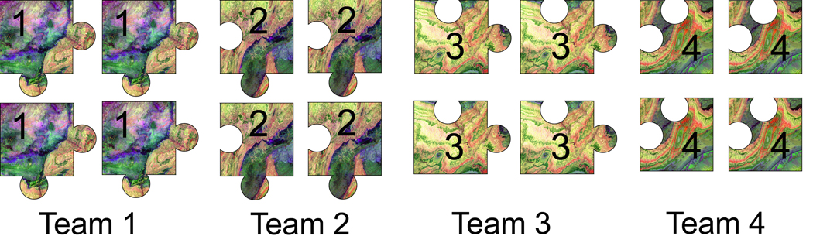
Jigsaw technique
Prepare several different assignments for the class
Divide class into teams
Each team prepares one of the assignments
Notes:
Remind them that they can post to the chat as we go along.

Slide 13
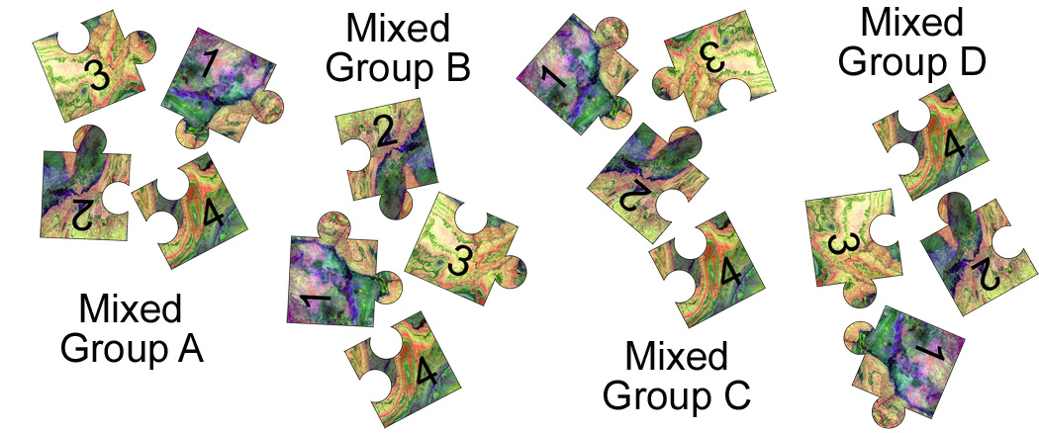
Jigsaw technique
Divide class into new groups with one member from each team
Individuals teach group what they know

Slide 14
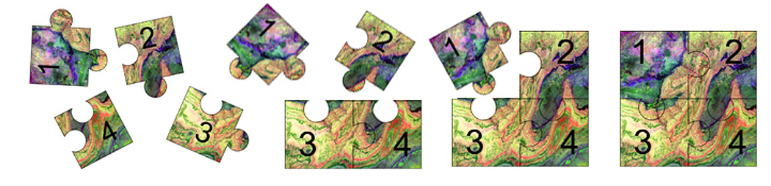
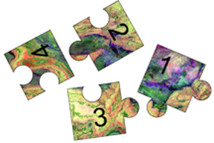
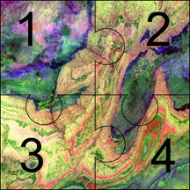
Jigsaw technique
Group task puts picture together
Critical – big difference between:
and

Slide 15
Simple jigsaw
Purpose: to engage intro students in igneous rock classification
Context: before introducing igneous rock classification
Box of rocks at classroom door – samples of granite, gabbro, basalt
Each student selects one rock
Notes:
make it clearer why I’m doing this particular example – deal with the too many rocks issues
Indicate that I will describe two examples; people can type questions in to the chat box.

Slide 16
Simple jigsaw
Preparation of team assignment
  Each student makes and writes down observations about his/her rock (± comparing observations with another student with the same rock)
In mixed groups (3 different rocks)
  Peer teaching: each student teaches the others what he/she has observed
  Group task: compare the similarities and differences

Slide 17
Simple jigsaw
Entire class
  Instructor asks groups for similarities and differences
  Instructor builds idea of igneous rock classification on the board from student responses

Slide 18
Designing a jigsaw
Example from Saharan paleolakes stratigraphic record
Traditional approach
  Lecture about idea that rock record preserves clues to paleoenvironment
  Present several examples of paleolake strat columns and show students how a geologist would interpret the data
  Present conclusions about Saharan rainfall change

Slide 19
Jigsaw version
Covers the same material
Takes about the same amount of class time
Students interpret the data themselves and draw the conclusions themselves – students engaged in analysis and explanation

Slide 20
Saharan example
Team assignments
  Done entirely in class
  Each team receives a different strat column
  Each team analyzes the data and develops a picture of what rainfall was like at what times and what the evidence is
  Instructor circulates to check teams
  Each team member ready to teach

Slide 21
Saharan example
Peer teaching in mixed groups
  Each person teaches what he/she has learned about team data set
  Instructor circulates to help if someone is stuck or confused

Slide 22
Saharan example
Group task
  Group combines what they have learned about all the data sets and puts together a temporal and spatial picture of timing and nature of rainfall change across the Sahara
  Group is given additional data, and they make and defend a prediction about rainfall change in the Sahara with global warming
  Picture not clear until group combines the pieces

Slide 23
Saharan example
Whole class
  Groups help instructor build time line
  Group discusses usefulness and limitations of the rock record
Individual follow-up
  Assumes mastery of team assignment and enough knowledge of others to explain group results
    Individual bullet list or
    Personal reaction paper or
    Incorporate results in summary paper

Slide 24
Value of the technique
Students are actively engaged in analysis and explanation
Students must know something well enough to teach it
Gives students practice in using the language
Students can learn one aspect/example well but see a range of aspects/examples without doing all the work
Well-structured group activity in which everyone has a valuable role to play

Slide 25
Critical elements of jigsaw
The assignment must be do-able – not easy or trivial but you must be confident that students can do it
Students must be prepared and not be wrong-headed
You must be happy that each student knows his/her assignment well and the others much less well
The group task is crucial - without it, it’s not a jigsaw
Some type of individual follow-up is valuable
Notes:
comment on original iteration of jigsaw by aronson

Slide 26
Questions and discussion
We will talk about questions posted earlier
If you have a new question as we are discussing, post it in the chat window

Slide 27
Other examples of jigsaws
Reading the literature
  Assign different articles – great for small classes (teams of 1!)
  Do more than say “come prepared” – have students answer questions
  Prepare to teach – students decide main take-home points, supporting evidence, how they will teach it
  Have students role-play the researcher (“I/we found that….”)
  Don’t forget the group task!!

Slide 28
Other examples of jigsaws
On field trips
  Divide outcrop into sections, one for each team
  Teams make observations, collect data, make sketches or concept sketches, answer questions
  Mixed groups – peer teaching down the outcrop + putting big pic together
  Allows students to focus, prevents both myopia and the butterfly problem

Slide 29
Other examples of jigsaws
With equations, graphs, calculations
  Assign each team a different range of data to process/plot/calculate
  Each person has experience with one iteration, & group task reveals the bigger pattern/picture/variation
  Can be short!
  For a big class, have people work in pairs or threes (helps avoid errors), check team results as whole class (doesn’t give away anything), groups then put the picture together.

Slide 30
Other examples of jigsaws
For samples, maps, thin sections when you don’t have multiple copies
  Each student works in detail with one
  Also great if doing more than one is overkill but you want students to see a range
  Use group task for students to develop picture of the range
  Forces students to explain what they have observed – the explanation effect is a powerful component of learning

Slide 31
In case we haven’t addressed..
How many team assignments?
  Generally 2-5 – peer teaching takes time
Ideal length?
  One class period or less; start small & simple!
What about odd numbers?
  Pair team members in groups if needed
Assessment?
  Rather than group grades, I prefer individual accountability for prep, with individual follow-up that uses the big picture from group task but does not demand equal mastery of all team assignments

Slide 32
Your turn
What might you develop for your course?
Post only your ideas, no chat
When timer is at 0:00, we will resume
Remember the critical elements:
  Employ the KISS principle (keep it simple…and do-able)
  Don’t expect students to know other team assignments as well as they know their own
  Build in preparation check
  Include a group task to put pieces together
  Consider individual follow-up rather than group grades

Slide 33
Questions?

Slide 34
More info on jigsaw
http://serc.carleton.edu/sp/library/jigsaws/index.html
Examples, more tips for success, results of research

