Slide 1
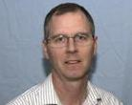
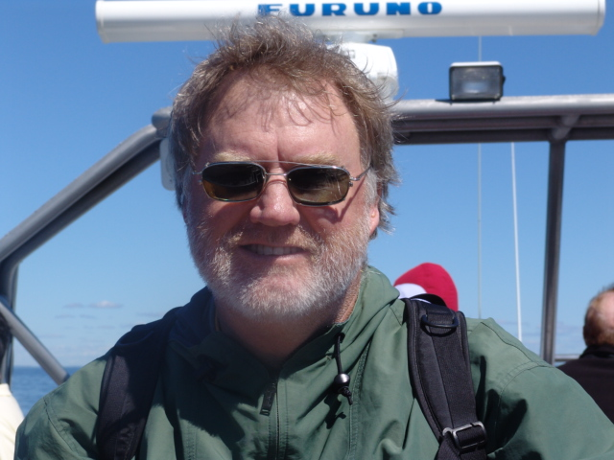
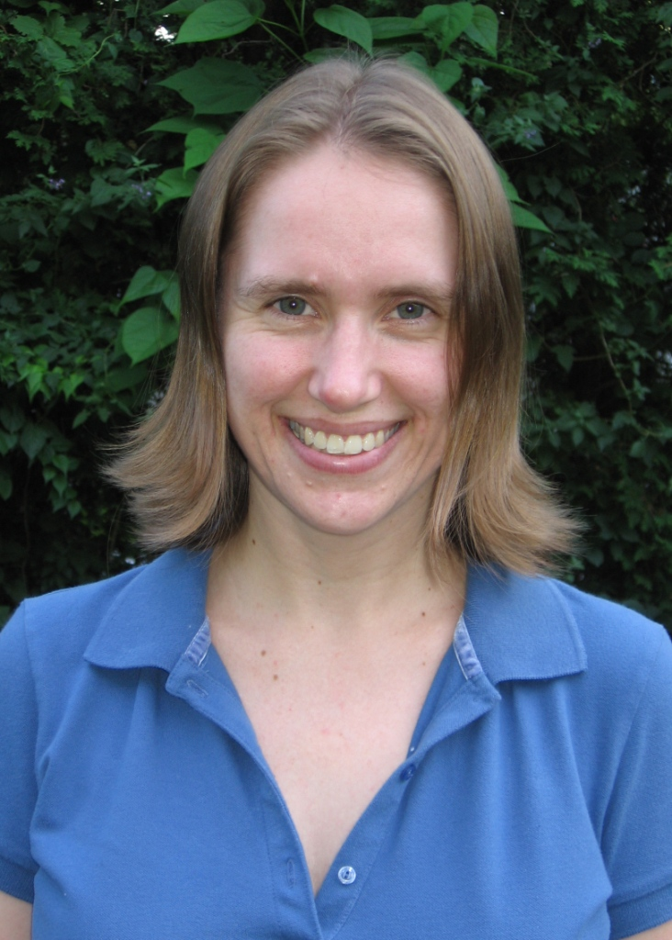
Introductions
David Steer is a professor of Geophysics in the Department of Geosciences at the University of Akron.
Jeff Knott is a professor of Geology at The University of California, Fullerton.
Karen Kortz is a professor of geology and oceanography at the Community College of Rhode Island.

Slide 2
Agenda
ConcepTests: What are they and why use them?
What does a good ConcepTest question look like?
How can I implement this?
Discussion

Slide 3
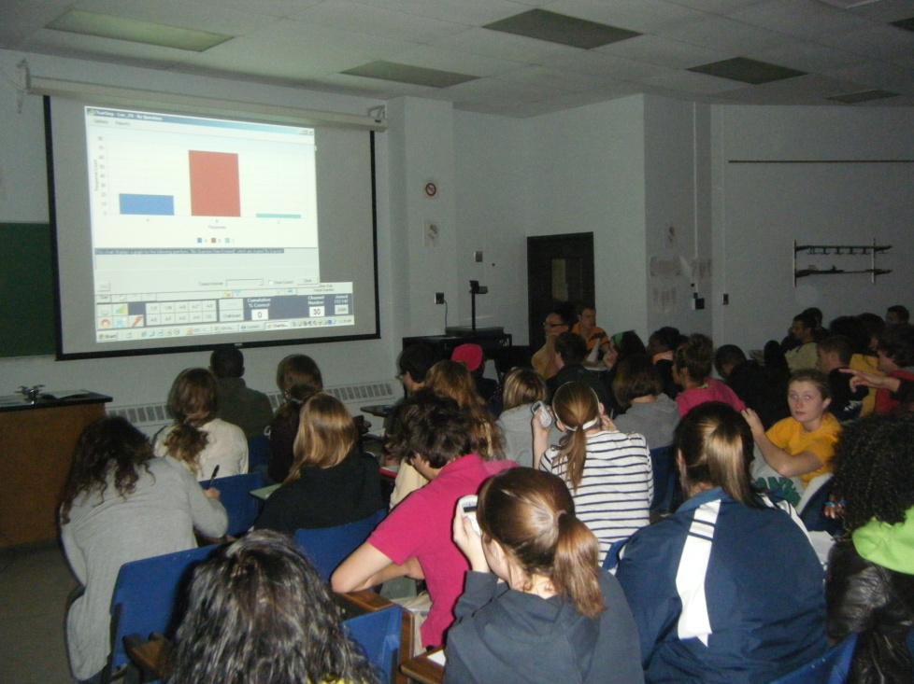
?
Have you used ConcepTests in some fashion in your class?
Respond by answering “yes” or “no” in the box to the upper right in Adobe Connect

Slide 4
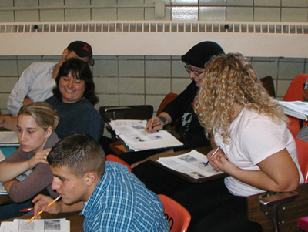
?
How often do you ask students to talk to each other in a typical class?
Rarely
1-2 times per class
3+ times per class

Slide 5
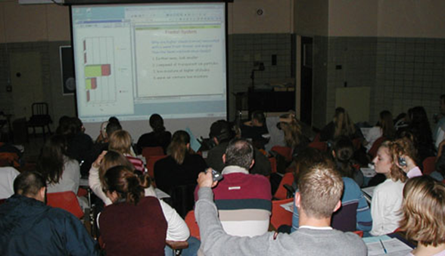
ConcepTests: The pedagogy
ConcepTests are multiple-choice questions embedded in the lecture. Good ConcepTests:
Focus attention on key concepts
Frequently include peer instruction
Are formative exercises that assess student understanding and progress during class.

Slide 6
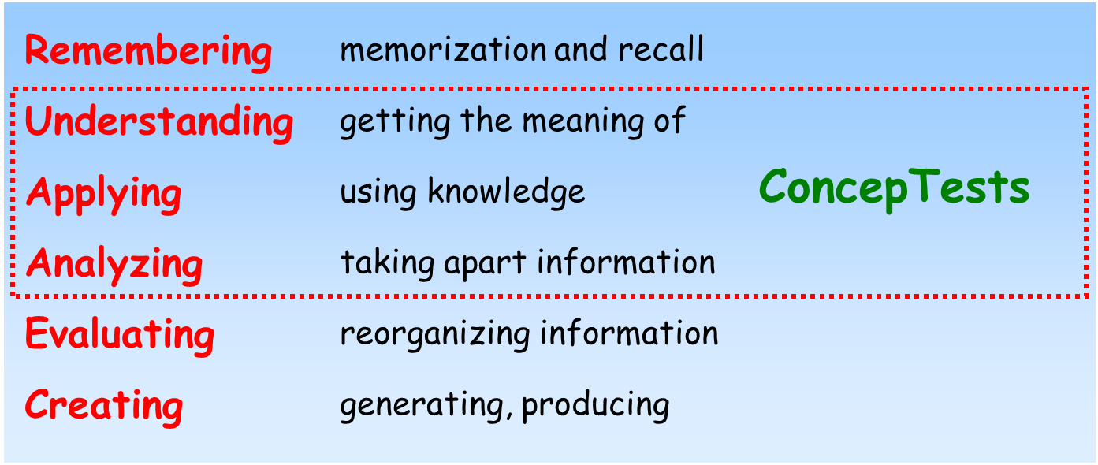
ConcepTests: The pedagogy
ConcepTests are appropriate for reinforcing learning goals at Bloom’s mid-level cognitive domains

Slide 7
?
Which of the following ConcepTest questions best targets the middle-level of Bloom’s cognitive domain?
What is the formula for stream discharge?
A stream channel is widened by erosion, but stream discharge is unchanged. Which of the following statements must be true?
How are stream discharge and flood recurrence intervals related to one another?
Design a procedure to measure a stream’s discharge.

Slide 8
ConcepTests: The pedagogy
Follow Chickering and Gamson’s* 7 principles of good teaching practice
Encourage student-faculty contact
Encourage cooperation among students
Encourage active learning
Give prompt feedback
Emphasize time on task
Communicate high expectations
Respect diverse talents and ways of thinking
*Chickering, A.W. and Gamson, Z.F., 1987. Seven principles for good practice in undergraduate education, Am. Assoc. Higher Ed. Bull., March, p. 3-7.

Slide 9
ConcepTests: The pedagogy
Used frequently with peer instruction
Lecture
Question is posed to entire class
Students answer question
  Answer → View Results → Discuss → Re-answer → Open Discussion*
  Discussion → Answer → View Results → Open Discussion* → (Answer New Question)
* Important to include the meta-cognitive aspect; get students to think about why they picked a particular response rather than just the “right” answer

Slide 10
?
Which of these sequences can you see yourself using in your classes?
Answer → View results → Discuss → Re-answer → Open discussion
Answer → Discuss → Re-answer → Open discussion
Discussion → Answer → View results → Open discussion → Answer new question
Something else
Notes:
10

Slide 11


?
Progress Update …
Are you following us so far? Indicate “yes” or “no.” Write questions that you have so far in the chat room at the lower right.

Slide 12
ConcepTests: Writing questions
Good ConcepTests
Focus on a single concept
Do not require calculations
Have good multiple-choice answers that include misconceptions
Are clearly worded (short on text, not terminology-intensive)
Recast concept in a way not covered directly in lecture
Are of intermediate difficulty (comprehension, application, analysis)

Slide 13
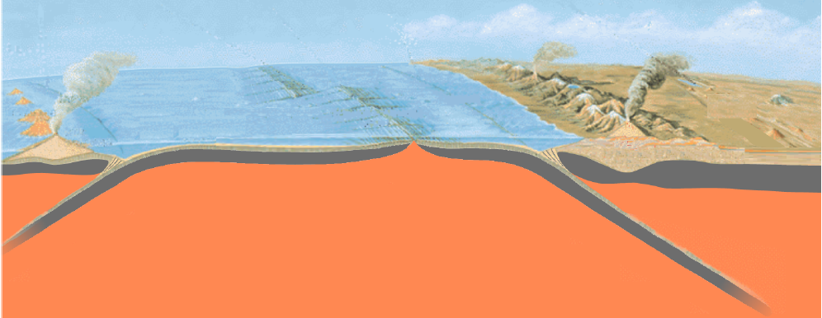
?
ConcepTests: Example
How do you think your students would answer this question: How many plates are present?
a. 2 b. 3 c. 4 d. 5 e. 6

Slide 14
ConcepTests: Writing questions
Ideas to get you started
• What is the best analogy
• What term doesn’t belong on or is missing from this list
• Observe and identify (e.g. on a photo, map)
• Classify an object/phenomena
• Infer the geology behind a news article
• Predict the outcome (e.g. of a demonstration)
• Convert text to an illustration and vice versa

Slide 15
ConcepTests: Writing questions
Guidelines for writing responses
Use plausible response options. Include misconceptions if possible.
Include 3-5 responses.
Avoid absolutes and complexity.
Keep the lengths of response options similar.
Unlike exam questions, it is okay to have some ambiguous answers to stimulate discussion.

Slide 16
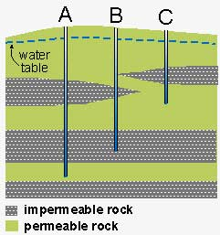
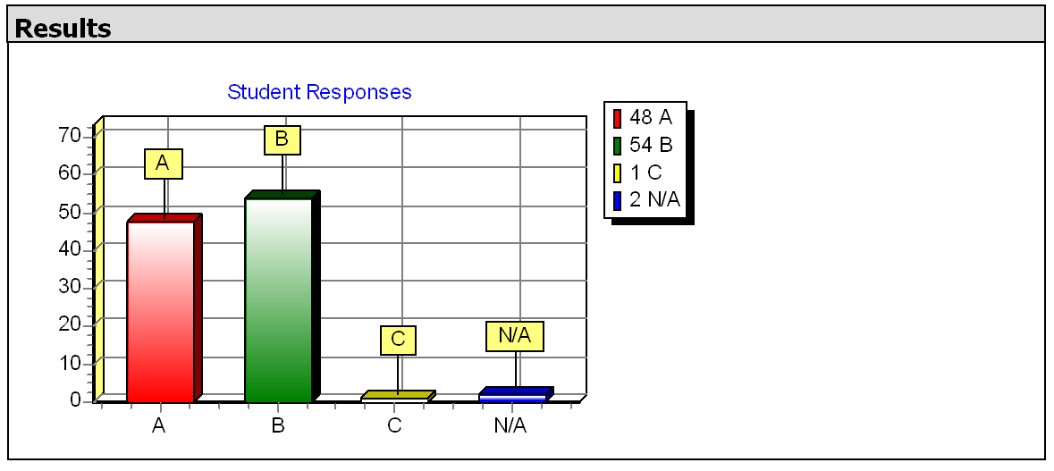
ConcepTests: Examples
Liquid hazardous waste is disposed of by pumping it down injection wells. Which well location would be the most suitable to use for an injection well?

Slide 17

ConcepTests: Examples
Place these materials (maple syrup, milk, peanut butter, frozen yogurt) in the correct position for their relative viscosity. What is at position #B?
a. frozen yogurt
b. milk
c. peanut butter
d. maple syrup

Slide 18
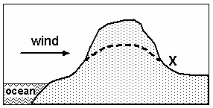
ConcepTests: Examples
In the landscape below, how would the amount of rainfall change at location X if the mountain eroded down to the dashed line?
a. Rainfall would increase
b. Rainfall would decrease
c. Rainfall would stay the same

Slide 19
ConcepTests: Examples
Grapes dried slowly in a warm oven are converted to raisins. This is an analogy for the formation of what rock type?
a. igneous rock
b. metamorphic rock
c. sedimentary rock

Slide 20
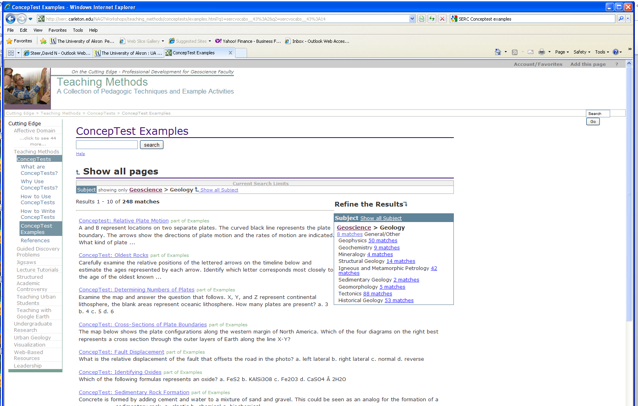
ConcepTests: Where can you find more?
http://serc.carleton.edu/introgeo/conceptests/examples.html

Slide 21
?
Reality Check …
Does this make sense so far? Indicate “yes” or “no.” Write questions that you have so far in the chat room.

Slide 22

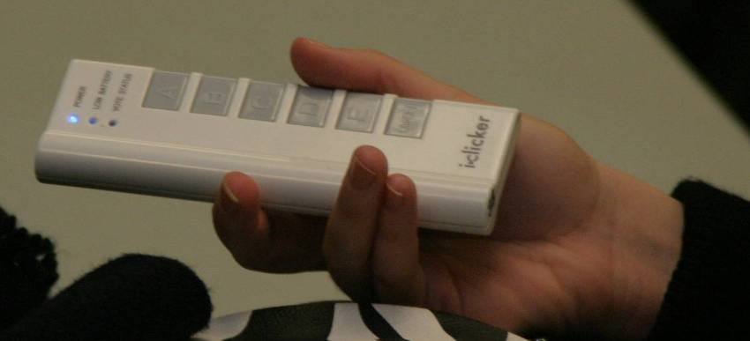
ConcepTests: Implementation
There are a variety of ways to implement this technique
Manual (show of hands, cards, cell phone flashlight)
Electronic response systems
Free options (Poll Everywhere, Twitter embedded in PPT)
A
B
C
D

Slide 23
?
What is your experience with using clickers (personal responses systems) in class?
I have used them.
I have not used them, but I know someone who does.
I have not used them, and don’t know anyone who does.

Slide 24
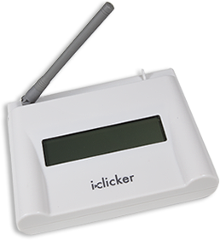
Easy to use and low cost
iclicker:
  Receiver and software free for classes >100 students (check with local rep).
    The receiver will accept hundreds of signals per second from any generation iclicker.
    USB connection
  Size
    About the size of a paperback book.
  Data
    All data stored on USB drive.
Image from www1.iclicker.com

Slide 25
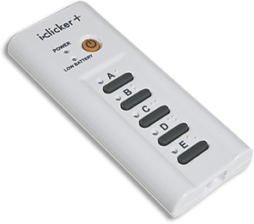
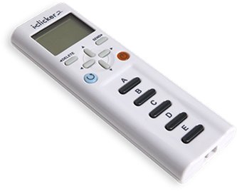
Easy to use and low cost
iclicker unit:
  May be purchased directly online of from bookstore.
    Include the ISBN number in your textbook order
    $39-$45 new
    Our bookstore has a rental program for $15/semester.
  Size
    It’s slightly larger than a cell phone.
  Registration online or in-class
    Registered clickers may be synchronized with your class roster from any number of class management programs.
  Smartphone may be substituted for the clicker
iclicker+
iclicker2
Images from www1.iclicker.com

Slide 26
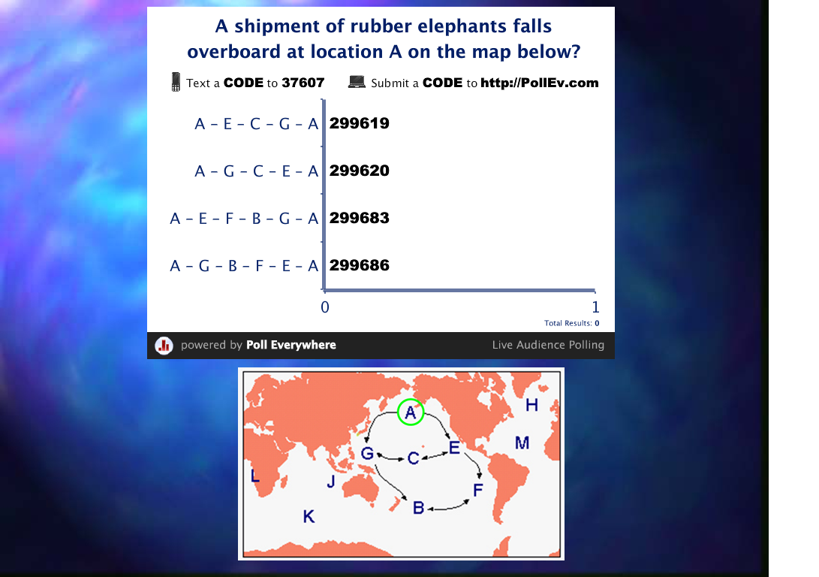
Other Options
Poll Everywhere:
  Free for up to 40 users.
    Design questions on web interface (www.polleverywhere.com)
    Export to a PPT slide
  Registration online or in-class
    Faculty must create free user account.
    No registration for students required
  Students use their cell phones to enter responses

Slide 27
Other Options
Twitter:
  Free
    Embed 3rd party Twitter tools in your presentation (http://timoelliott.com/blog/powerpoint-twitter-tools)
  Registration online or in-class
    Faculty and students must have Supertweet.net accounts.
  Students use their cell phones to enter responses
    Can handle polls, scrolling text feeds, feedback slides and a variety of other options*
    Launches through standard PPT
* As of March 5th it is not clear all options will still be supported

Slide 28
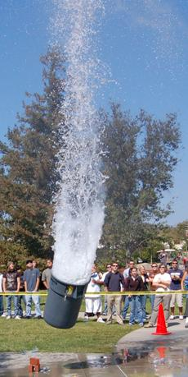
?
What are the positives of using ConcepTests for me (the instructor) and the students?
Share your ideas in the chat box.

Slide 29
What are the positives for me and the students?
Easy to implement.
  Large classrooms, no TA support, research and service makes changing your teaching methods less attractive.
  ConcepTests are simply inserted into your PowerPoint lecture.
  It’s as fast as cut and paste.
Reduce the “blank stares”
  Giving the students a chance to discuss in class is invigorating for both you and the students.
May improve some student’s metacognition.

Slide 30
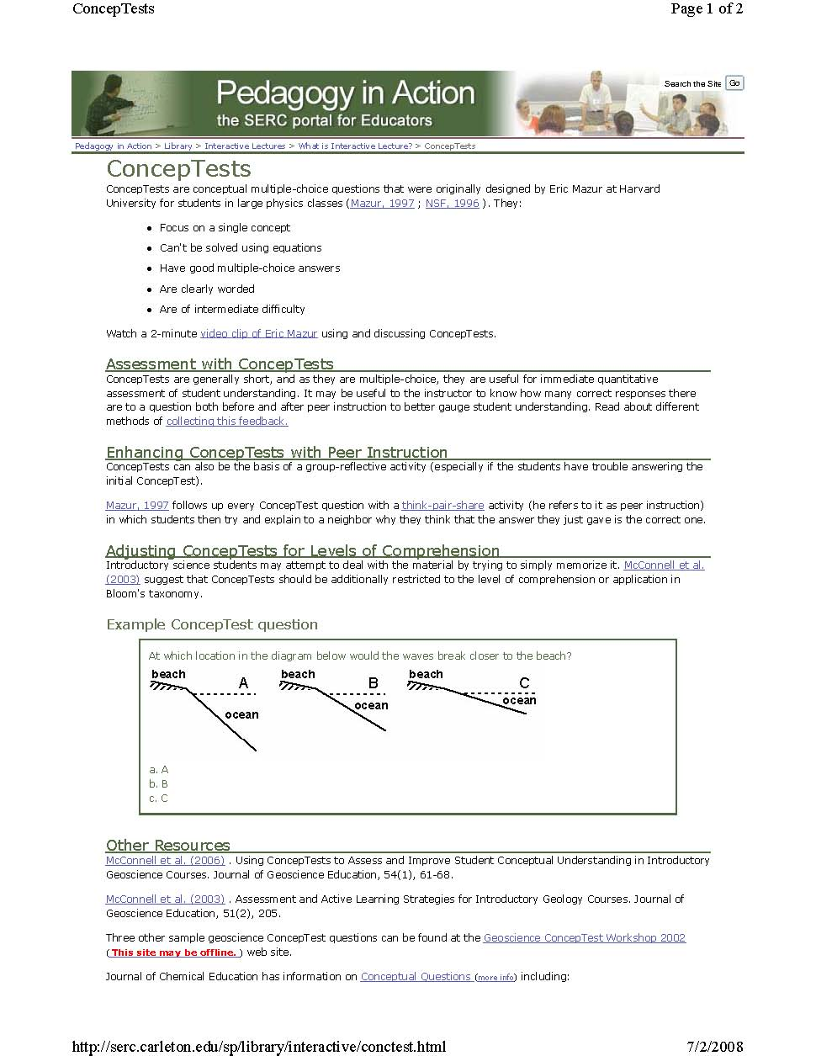
Conceptests: Discussion
http://serc.carleton.edu/introgeo/interactive/conctest.html

