Slide 1
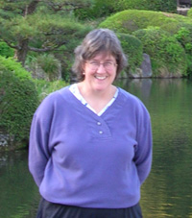
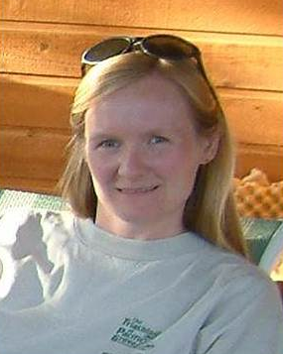
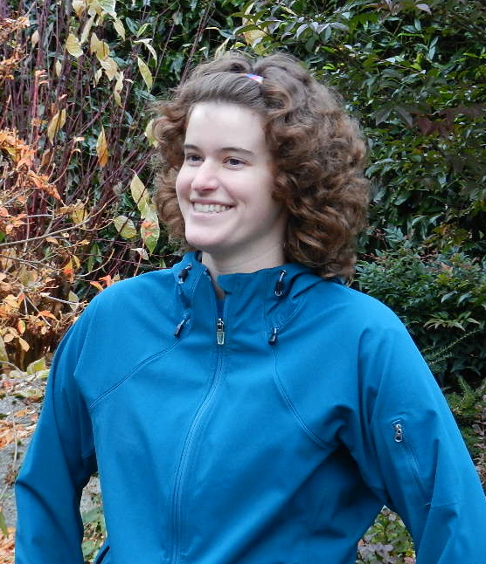
Pursuing an Academic Career
Virtual Event Series
Series Conveners and Event Moderators
Heather Macdonald
College of William and Mary
Elizabeth Ritchie
University of Arizona
Molly Kent
Science Education Resource Center (SERC)
Notes:
what does this mean for the classroom?

Slide 2
Networking for Academic Careers
Prof. Tracey Holloway
for
On the Cutting Edge
Nelson Institute for Environmental Studies
Center for Sustainability and the Global Environment (SAGE)
University of Wisconsin Madison

Slide 3
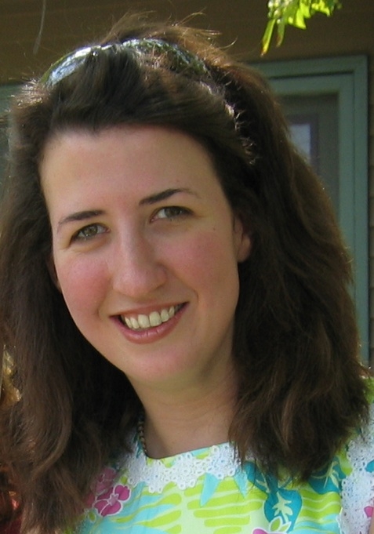



Hi! (this is me)
Tracey Holloway
Associate Prof. @ UW-Madison
  Nelson Center for Sustainability & the Global Environment (SAGE)
  Nelson Institute for Environmental Studies
  Atmospheric and Oceanic Science
  Civil & Environmental Engineering
Broader Activities
  Deputy Leader, NASA Air Quality Applied Sciences Team
  Exec. Board, Environmental Research Letters
  Founding Board Member, Earth Science Women’s Network (ESWN); ES Jobs Network

Slide 4

Networking & Me
Networking training/experience, e.g.
  Founding ESWN & ES Jobs Net
  Helped develop ESWN Training programs (“Networking for Scientific Careers,” 6/12)
  Aldo Leopold Leadership Program (2 weeks training on leadership & networking)
  Training UW Madison students
  My networking gurus: Kerry Ann Rockquemore (NCFDD) & Chris Olex

Slide 5
In the next hour
What is “networking” for academics?
  → Let go of schmoozy preconceptions
How to do it?
  → Nuts and bolts
Who should you network with?
  Map your network

Slide 6


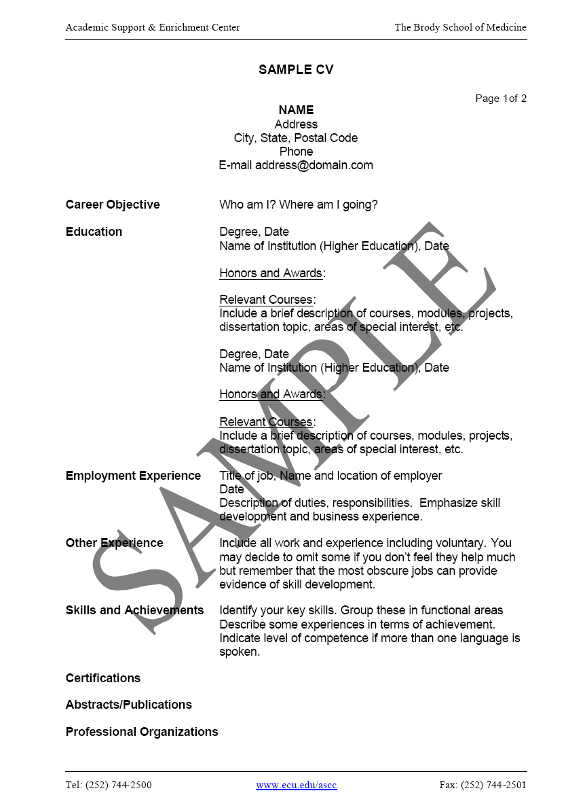



Slide 7
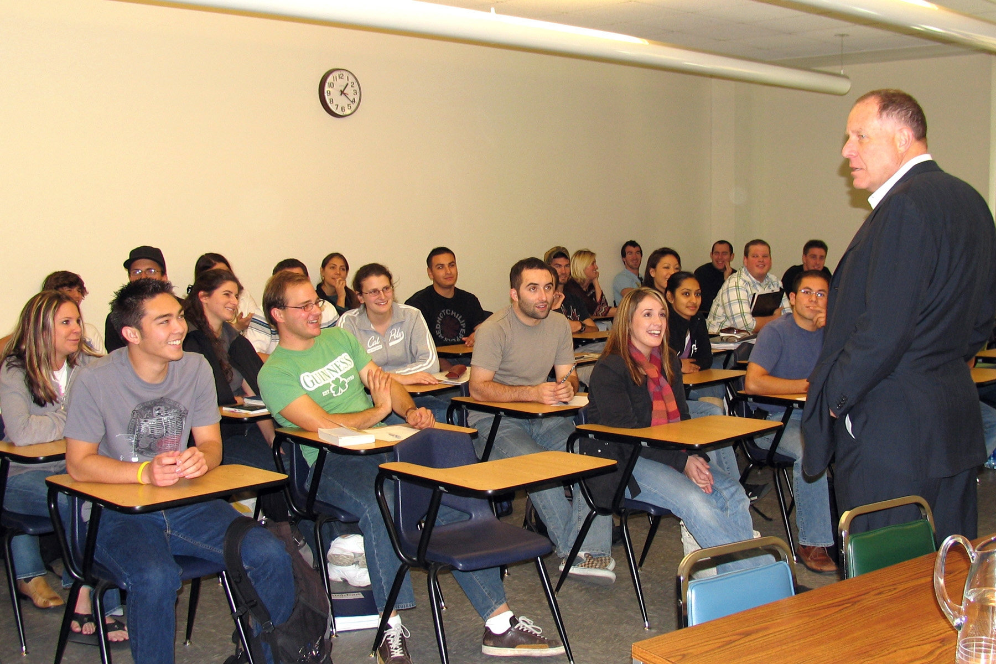
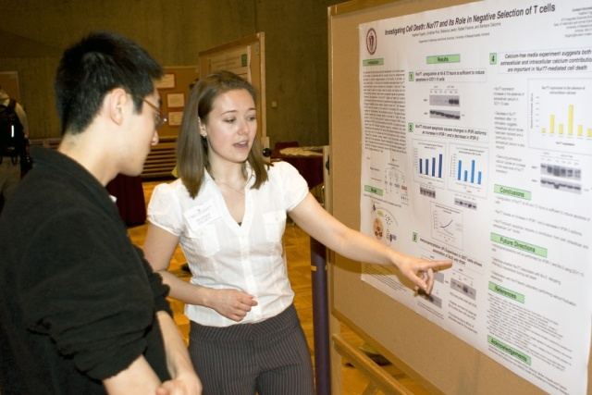
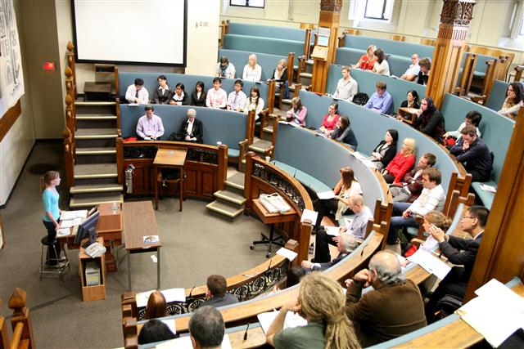
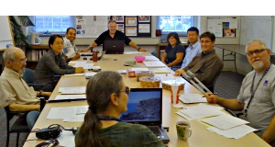

Slide 8
In a recent Rutgers study...
“...help of family and friends to find 70% of the jobs they held over their lifetimes; they all used personal networks and insider information if it was available to them”
“..only 14% mentioned that they had received help of any kind from others”
http://opinionator.blogs.nytimes.com/2013/05/05/how-social-networks-drive-black-unemployment/

Slide 9
Can we separate professional networking from favoritism?
“. And while exclusion or discrimination is illegal, inclusion or favoritism is not — meaning it can be more insidious and largely immune to legal challenges.”
“Favoritism is almost universal in today’s job market.”
http://opinionator.blogs.nytimes.com/2013/05/05/how-social-networks-drive-black-unemployment/

Slide 10
What is “networking” (for academics)?
Engaging people to evaluate our work (reference letters, reviewers, nominators, grant managers, informal feedback, etc.)
Connect w/ people who are interested in our work, and vice versa (research conferences, department seminars, speaker invitations, journalists, twitter, blogs, collaborators, new ideas)
Navigating a specialized job market (tenure letters, grant managers, hiring initiatives, sharing information, getting advice)
Supporting our students (introducing them to alumni & experts, bring them to conferences, sending job announcements, advise on online identity issues)

Slide 11
Networking & Academic Jobs
But they still depend on your references, reputation, community engagement, etc.
Most permanent jobs: publicly announced; competitively awarded

Slide 12
Networking & Academic Jobs
Many opportunities require personal connections: Award nominations, collaborations, mentoring
Institutions (usually) build opportunities for these connections... but individuals are expected to engage

Slide 13
Networking & Academic Jobs
Do you know all the opportunities out there? Do you know when and where advice would be helpful?
Formal or informal networks can help you with the “unknown unknowns”

Slide 14
You never know...
$
Me
NASA
Papers
ESWN
Louisa & Peter
Tenure
NCAR
NASA

Slide 15
Scenario 1
You’re at a conference and see a senior colleague you know by name only, and want to meet. What do you do?
Approach him/her saying “I’d like to introduce myself...”
Ask a colleague to introduce you
Approach him/her and offer your help “I think your X project is great, and if there’s anything I can do to help out, I’d be happy to.”
Email a follow-up after the meeting “I didn’t get a chance to talk to you at ...”
Other

Slide 16
3 ways to make 2 minutes of conversation with any academic: “Hi, my name is ___...”
1) “...I really enjoyed your talk – do you have a paper out related to that work?”
2) “... I wanted to introduce myself because ____”
3) “... I’m working on ___, and was wondering what you thought about ___?”
Tracey’s Tip #1:

Slide 17
3 ways to make 30 minutes of conversation with any academic:
1) “Could you tell me a little more about your research?”
2) “How did you decide to pursue ____?”
3) “Do you have any advice for someone on the job market?” (etc.)
Tracey’s Tip #1.5:

Slide 18
Tracey’s Top 9 Places for Academic Networking
5 minutes before department seminar
Obligatory meetings with visiting speakers
Quasi-social events, especially w/ peers
Big conferences + brief convo + email follow-up
Small conferences + longer convo + email follow-up
Offer to give guest lectures in classes
Email + coffee with (would be) mentor
Twitter + email or real-life follow-up
Your webpage (you never know who’s looking!)

Slide 19
Scenario 2
A colleague wants to (secretly) nominate you for a MacArthur Award. What is the one thing you could add to your webpage to help her write a compelling nomination?
Webpage? What webpage?
A full, up-to-date CV
Compelling, narrative description of your work
Links to your publications
Other

Slide 20
Tracey’s Tip #2:
Never underestimate the power of a good webpage
Looks official
Include your pic
CV linked
You & your work
Image gives instant overview

Slide 21
“Mission-Driven” Networking:
Strategy 1... Build your force
Set up in-person (or phone) meetings with mentors, former professors and other contacts.
Bring a copy of your CV &/or other info
3) Ask for their advice. Take notes. Nod.
4) Ask them who else you should talk to.
5) Follow up with a thank-you note & updates

Slide 22
Why it works
Gets the word out that you are on the market (or whatever your goal)
Reminds potential advocates who you are, and why they like you so much
Gives you immediate feedback on strategy
Makes mentors feel like they are part of your team → advocates/sponsors
Builds your network
Personal recommendation very powerful
“If you want $, ask for advice” (and if you want advice, ask for advice)

Slide 23
“Mission-Driven” Networking:
Strategy 2... Direct
Find people with whom you would like to work
Email with your CV and a super-polite, positive “cover” letter. Be specific about why them. Compliment their work.
Doesn’t matter if they are advertising or not (or for a level higher/lower than yours)
Worst case: you put yourself on the radar of a potential employer, but no response Best case: Unadvertised opportunities, or they forward your email to others.

Slide 24
Why it works
Many jobs are not well advertised
Many job opportunities are “emailed around”
In academics, skills/backgrounds are highly specialized... Your future employer needs to know you exist.
Even if this person/org is not hiring now, they may remember you for the future.

Slide 25
My hiring story
Job lists
Me
Mike
Prof. Netwk
Joe
Emails
Erica

Slide 26
Part 2
Jason
4
Me
6
3
Jonathan
5
1
Email
Brian
2

Slide 27
Tracey’s Tip #2:
Make it as easy as possible for future employers, funders, etc. to “find you” through professional networks

Slide 28
You have the job... Why keep networking?
Who will write your recommendation letters? Tenure letters?
Who will invite you for talks? Suggest you for panels? nominate you for awards?
Who will give you career advice?
Who will invite you to collaborate?
Who will review your papers & grants?
Who will be on the job search committee?
Who will give you the “inside scoop”?
Who will give you feedback on your work?
...

Slide 29
Mentors and Sponsors
High-value members of your network, especially in academia.
Cultivate mentors who know your work, who feel invested in you.
Sponsors impact how you are discussed “behind closed doors.” Invested mentors are excellent sponsors.
Your “mentors” do not need to be official... Just helpful senior/peer colleagues

Slide 30
How Can Mentors/Sponsors Help?
Writing letters for jobs, tenure, fellowships
Inviting you to workshops, committees, etc
Closed-door discussions about your job application, performance, etc.
Giving Advice
Sending info your way
Talking you up

Slide 31
Tracey’s Tip #3:
Don’t ignore the way your network operates behind closed doors

Slide 32
Poll Question: Which of these would help you most now?
Substantive feedback/advice
Sponsors to advocate for me
Access to opportunities (jobs, funding, etc.)
Intellectual community
Emotional support

Slide 33
Are there other roles where a network could help you?
Please write in thoughts

Slide 34
5 minutes: Mapping your network
What are the top 6 ways that a network could help you now?
Blank sheet of paper →
Possible goals:
Feedback (ideas, papers)
Advice (job search, career)
Sponsors/advocates
Info/Access: jobs, funding, etc.
Intellectual community
Emotional support
- In & out of your institution
- In & out of current field
1
YOU!
4
2
5
3
6

Slide 35
5 minutes: Mapping your network
What are the top 6 ways that a network could help you now?
Blank sheet of paper →
1
YOU!
4
4.) Feedback on Research
Paul M.
2
5
Arlene
Jonathan
3
6
Christine

Slide 36
Who is in your network?
Do you have people within your institution, and external to it?
Do you have trusted allies? And others to show your “game face”?
Do you have both peers & senior people? (And maybe junior)?
Do you have the same name too many times?
Are there empty spaces?

Slide 37
In mapping your network, did you ..
Have an “ah-ha” moment?
See any gaps?
Have any questions?
Please write in thoughts

Slide 38
Why network mapping works
You are in control of your network
You can understand how to best connect with individuals
If you are missing connections in certain areas...you can fix it
Are you relying too much on any one person?
Targeted projects may benefit from mapping (e.g. how to promote a textbook?)

Slide 39
Tracey’s Final Thoughts
The easiest way to network is to volunteer to help others
The 2nd easiest way is to promote other people (nominate someone for an award, invite students to meet a visiting speaker, e-introduce two colleagues)
Know your boundaries, and work within a space that is comfortable for you

Slide 40
Time for Questions

Slide 41

Thank you!
Contact: taholloway@wisc.edu
Twitter @tracey_holloway
www.sage.wisc.edu

Slide 42

Thank you!
We’re glad you were able to join us today.
Please help us by completing an evaluation form (we will email you the link).
http://nagt.org

