Slide 1
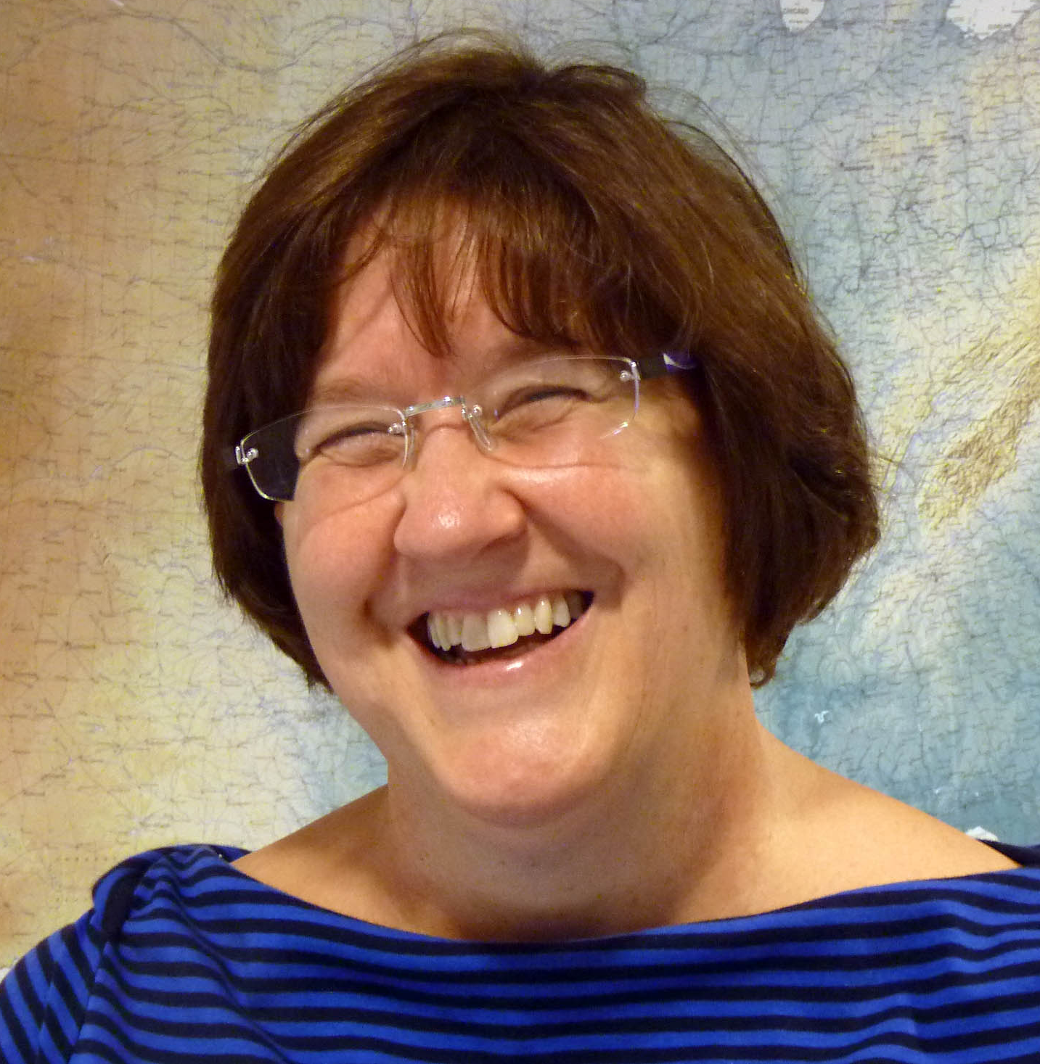
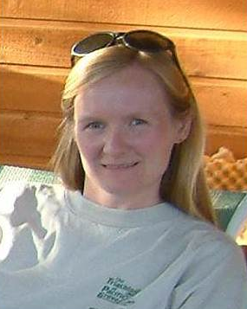
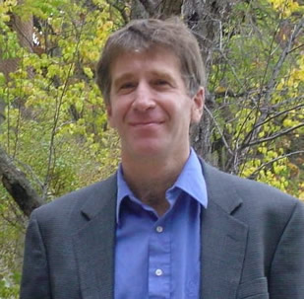
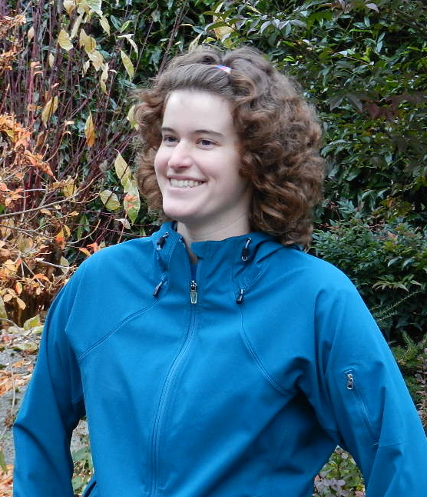
Effectively communicating your research: From elevator talks to job interview presentations
Heather Macdonald
College of William & Mary
Elizabeth Ritchie
University of Arizona
Tim Bralower
Pennsylvania State University
Molly Kent
Science Education Resource Center (SERC)
Notes:
Different perspectives

Slide 2
Webinar overview
Communicating your research
Elevator talks
  Key elements and how to modify for different audiences
  Questions
Academic job talks (research)
  Suggestions and strategies
  Examples
  Questions
Evaluation of webinar
2
Notes:
Tie in to goals Learn more about communicating your research in informal "elevator talks“
Consider how your “elevator talk” might be different for different audiences
Learn about aspects of designing a presentation about your research for an academic interview
Leave with some practical strategies of how to prepare and deliver a great job talk

Slide 3
Questions for you
1. How often do you explain your research to others outside your research group?
  Every week
  Once or twice a month
  Frequently when I’m at a professional meeting but not much the rest of the time
2. How many job talks (about research) have you heard or given in the last year?
  None
  1-3
  4 or more
3

Slide 4
You’ve meeting someone for the first time and they ask you about your research. What do you feel?

Slide 5
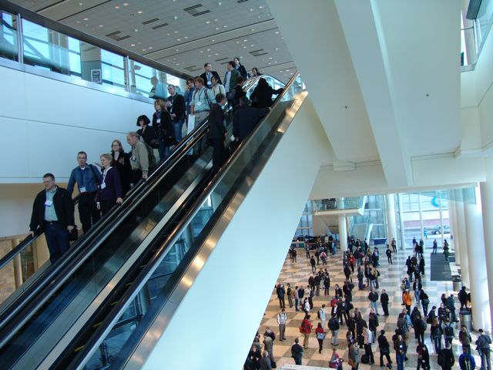
Elevator talks
You are on an elevator (or escalator)
Someone asks “What do you do?”
You have 30-60 seconds to tell them. Are you ready?
5
Michael Tobis http://init4au.files.wordpress.com/2009/12/escalator.jpg
Notes:
Make a good first impression

Slide 6
Elevator talks:
Content
What excites you most about your research? What you do, what question you are addressing, what methods you use.
Why it is important?
Strategy:
  20-30 seconds talk
  1-2 sentences on your research
  1 on its significance
6
Notes:
Compelling content
Nature article, Nancy Bacon COMPASS. 1. the problem; 2) why it matters; 3) potential solutions; 4) benefits of fixing it. Might add to the list of two, what techniques, approaches etc. (your skills set)

Slide 7
Elevator talks:
Content, clarity
Who is the audience
  Colleague, undergraduate, neighbor, dean
  Consider both vocabulary and scope
Watch out for jargon
Short sentences
I rather than we (when possible)
Strategy:
  Modify for different audiences
7
Notes:
Appropriate to audience, Different audiences interview with colleague in same specialty, with another geoscientist, with a dean who studies Victorian literature, with undergraduate students

Slide 8
Elevator talks:
Content, clarity, delivery
Establish eye contact
Show enthusiasm for your work (being true to your personality and style)
Vary tone of your voice
Watch for eyes glazing over
It’s the beginning of a conversation
Strategy:
  Practice and get feedback
8
Notes:
It’s a conversation
Engaging delivery

Slide 9
Preparing your elevator talk
Jot down main points
Work into 2-3 sentences; may need to omit some points
Practice different versions
  Short, longer
  For specialist, for non-specialist
Get feedback and revise
Start now:
9
Notes:
What do you need to do to revise your elevator talk? Refer back to opening slide – how often you do this

Slide 10
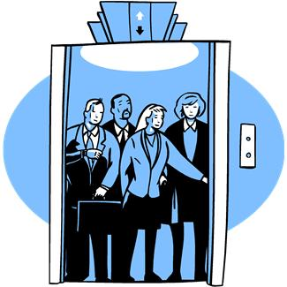
What questions do you have about elevator talks?
Please type your questions into the chat box.
Feel free to respond to questions or comments posed by others
10

Slide 11
Research presentations – job talks
What level?
What topic?
How long?
What to do for a 15 minute talk?
Lose the beginners or bore the experts?
I have more than one project?
How to begin and end?
How much detail? Depth vs breadth?
11
Notes:
MW

Slide 12
The job talk
The audience
The presentation
  Important considerations
  Handling questions
  If your work is interdisciplinary
The preparation
Thanks to Early Career Geoscience Faculty workshop alumni, Mike Williams, Rachel Beane, College of William & Mary science faculty, & webinar participants
12
Notes:
The performance

Slide 13
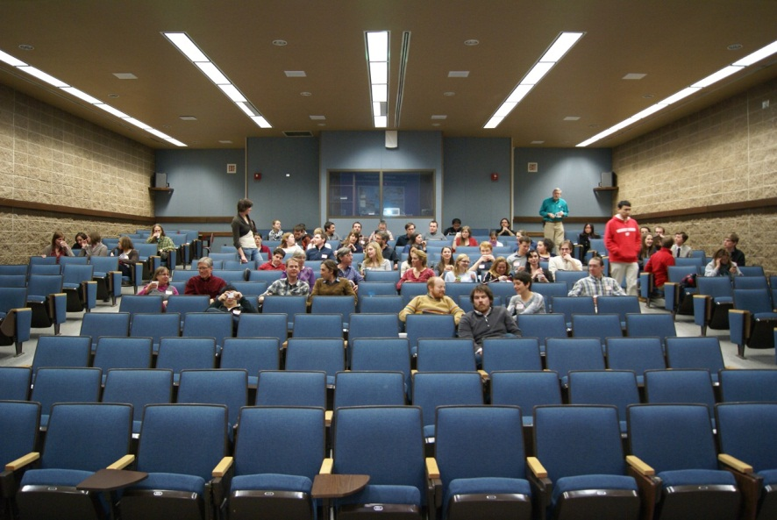
The audience
Faculty in the department
Faculty in your specialty?
Faculty in other departments?
Post-docs?
Graduate students?
Undergraduates?
Photo by Basil Tikoff

Slide 14
What are they looking for?
Quality of research and its potential
Teaching ability
What you would bring to the department
At a liberal arts college/PUI, use the talk to show that you are able to communicate complex science to undergraduates. Showing that you do research is good, and making it accessible for undergrads is good, and showing that you can make undergrad sized projects for them is good. Don’t go through your entire defense.
14
Notes:
If the audience is a mix, include "hooks" that ensure the undergrads will be able to understand the basics and the importance of the material but also include specifics to convince the faculty that your research is at the forefront of the field. Try to span the difficulty level. Show that you can talk to a wide audience without losing anyone. Also be sure to "show your stuff," and don't be afraid to lose them!

Slide 15
The presentation
Give them your best work
Pick one research project
Make it a story
  Introduction to engage the audience
  Heart of the talk – take to the MAX scientifically
  Conclusions and future plans
What are the learning goals (take-aways) for your audience
15
Notes:
NOT mentioning projects in terms of Ph.D or postdoc research. "For my Ph.D dissertation

Slide 16
Introduction is critical
Highlight broad context and significance, then telescope to problem at hand
  Hook the audience, make them interested
  Clear statement of research questions
  Avoid “this talk is about”, “my area is”
Provide some context for the work you're going to present. Why is it important? Why should a igneous petrologist care about soil moisture? When possible, try to put your work within the context of the "grand challenges" being faced by your field. It’s often the case that I won't be able to assess the originality and value of your research… so you need to articulate that for me.
16

Slide 17
Introduction is critical
First 5 slides are key
Consider problem-oriented introduction
  Statement of fact(s)
  Statement of problem (related to the facts)
  Purpose of talk (aimed at solving the problem)
Outline on slides or verbal roadmap?
My top suggestion is to choose 3 or 4 key points - your "message" (basically strong conclusions) - introduce them at the beginning, then provide the supporting data and analysis to convince the audience, then come back to them at the end. These are the 3-4 ideas you want them to walk out the door remembering. Don't give them too much!
17

Slide 18
The rest of the story
An engaging story has a beginning (broader context), a middle ("character development"), and an end (climax & resolution). The audience will follow something linear better than something with a lot of detours. They will glaze over if you go into too many details.
Give clear explanations
Showcase your research & show how you meet their selection criteria or enhance their areas of expertise
Level of presentation re different audiences
Acknowledgments
A strong end
  A few concrete conclusions
  Relate to broader implications
  Future plans
  “Thank you”, not “that’s all I have”
18
Notes:
– to make them strongeri.e., show them they need your expertise Don’t spend too much time on acknowledgments ,

Slide 19
Include something unexpected. Something tasteful yet memorable that makes the audience laugh is good. Laughter causes the body to produce endorphins, brain chemicals known for their feel-good effect.
I had taken the time to research the department via their web page prior to interviewing, and had found and used a relevant quote from one of their former students in my job talk.
Tailor your future research directions to … that institution, and think about how to make the possibilities feel exciting to that audience.
19

Slide 20
Engaging visuals
One idea per slide
Uncluttered slides
Help the audience through the visual details
Be sure to walk through each graph and figure--describing the axes then the data and take home message
I made a lot of my own schematics and illustrations that highlighted the key concepts in the intro. These seemed to be more effective than using another author's figures, which may have too much detail or not highlight exactly what you want.
20

Slide 21

Giving the talk
End on time. A good way to ruin a good talk is to run overtime.
Speak to everybody in audience
Speak confidently, show your interest
  Talk a deep breath now and then and let your mind catch up. What seems interminably long to the speaker is a short (and welcome) break to the audience.
As students walk in, say hello and introduce yourselves to them (during the awkward wait time), shows you’re interested in them and in connecting with them.
21
Notes:
not to the screen

Slide 22
Handling questions
Repeat the question, rephrasing it
Keep the answers short, and answer the question
Be ready for off-the-wall questions
  Steer your answer back to a point you want to emphasize
Anticipate responding to questions to which you don’t know the answer.
I try to look at questions as a fun challenge, not something to dread. Try to think of answering a question. Not as YOU vs THEM, but rather as the beginning of a short conversation.
22
Notes:
Some speakers launch into a second talk

Slide 23
If your work is interdisciplinary
I spent more time on background than you would traditionally do in a talk. That said, the background was important for everyone to understand my research so it was ok and was appreciated. Highlight the main themes from each field and keep going back to the ways they are important in your research results.
Connect what you do in research and in the classroom to what professionals in the field do…
I have a joint appointment and had to give two talks - one about my research, the other about how I could bridge departments. I made a Venn Diagram and then had bubbles discussing case studies for how I incorporate multidisciplinary approaches to my teaching, mentoring, and research.
23

Slide 24
The preparation
Before the interview
  Ask about length of presentation
  Ask about the audience
  Practice with an audience, respond to questions, ask for feedback
  Bring water bottle
Short break before the talk
  Review your talk / first slides - paper or electronic
  Warm ups (theatrical training)
  Do something to help you relax
  You may not get the 10 minute break
24

Slide 25
Words of wisdom
Remind yourself that YOU are the expert on the topic of your talk, and that THEY saw something in you that made them want to bring you to campus and learn about you. Be confident.
“When you walk into an interview, your goal is to convey an image of yourself as a colleague. After all, a colleague is what your interviewers are looking for.”
Mary Dillon Johnson
The Chronicle of Higher Education
http://chronicle.com/article/The-Academic-Job-Interview-/44607/
25
Notes:
RB
Some of you asked “What qualities do interviewers look for?” or “What do employers want to know most?” This is a response to that question – keeping in mind that your interviewers are all individuals with different aspects they might be seeking.
The interview is a time for you to express your excitement and enthusiasm for your work, for the work of members of the hiring department, and for the institution. You want to convey the feeling that you are already comfortable as a member of the academic profession.
That’s the big-picture goal

Slide 26
What questions do you have about job talks?
Please type your questions into the chat box.
Feel free to respond to questions or comments posed by others
26

Slide 27
What is one important thing you’ve learned in this webinar?

Slide 28
Pursuing an Academic Career
Webinar Series
Early career negotiations: Negotiating for what you need to be successful March 28, 2013, (Wednesday) Chris Thorncroft, SUNY Albany; Kate Miller, Texas A&M University; Julie Bartley, Gustavus Adolphus College
Networking for Academic Careers May 16, 2013 (Wednesday) Tracey Holloway, University of Wisconsin
28

Slide 29

Thank you!
We’re glad you were able to join us today.
Please help us by completing an evaluation form.
http://nagt.org

