Slide 1
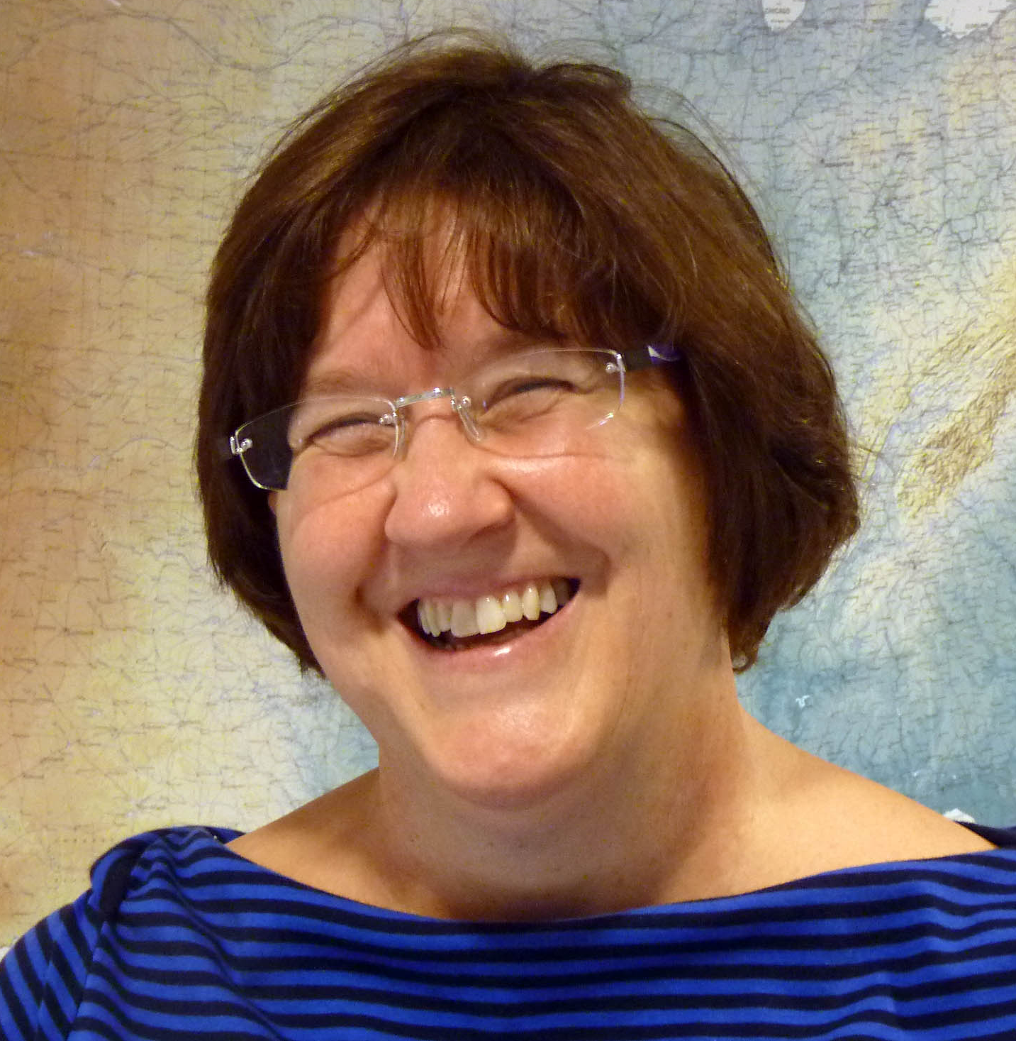
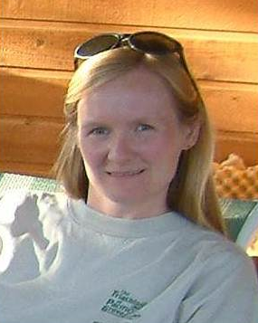

Pursuing an Academic Career in the Geosciences Webinar Series
Heather Macdonald
Department of Geology
College of William & Mary
Elizabeth Ritchie
Department of Atmospheric Sciences
University of Arizona
Molly Kent
SERC
Notes:
Different perspectives

Slide 2

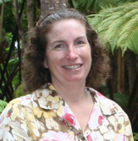
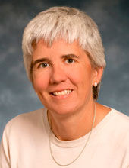
Early career negotiations: Negotiating for what you need to be successful
Christopher Thorncroft, Chair
Dept of Atmospheric & Environmental Sciences
University at Albany, SUNY
Julie Bartley, Chair
Department of Geology
Gustavus Adolphus College
Kate Miller, Dean
College of Geosciences
Texas A&M University
Notes:
Different perspectives

Slide 3
Overview of Webinar
The offer process and key players
Q&A regarding the players
Negotiations: Salary, startup, and other considerations
Q&A regarding negotiations
Other advice, information & Information-gathering
Discussion and Q&A
A few examples of information and other resources
Note: different perspectives

Slide 4
Negotiations
Negotiations start during the interview
In particular, be ready to discuss start-up needs during the interview

Slide 5
Negotiations
Receiving an offer for a faculty position is a BIG deal!
An offer will likely be made clear at the time you are offered the job.
The offer will consist of a salary and a start-up amount.
Be aware that a written offer will likely not be made until the negotiations are completed and you have agreed to the offer.
Internationally, there may be differences
Notes:
Liz will speak to the international perspective

Slide 6
Negotiations
Who are the players?
YOU
THE CHAIR
THE COLLEGE DEAN
THE PROVOST

Slide 7
Negotiations – key points about the players
YOU: Clearly you wish to get the best deal for you personally and you hope to achieve this without getting off on the wrong foot with your future boss.
CHAIR: The Chair, together with the faculty, have chosen YOU. This is important to remember. The Chair should have your best interests at heart since the Chair is keen to recruit you. Depending on the institution key discussions
and negotiations can take place between YOU and the Chair.
DEAN: The Dean also wants to help the Chair to recruit YOU.
The Dean will usually set the limits for salary and start up. At some institutions key discussions and negotiations
take place with the Dean.
PROVOST: The Provost also influences the budget side of the offer and
must ultimately agree to the offer and hire. If for some reason the offer moves beyond the limits the provost may have to be
involved.
Notes:
As the department chair is negotiating with you, s/he may also be negotiating with his/her dean re. salary and startup.

Slide 8
Q&A
Other perspectives
Variations across institution types
Roles of the players
How to navigate the particulars of your situation
What questions do you have?
Please type your questions or comments into the chat box.
Notes:
Liz will ask for other perspectives. Julie, then Kate.

Slide 9
Negotiations – what needs to be agreed
Salary and Start-up are the two major items to be agreed
Starting salary – including how many months this is for. It is important for you to know how many additional months of salary you can have in the summer. While the salary is negotiable – the months it is for will not be.
Note that it is NOT in the interest of the Chair to beat you down here. Ideally you should have an open discussion about this with the Chair.
You should be aware, however, that the Department does have a pay structure that the Chair or Dean may be reluctant to disrupt.
Do your homework –
  Sources include Chronicle of Higher Education, other institutional websites, salaries at public institutions are usually on the web somewhere
  Salary structure at regional universities, liberal arts colleges etc. may be lower
  Be aware of cost of living (e.g. urban California vs. small college town), cost of living calculators can be found on the web
Notes:
Kate could add comments on the homework point if needed

Slide 10
Negotiations – what needs to be agreed
(ii) Start-up – this can cover many things including the following:
computer hardware and software needed for your research
lab facilities (if appropriate) and lab technicians
key instruments for your research if appropriate
faculty development (e.g. travel, page charges, professional membership)
graduate student support (RA, TA, endowed fellowships)
undergraduate student support
summer salary (since you may not have a grant by your first summer)
office furniture (sometimes needs to be included)
institutional membership in a research consortium
some departments have shared assets that will benefit from start-up funds
institutional matching funds for external grants
pre-tenure research leave
The major aim here is to ensure that YOU can start work on day 1. What do YOU need to ensure this happens? You can be frank with the Chair or Dean about your needs but they should be reasonable.
Notes:
Kate made several interesting points today and could speak to those at the end of this slide
- For

Slide 11
Negotiations – other considerations
Other topics for potential discussion and agreement:
(i) teaching load
(ii) probationary period (tenure clock)
(iii) starting date –
flexibility over starting a year later – to do a postdoc for example
starting in Spring may be a disadvantage at some places, in others it’s an advantage
(iv) moving expenses
(v) spousal/partner issues
(vi) visa issues
(vii) maternity/paternity/parental leave
(viii) child care options
(ix) Benefits and pensions – not negotiable but helpful to know details
You should feel comfortable to raise any questions about the job that you have been offered.
Get it in writing (including details)
Notes:
Actually, spring semester can be a good start time, if that give you another 9 months on the tenure clock, as it does at both universities that I’ve worked for.
Be sure you understand the length of your probationary period
Information on family leave, benefits, tenure clock policies, even spousal placement policies are often on the institutional website.

Slide 12
Q&A
Other perspectives
Variations across institution types
Salary, startup, other negotiations
How to navigate the particulars of your situation
What questions do you have?
Please type your questions or comments into the chat box.
Notes:
Liz with frame, Kate then Liz,
The startup package isn’t a competition for who can get the most $$s. No reason to be greedy. Your start up package ask should include other considerations such as existing assets/lab facilities at the university. Generally, assistant professors struggle to spend all their start up money in the allotted three year time period. Lab technicians can be ask for – but are likely to be time-limited, if possible. Sharing with other faculty members should be considered.

Slide 13
Negotiations – more advice
This has to depend on individuals but remembering that the Chair really wants you to be happy with your offer – you should feel comfortable discussing all aspects of the offer and, ultimately, to trust them.
Some faculty feel that they have to ask for more but some chairs may feel that the first offer is their best offer (to avoid the “game”). If the offer is a good one YOU should not feel bad.
To enhance your “comfort-level” I think it is appropriate to have discussions/contact with other members of faculty in the Department and especially if you know them. The Chair should encourage this.
Talk with peers about their start-up packages, equipment, space, recommendations, and so forth.

Slide 14
Spousal/partner hires – when to bring it up?
Early – Pros
  If the faculty really wants you, it gives the chair, dean, and provost more time to think about how to accommodate you and your spouse/partner
Early – Cons
  Less progressive faculty members may use this knowledge to subtly weed you out of the pool.

Slide 15
Spousal/partner hires – strategies
If it’s the same field – apply together
Give the search chair a call, to see if a spousal hire is even viable, before you apply
Search the web to see if the University has had an ADVANCE Institutional Transformation grant.
At the interview, let the search chair/ department chair know about your needs.
Notes:
Different views on some of these points

Slide 16
Tenure criteria
Make sure you have a full understanding of the tenure criteria for the department you are joining. Are the tenure criteria written down anywhere in a policy?
Is there a third year (pre-tenure) review process?

Slide 17
Negotiations – improving one’s lot!
Work to get an appropriate salary up front
Ask for targeted one-time funds to advance new directions for your research/education agenda
Choose a department with a collegial atmosphere, then play on the team
Take on significant service roles – at a price
Later negotiations – outside offers, retention negotiations, tenure time (after you receive tenure), administrative appointments
Notes:
Perhaps Kate could speak to this

Slide 18
Discussion
Other perspectives
Variations across institution types
Words of wisdom
What questions do you have?
Topics we addressed
Other topics related to negotiations
What suggestions do you have about negotiating?
Please type your questions or comments into the chat box.
Notes:
A word of wisdom from each presenter, think about what is the word of wisdom and what is the order (include Heather and Liz in this)

Slide 19
Examples and links to other resources
These last few pages provide some examples of the types of resources you can search for at different colleges and universities
Remember, the more informed you are, the more effectively you can negotiated for yourself and ensure you end up in a position you are happy with

Slide 20
Example: AAUDE Salary Data 2011-2012* (mean salaries)
Field | Faculty Rank | Texas A&M Peer Group (9 months)
Atmospheric Sciences | Professor | $129,190
 | Associate Professor | $92,102
 | Assistant Professor | $81,515
Geography | Professor | $130,597
 | Associate Professor | $86,306
 | Assistant Professor | $73,460
Geology and Geophysics | Professor | $127,974
 | Associate Professor | 86,871
 | Assistant Professor | $75,130
Oceanography | Professor | $135,648
 | Associate Professor | 77,687
 | Assistant Professor | $69,959
* Source: http://dars.tamu.edu/Data-and-Reports/Faculty#aaude
Notes:
What is American Association of Universities Data Exchange, point out that the assistant prof are not starting salaries

Slide 21
Example FMLA Policy: Texas A&M System
Eligible employees may be granted up to 12 workweeks of family and medical leave during a fiscal year or up to 12 workweeks of parental leave as described in System Regulation 31.03.05. Any family and medical leave or parental leave runs concurrently with any paid and/or unpaid sick leave used.

Slide 22
Example Guidelines For Parental Leave for the Birth or Adoption of a New Child*
The College of Science, and its departments, have a vested interest in the long term productivity of their faculty. For long-term faculty, departments are encouraged to be flexible in dealing with temporary interruptions in normal service.
Therefore, to the extent possible departments should work with faculty to arrange one / two semester(s) of teaching relief for the birth or adoption of a new child for any eligible faculty member.
Eligible faculty members are those that are either tenure-track, senior lecturers or have worked 5 out of the last 7 years for the department and will be the primary caregiver for the new child.
Faculty can, of course, take available and appropriate leave under FMLA. The faculty member may be assigned modified duties for any time not covered by that leave in order to meet teaching workforce reports.
A tenure-track faculty member can request an extension of the tenure clock due to the birth or adoption of a child. The College of Science will be supportive of any such request.
*Source: Texas A&M College of Science

Slide 23
Example Tenure Clock Extension Policy – Texas A&M
Extensions to the probationary period may be granted upon petition by the faculty member, recommendation by the Department Head and Dean, and approval by the Dean of Faculties.
Extensions are usually for one year, but a longer period may be requested in compelling circumstances. Any extension greater than one year must be approved by the Provost. A faculty member may petition for an extension in the following cases:
The faculty member is taking leave without pay, or a reduction in service to 50% time for a semester or academic year, provided the leave is not taken solely for the purpose of pursuing activities that will enhance the faculty member’s qualifications for tenure and promotion.
The faculty member has encountered circumstances that may seriously impede progress toward demonstration qualification for the award of tenure and promotion. Such circumstances might include (but are not limited to):
  serious illness or injury
  having responsibility for the primary care of an infant or small child
  having responsibility for the primary care of a close relative who is disabled, elderly or seriously ill
  any serious disruption of the probationary period for unexpected reasons beyond the faculty member’s control.

Slide 24
Useful Negotiation References
Getting to Yes: Negotiating Agreement Without Giving In by Roger Fisher, William Ury, and Bruce Patton
Ask For It: How Women Can Use the Power of Negotiation to Get What They Really Want by Linda Babcock and Sara Laschever
COACh workshops for women scientists and engineers
On the Cutting Edge: Negotiating for What You Need to be Successful: http://serc.carleton.edu/NAGTWorkshops/careerprep/jobsearch/negotiating.html
Please type your questions or comments into the chat box.
Notes:
Perhaps Kate could speak to this

Slide 25
Pursuing an Academic Career in the Geosciences Webinar Series
Networking for Academic Careers
May 16, 2013 (Wednesday) Tracey Holloway, University of Wisconsin
25

Slide 26

Thank you!
We’re glad you were able to join us today.
Please help us by completing an evaluation form (we will send you the link).
http://nagt.org

