Slide 1
Pursuing an Academic Career Webinar Series
Developing a thriving research program and balancing it with teaching, service and other passions
May 2, 2012
Audio access: Call in 1-800-704-9804
Access code:
Alternate number: 1-404-920-6604 (not toll-free)
Please mute your phone by pressing *6
Technical problems?
Contact Monica: mbruckne@carleton.edu
Program begins at:
2 pm Eastern | 1 pm Central | 12 pm Mountain | 11 am Pacific
You can find information about the event at
http://serc.carleton.edu/NAGTWorkshops/careerdev/AcademicCareer2012/may_2012.html

Slide 2
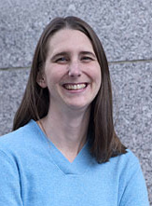
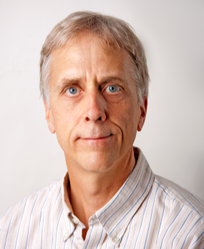
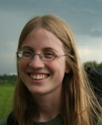
Pursuing an Academic Career
Series conveners and moderators
Prof. Rachel Beane
Bowdoin College
Prof. Mike Williams
University of Massachusetts, Amherst
Monica Bruckner
Science Education and Resource Center (SERC)

Slide 3
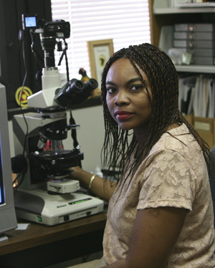
Developing a thriving research program and balancing it with teaching, service and other passions
Guest Co-Presenter
Prof. Francisca Oboh-Ikuenobe
Missouri Univ. of Science and Technology

Slide 4
Webinar overview
Strategies for developing a research program
  Expectations
  Strategic planning
  Initiating a project
  Funding
  Collaborations
  Research with students
Starting to prepare your faculty research
program while a grad student or post-doc
Balancing a research program with teaching, and other responsibilities and interests

Slide 5

Where do you – or would you like to – develop your research program?
2-year (community) college
4-year liberal arts college
Research oriented university
Research associate / post-doc
Research in industry

Slide 6
Expectations
Know the expectations for research success in your institution
Knowing the expectations will help you establish realistic goals and aligning your goals with those of your institution.
What is expected for tenure, mini-tenure,
pre-tenure…?
Discuss expectations with Department Head, Personnel Committee, Mentoring Committee
This should be an on-going discussion, each semester, each year…

Slide 7
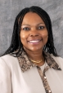
Expectations
Typical Expectations
funding? publications? students?
Three examples
University of Massachusetts, Amherst
Public university with Ph.D. program
Missouri Univ. of Science & Technology
Public university with Ph.D. program
Bowdoin College
Private 4-year college

Slide 8
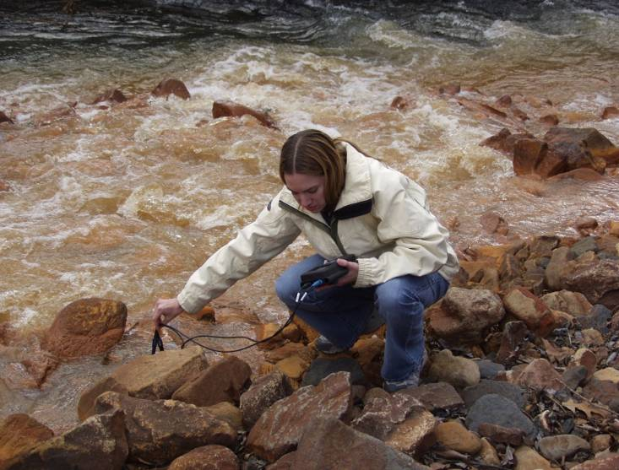
Your own expectations
for research success
A major source of stress comes from unreasonable and overambitious expectations… We all do it!
Try to balance your research, for example
Large field-oriented project
Collaboration
Smaller project
Pilot project

Slide 9
Be strategic with your research
You’ll want to establish a realistic & achievable research plan. To accomplish this, consider a short-term plan and a 5-year plan, and be prepared to adjust your plans.
Develop a plan based on your goals
Implement/reformulate your plan
Disseminate the results
Following 3 slides modified from Richard Yuretich slide as found at
http://serc.carleton.edu/NAGTWorkshops/earlycareer/research/plan.html

Slide 10
Be strategic with your research
Develop a plan
Project goals
Plan to obtain facilities or instruments or conduct field research
Available
Resources
Needed
Resources
Plan to recruit students & collaborators
Notes:
Richard Yuretich slide
For webinar, might be broken into multiple slides

Slide 11
Be strategic with your research
Develop a plan
Project goals
Plan to obtain facilities or instruments or conduct field research
Available
Resources
Needed
Resources
Plan to recruit students & collaborators
Implement your plan
Write & submit
proposals
Revise & resubmit
Begin field work
And/or
Set up laboratory
Conduct Research
Recruit collaborators
as needed
Recruit students
Notes:
Richard Yuretich slide
For webinar, might be broken into multiple slides

Slide 12
Be strategic with your research
Develop a plan
Project goals
Plan to obtain facilities or instruments or conduct field research
Available
Resources
Needed
Resources
Plan to recruit students & collaborators
Implement your plan
Begin field work or
Set up laboratory
Write proposals
Conduct Research
Disseminate the results
Formal Publications
Web Sites
Initial
Presentations
Ph.D. Dissertations
Student Projects
Honors & M.S. Theses
Independent Studies
Notes:
Richard Yuretich slide
For webinar, might be broken into multiple slides

Slide 13
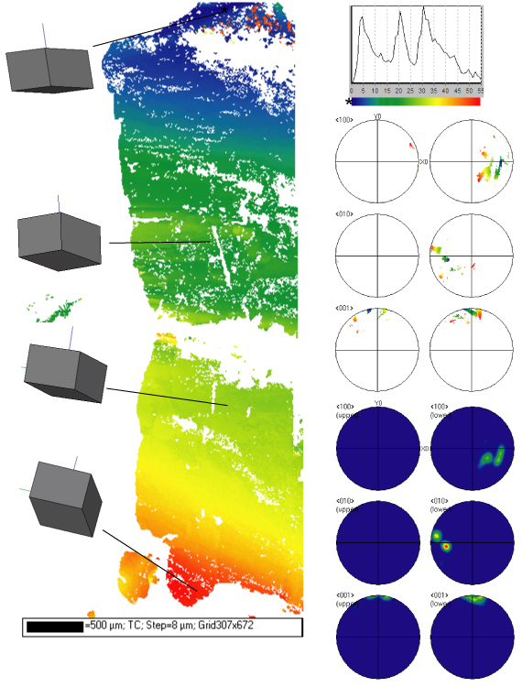
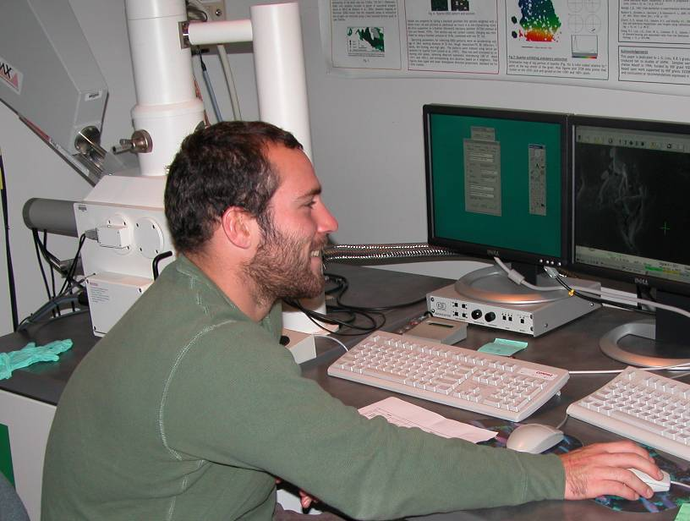
Example of a strategic research plan
Consider goals
Research: Use mineral microstructures to interpret
solid earth processes
Teaching: Establish laboratory used by undergraduates
Personal: Develop collaborations & reduce travel
Write proposals to acquire instrumentation
Submit NSF proposal for SEM-EDS
Submit NSF proposal for EBSD
first proposal declined, used sabbatical to gain
experience and resubmit for funding
Set up lab and conduct research
Undergraduate research & course use
Collaborative projects
Funding through small internal & external grants
Publish with undergraduates & collaborators
Notes:
Will include photo of students in lab
(at the time only solid earth profesoor in dept) through collaborations. Gain EBSD expertise in geoscience applications. Invite collaborators to my lab, rather than always traveling to other labs.
Step 1: Acquire instrumentation
Submitted NSF grant for SEM-EDS instrumentation 1st year at institution – successful
Submitted NSF grant for EBSD (3rd year) – declined (no experience, untested method)
Junior sabbatical University of Liverpool (4th year) - gained experience with EBSD
Submitted NSF-MRI grant for EBSD (5th year) – successful
Step 2: Set up EBSD lab (same year as submitted tenure material and gave birth to first child)
Step 3: Research, research collaborations, teaching exercises (ongoing, included EBSD symposium that helped establish connections) Funding for lab supplies and student summer support through collaborations and small internal and external grants
Maybe modified text for some oral/some written
http://serc.carleton.edu/NAGTWorkshops/earlycareer/balance/casestudies.html

Slide 14
Initiating a New Research Project
Q. “What are some strategies to establish and grow/diversify a research program, particularly in a new area or field? Is it more effective to initially focus on research projects at a smaller scale and/or scope and allow the program to branch out over time, or to establish the program on broad concepts and narrow down as the research progresses?”

Slide 15
Initiating a New Research Project
Q. “What are some strategies to establish and grow/diversify a research program, particularly in a new area or field? Is it more effective to initially focus on research projects at a smaller scale and/or scope and allow the program to branch out over time, or to establish the program on broad concepts and narrow down as the research progresses?”
Q. “When should I decide to begin a new research topic?”

Slide 16
Initiating a New Research Project
Q. “What are some strategies to establish and grow/diversify a research program, particularly in a new area or field? Is it more effective to initially focus on research projects at a smaller scale and/or scope and allow the program to branch out over time, or to establish the program on broad concepts and narrow down as the research progresses?”
Q: :”When should I decide to begin a new research topic?”
Funding a large, first-time project can be difficult. Try to get some initial results…

Slide 17
Initiating a New Research Project
Q. “What are some strategies to establish and grow/diversify a research program, particularly in a new area or field? Is it more effective to initially focus on research projects at a smaller scale and/or scope and allow the program to branch out over time, or to establish the program on broad concepts and narrow down as the research progresses?”
Funding a large, first-time project can be difficult. Try to get some initial results…
Pilot Project
Collaboration
Student project

Slide 18
Initiating a New Research Project
Q. “What are some strategies to establish and grow/diversify a research program, particularly in a new area or field? Is it more effective to initially focus on research projects at a smaller scale and/or scope and allow the program to branch out over time, or to establish the program on broad concepts and narrow down as the research progresses?”
Funding a large, first-time project can be difficult. Try to get some initial results…
Pilot Project
Collaboration
Student project
An exciting initial result goes a long way!

Slide 19
Funding Your Research
Q. “How do you make sure there is a long-term funding source?”
Q. “Where do you find funding for 2-year colleges?”

Slide 20
Funding Your Research
Start Small
Internal grants at your institution
NSF SGER (“Small Grants for Exploratory Research”)
Small collaborative addition to another grant

Slide 21

Funding Your Research
Start Small
Internal grants at your institution
NSF SGR
Small collaborative addition to another grant
Full-scale proposals
Plan ahead
Read the solicitation and proposal guide
Internal resources at your institution
Talk to (visit) NSF Program Directors
Collaboration!
Broader Impacts… Very Important!

Slide 22
Funding Your Research
Start Small
Internal grants at your institution
NSF SGR
Small collaborative addition to another grant
Full-scale proposals
Plan ahead
Read the solicitation and proposal guide
Internal resources at your institution
Talk to (visit) NSF Program Directors
Collaboration!
Broader Impacts… Very Important!
Opportunities outside of NSF
USGS (StateMap, EdMap…)
IODP, NASA, NOAA,…
Petroleum Research Fund
State sources (NYSERDA… )
Companies (Mining, petroleum, consulting)

Slide 23

Funding Your Research - 2
Budget:
Many NSF Program Directors will say “Don’t worry about the budget… ask for what you need”.
There are reasons to keep it modest the first few times…

Slide 24
Funding Your Research - 2
Budget:
Many NSF Program Directors will say “Don’t worry about the budget… ask for what you need”.
There are reasons to keep it modest the first few times…
Other Thoughts:
Many proposals are declined the first time
Try Again…
Talk to your Program Director!
In many institutions: submitting proposals counts!

Slide 25

Funding Your Research
What questions do you have about funding your research?
What suggestions can you share about funding?
Please type your questions & suggestions in the chat box.

Slide 26
Collaboration
Collaborative research takes place between scholars with assigned roles of conducting research
May be simple (between a few researchers) or complex (among several multidisciplinary teams); may be an informal or formal relationship; may be between academia and industry
Consider establishing good professional collaboration early in your career
  How should it start?
  With whom?
  What are the expectations?
Positive collaboration will likely benefit from
  Clearly delineating roles and responsibilities
  Developing effective management plans
  Fostering a high level of cooperation
  Developing trust, collegiality, fairness and accountability
How can this positive collaboration be ensured?

Slide 27
Collaboration
Critical issues identified by Shamoo and Resnik (2003)* for establishing successful research collaboration
Establishing critical research roles and responsibilities
  Who is responsible for what?
  What will the responsibilities entail?
  How well will this information be communicated to members of the research team?
  Accountability and responsibility are both important in research, but it is also important to keep them distinct
Deciding on the extent of the collaboration
  Determined by his/her capability of handling assigned role and responsibilities, interest in pursing a particular area of research with other investigators, and availability to serve in the project
*Shamoo, A.E., and Resnik, D. (2003). Responsible Conduct of Research. Oxford University Press, Inc., Oxford .

Slide 28
Collaboration
Selecting funding sources
  Determined by funding source preferences, nature of the research, researcher(s) who will submit the proposal, funding trend, nature of the funding source, duration of funding, etc.
Disclosing conflicts of interest
  Conflicts of interest (COI) are coexisting and competing obligations and interests. Avoid financial gain, work commitments, and intellectual and personal matters.

Slide 29
Collaboration
Agreeing on resource sharing
  Items necessary to support completion of the stated research goal(s), such as funding, personnel (e.g., research and administrative), data (e.g., preliminary and final), equipment (e.g., specialized, diagnostic, administrative), and even ideas generated from the research.
Clarifying intellectual property issues
  Each member of a collaborative team should be familiar with the existing intellectual property arrangements at their respective institutions, and how these arrangements may affect the collaborative relationship.
Determining authorship
  Collaborators should agree and decide on the allocation of credit in order to determine who will contribute to the writing effort. Specifically, who will participate in drafting and submitting the research findings, how will the authoring position be determined, and what journals are deemed appropriate choices for submission.

Slide 30
Collaboration
Memorandum of understanding
  Consider an MOU, which is a written documentation of a set of agreements and expectations between two or more parties. Not regularly used in research settings between collaborators.
In summary……..
Go outside your comfort zone occasionally and choose your collaborators carefully.
Your chances of obtaining competitive research grants are higher, and so will be your research and publication productivity

Slide 31
Involving Students in Your Research
Undergraduates and Graduates
Q. “How diverse (in terms of scientific topics) should your program be? What's the expected number of undergrad, masters, and PhDs various types of institutions look for?”
Q. “What are the best methods for managing students? How do I not let management overwhelm or seep into other academic commitments?

Slide 32
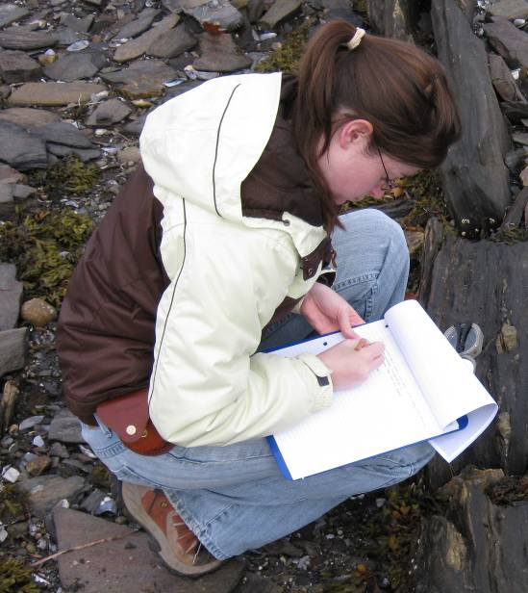
Involving Students in Your Research
Undergraduates and Graduates
Undergraduate students
The goal of (undergraduate) student research is for the student to learn how research is accomplished and to conduct their own research.
…not necessarily to contribute to high-level research.
The student will need guidance to understand the problem, purpose, methods, and potential resolution.
Choosing the right project is everything!
Successful projects often investigate significant rather than trivial problems.
Some are worthy of presentation at conferences or contributions to papers.

Slide 33
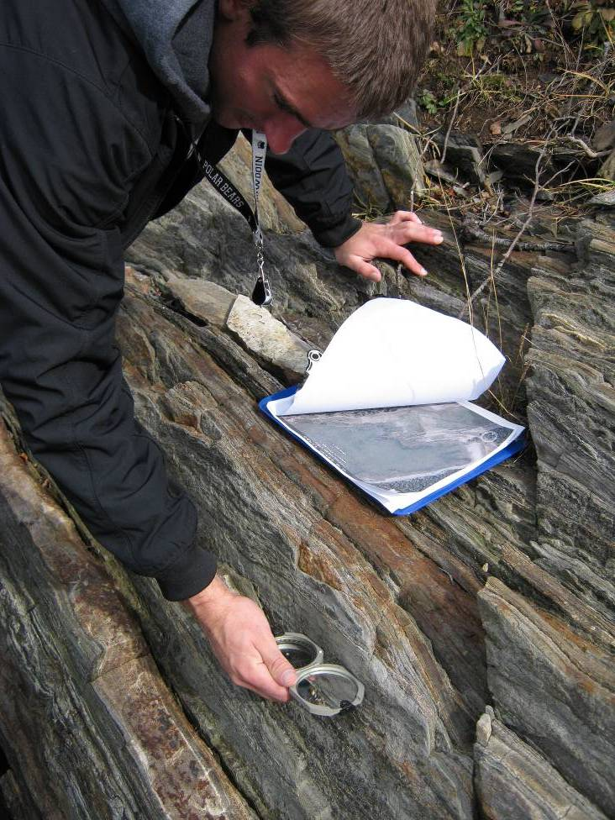
Involving Students in Your Research
Common comments
At the end of the project, I realized that the student did not really understand the initial problem we were solving…
I could have done the work in an afternoon
The student basically came to the conclusion that we started with…

Slide 34
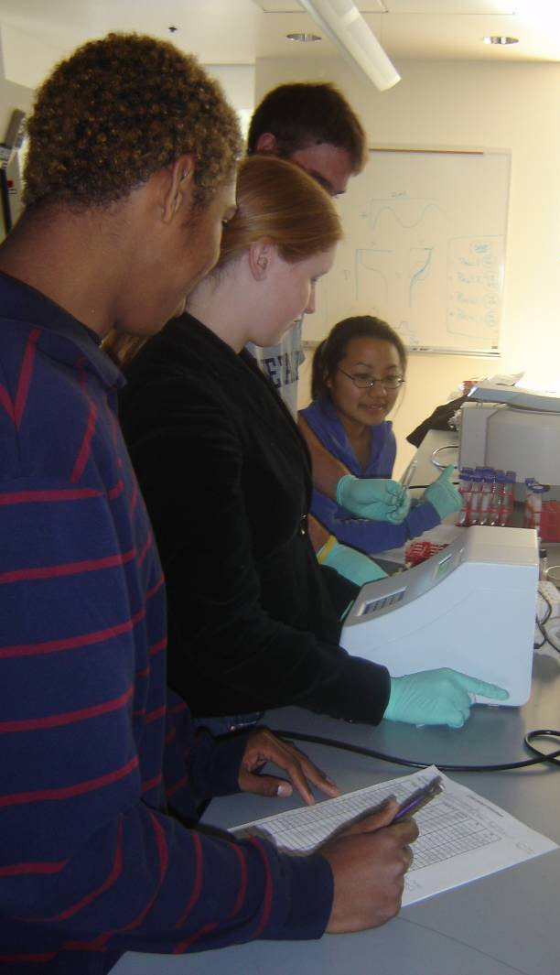
Involving Students in Your Research
Suggestions
If you are working on aspects of the students’ project, let the students help to keep you working a bit at a time…
Help the students to set deadlines and set a few for yourself.
Students can collect or process data that may be publishable… but you might need to check quality.
Think of undergraduate research as part of your teaching/mentoring that might yield useful research.

Slide 35
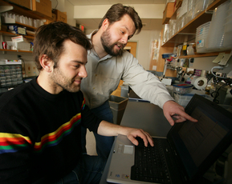
Involving Students in Your Research
Graduate-students
Grad research can be different,
…but not that different!
It is still critical to select the right project and remember that they are learning to do research.
Graduate students (especially M.S. students) can help you engage and focus on your research; they much more rarely contribute major new results and data sets…
Ph.D. students can make significant contributions, but the goal is to help them to build a career and reputation.

Slide 36
Involving Students in Your Research
Research Contracts
Make explicit expectations for both student and advisor
May include:
  Project title and overall goal
  Research and learning objectives
  Start and end date of project
  Dates to accomplish specific objectives
  Dates for training, material acquisition, field work, instrument time
  Safety considerations
  Responsibilities of student and advisor
  Deliverables (map, paper, presentation…)
  Evaluation plan

Slide 37
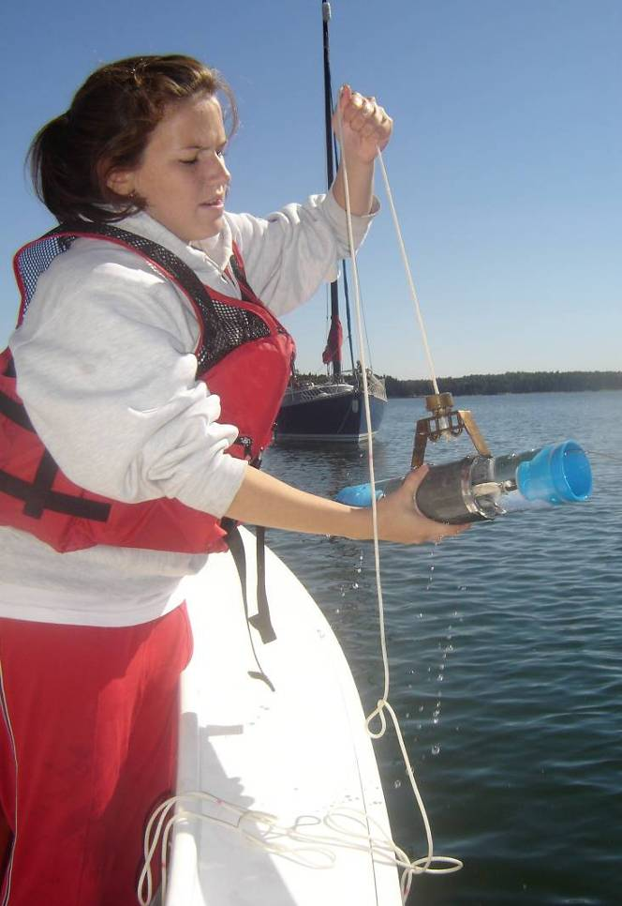
Involving Students in Your Research
If you have supervised students research projects, what advice would you offer?
What questions do you have about involving undergraduates or graduates in your research?
Please type your advice and questions in the chat box.
Additional case studies, advice, & guidelines for student research can be found at:
http://serc.carleton.edu/NAGTWorkshops/earlycareer/research/students.html

Slide 38
Getting a Head Start
Q. “What can you do while a graduate student or post-doc to jump-start your faculty research program?”

Slide 39
Getting a Head Start
What can you do while a graduate student or post-doc to jump-start your faculty research program?
Start a small pilot project outside of the dissertation research
… something that might grow in the future
Begin to establish collaborations
Attend workshops or short courses to learn new analytical techniques
Attend field trips, conferences outside of your own direct research
Many have student support
Make connections… not necessarily commitments
Submit a grant proposal

Slide 40
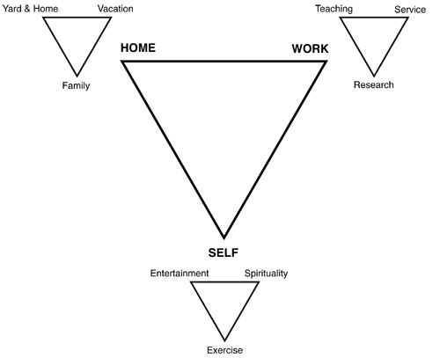
Balancing research with
teaching, service and other passions
Diagram by Paul Hoskins.
http://serc.carleton.edu/NAGTWorkshops/earlycareer/balance/hoskin.html

Slide 41
Balancing research with teaching
Advice from Early Career Workshop alum:
“As a new faculty member, I found it difficult to get a lot of research done. However, I incorporated my research into the upper-level geology classes that I offer as either full semester projects or a month-long project. This helped me to accomplish a few goals: 1) got students involved in research, which they found fun and different than other classes they typically take because this is a different, more involved learning process, 2) gave me seed data to write proposals, and 3) made me keep up on recent geology literature.”

Slide 42
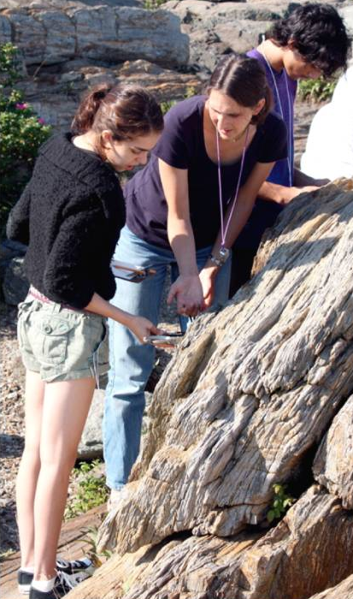
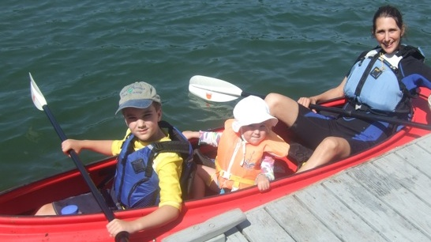
Balancing research with teaching
An example of a strategic plan to balance research & teaching & family
Goal: Develop field-based program close to campus for class & summer projects
Funding: internal, followed by NSF grant
Courses: Intro – advanced undergraduate
Publications: book chapter*, meeting presentations, papers in progress
Bonus: Field area near home fosters balance between family & research/teaching
* Beane, R.J. and Urquhart, J. 2009. Providing Research Experiences to Non-Science Majors in an Introductory Science Course. Council on Undergraduate Research.

Slide 43
Balancing research with teaching
Question from participant in this webinar:
“How do I design a research program that can be integrated into teaching?”
One suggestion: Chunk your research into smaller bits and consider how these might fit in one or more classes.
For example:
Could you design one or more labs to collect field or analytical data that might support your research?
Could you design an exercise to analyze data relevant to your research?
Could you read and discuss papers related to your research in a seminar?
Caution: The primary goal of undergraduate classes should still be student learning (not just advancing your research agenda).

Slide 44
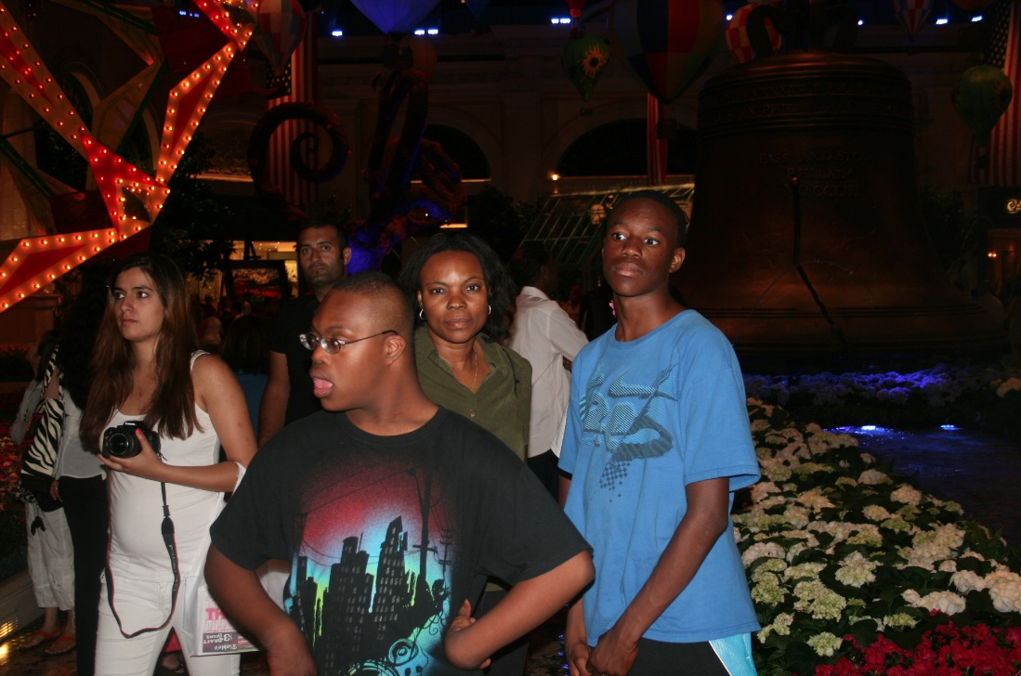
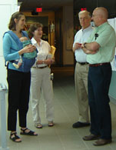
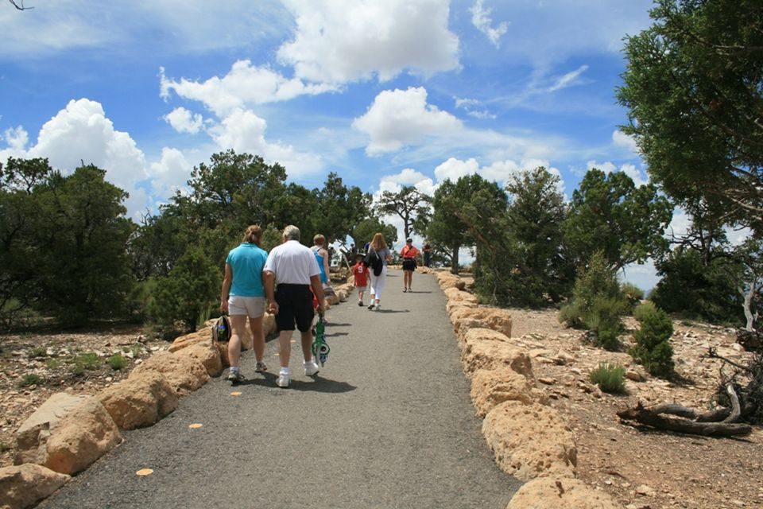
Balancing careers with other passions
What questions or suggestions do you have for balancing research, teaching & service with other passions?
Please type your questions and suggestions
in the chat box.
Additional case studies and advice on task management and balancing careers & families at:
http://serc.carleton.edu/NAGTWorkshops/earlycareer/balance

Slide 45
Online resources
Responsible Conduct of Research (RCR)
http://ori.hhs.gov/education/products/niu_collabresearch/index.html
Developing a Thriving Research Program
http://serc.carleton.edu/NAGTWorkshops/earlycareer/research/index.html
Planning a Research Program
http://serc.carleton.edu/NAGTWorkshops/earlycareer/research/plan.html
Involving Students in Research
http://serc.carleton.edu/NAGTWorkshops/earlycareer/research/students.html
Time/Task Management
http://serc.carleton.edu/NAGTWorkshops/earlycareer/balance/time.html
Finding your balance
http://serc.carleton.edu/NAGTWorkshops/earlycareer/balance/index.html

Slide 46
Thank you!
We’re glad you were able to join us today!
Please help us by completing an evaluation form at:

