Slide 1
Pursuing an Academic Career
Virtual Event Series
Faculty Positions:
exploring the range of possibilities
June 21, 2011
Audio access: Call in 1-800-704-9804
Access code: -------
Please mute your phone by pressing *6
Alternate number: 1-404-920-6604 (not toll-free)
Technical problems? Contact Monica at mbruckne@carleton.edu
Program begins at:
2 pm Eastern | 1 pm Central | 12 pm Mountain | 11 am Pacific
You can find information about the event at
http://serc.carleton.edu/NAGTWorkshops/careerdev/AcademicCareer2011/june_2011.html

Slide 2
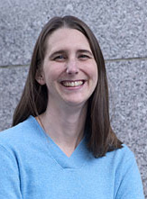
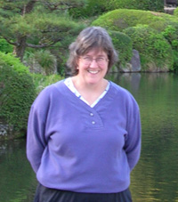
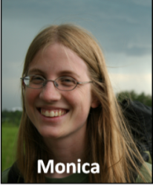
Academic Positions
Pursuing an Academic Career
Virtual Event Series
Series Conveners and Event Moderators
Rachel Beane
Bowdoin College
Heather Macdonald
College of William and Mary
Monica Bruckner
Science Education Resource Center (SERC)

Slide 3
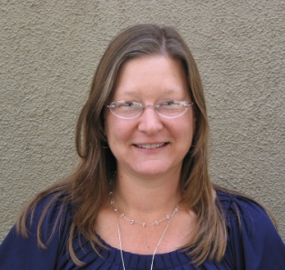
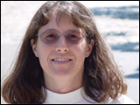
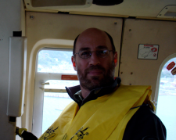
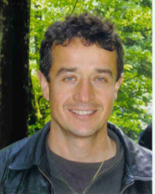
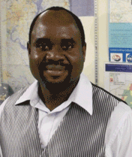
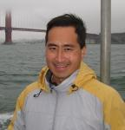
Pursuing an Academic Career Virtual Event Series
Panelists
Faculty Positions: Exploring the Range of Possibilities
Jon Lewis
Indiana University
Of Pennsylvania
Elizabeth Nagy-Shadman
Pasadena City College
Carol Pride
Savannah State
University
Rob Rhew
University of California
Berkeley
Sergio Sarmiento
Lone Star College
- CyFair
Joseph Zume
Shippensburg
University
Notes:
, advertise career prep workshop and other events in Pursuing series

Slide 4
Overview
Icebreaker
Introduction to faculty positions
Questions and Responses
  Structured questions
  Open questions
Concluding advice
Evaluation of event

Slide 5
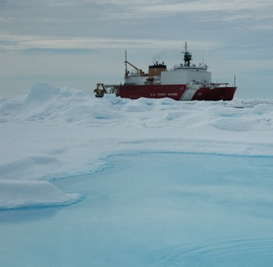
Icebreaker
LuAnn Dahlman; http://serc.carleton.edu/details/images/11673.html

Slide 6
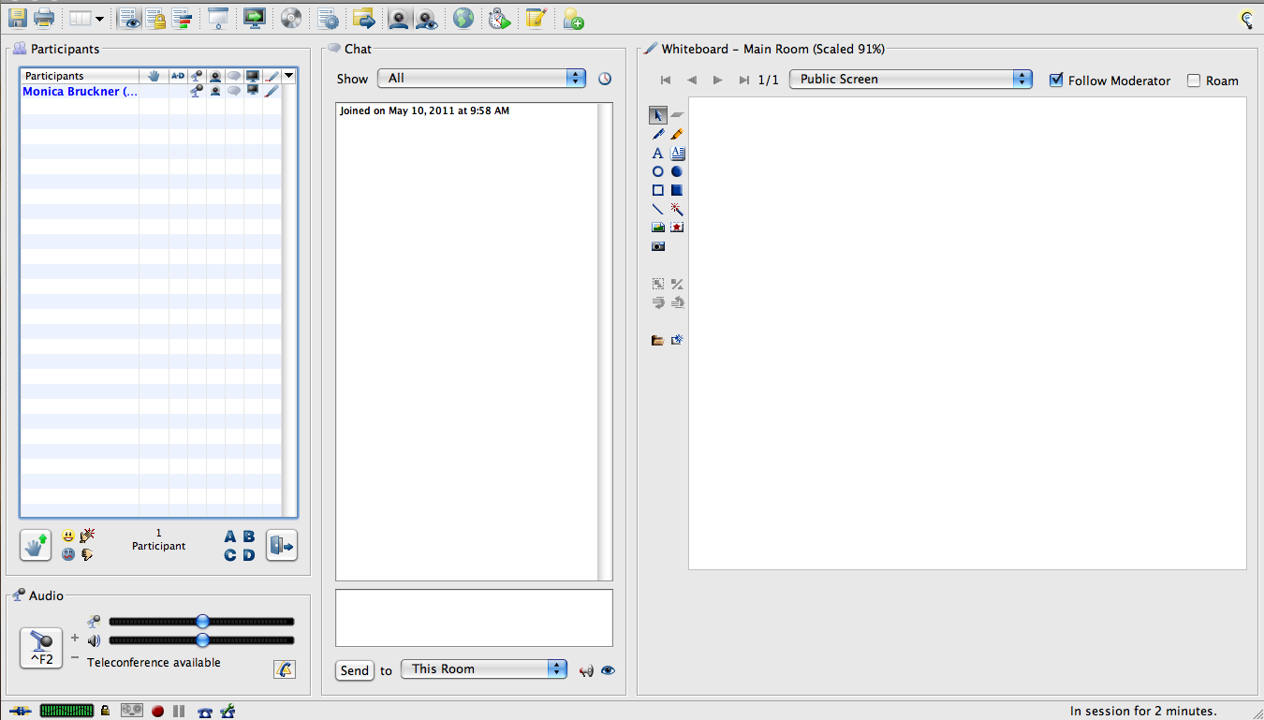
Elluminate

Slide 7

What types of institutions are you considering?
Research university
Primarily undergraduate institution
2-year college
Applying to all institutions
Not certain yet

Slide 8
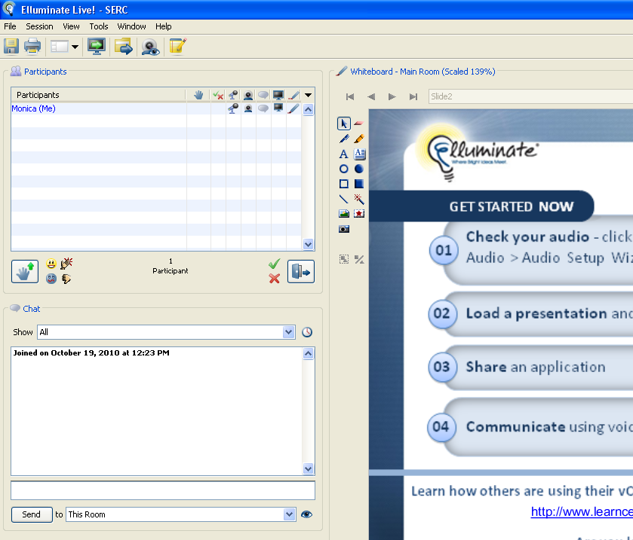
Type something

Slide 9
Question 2: Why do you seek an academic position?

Slide 10
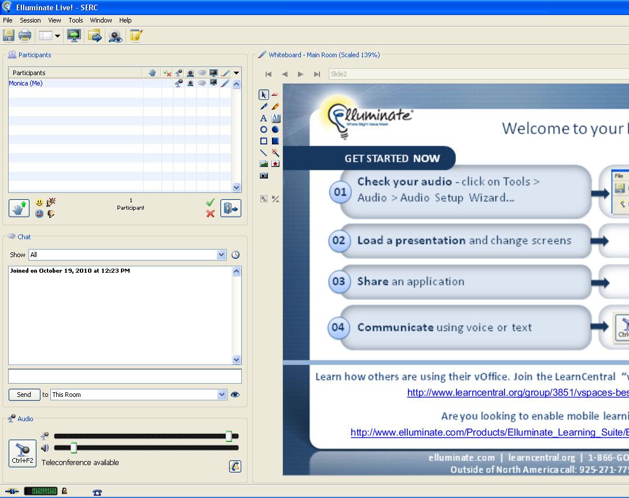
Elluminate
Notes:
On to the presentation, if you have comments or questions you can type them here or on the discussion board.

Slide 11
Introduction to Faculty Positions
Notes:
#1: No set # of papers, no secret checklist
#2: There is an incredible diversity of opportunities and roles within the academy...and beyond!
#3: There is no quick fix...everything should be a long-term investment If the foundation is not strong, the building will fail

Slide 12
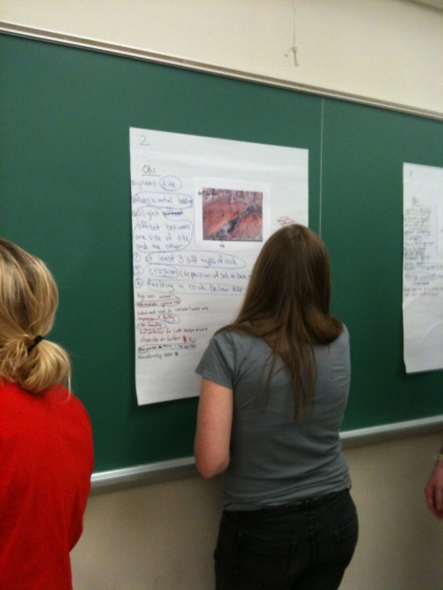
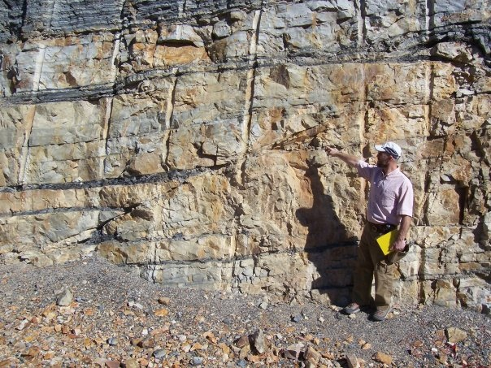
Job responsibilities
Teaching: I generally teach 12 contact hours per semester. Last semester, for example:
  Foundations of Geology (two 1-hour lectures/week, one 3-hour lab/week)
  Environmental Geology (two 1-hour lectures/week, one 3 hour lab/ week)
  Geology of the American SW Seminar (one 1-hour meeting/week)
  Independent Study (1-on-1 student meetings as necessary, ~1 hour/week)
Research: I make progress through the efforts of my undergraduate collaborators, with whom I hold weekly “lab meetings.”
Service: I contribute to university governance through committees, and to the scientific community at-large through committee work for IODP, proposal review for NSF, and journal review as requested.
Jon Lewis
Indiana University of Pennsylvania
Undergraduate Institution

Slide 13
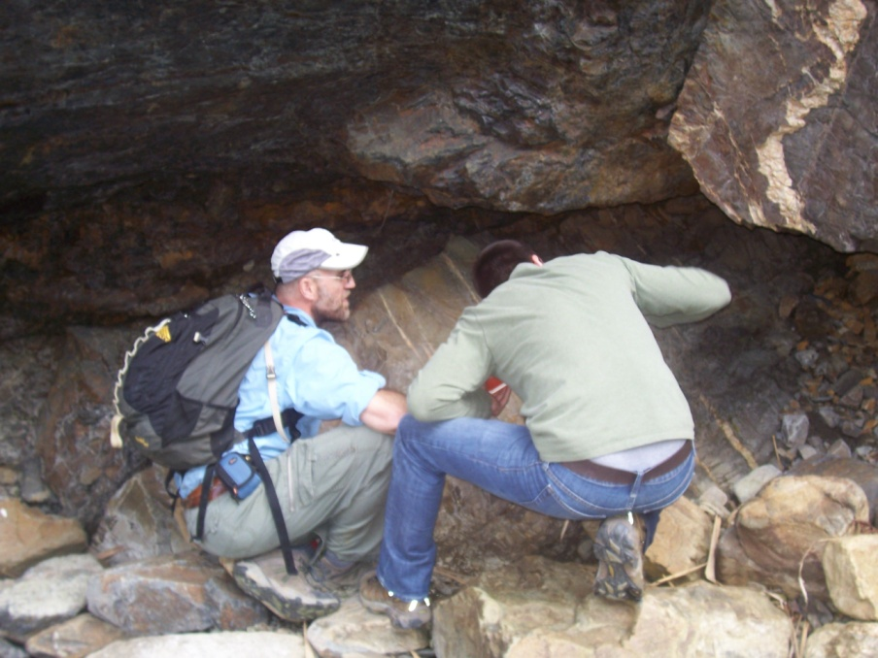
Best part
Providing a research-rich environment to help undergraduate students to become life-long learners and critical thinkers.
Jon Lewis

Slide 14

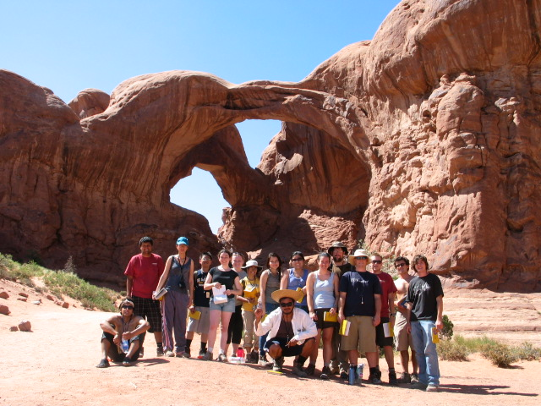
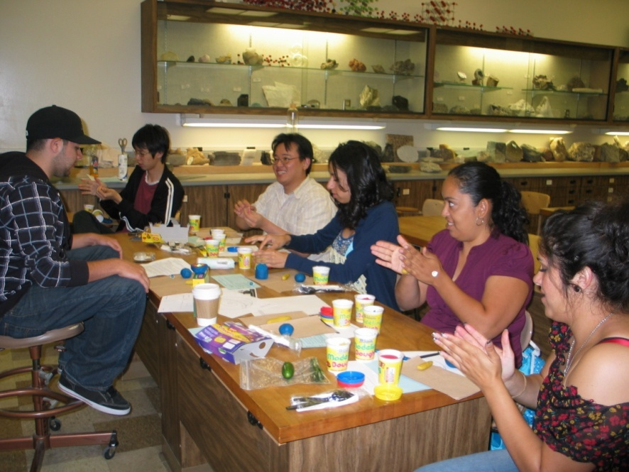
Current Job Responsibilities
Elizabeth Nagy-Shadman, Pasadena City College, 2-year college
I teach four classes each semester:
  Three classes on-campus
  (35-40 students)
  One field course
  (28 students; 4 days field work)
  Office hours (5.5 hours/week)
No research or service requirements
Fridays, summers and winters off (optional)
ALSO - perform peer evaluations (1/yr), attend Division Meetings, incorporate and assess student SLOs, and play an active role with fellow geoscience faculty regarding departmental and division issues.

Slide 15
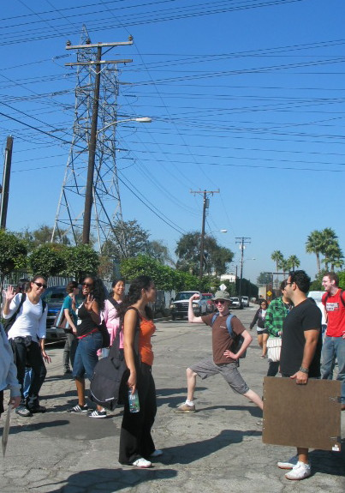
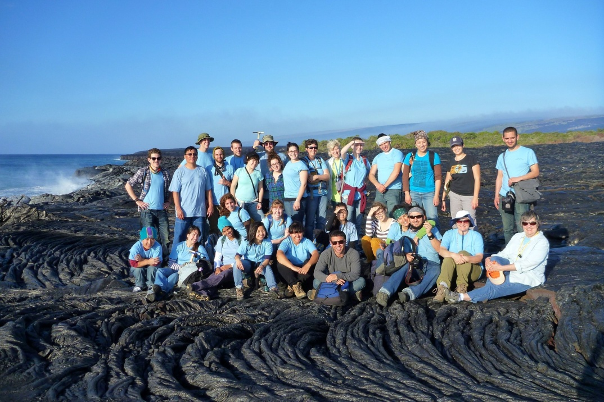
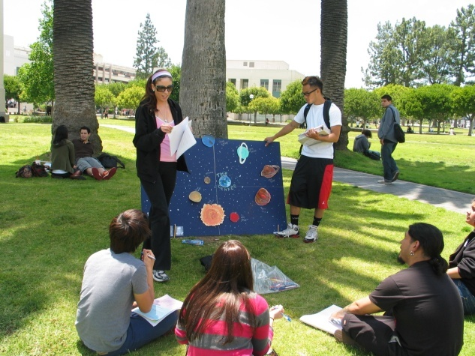
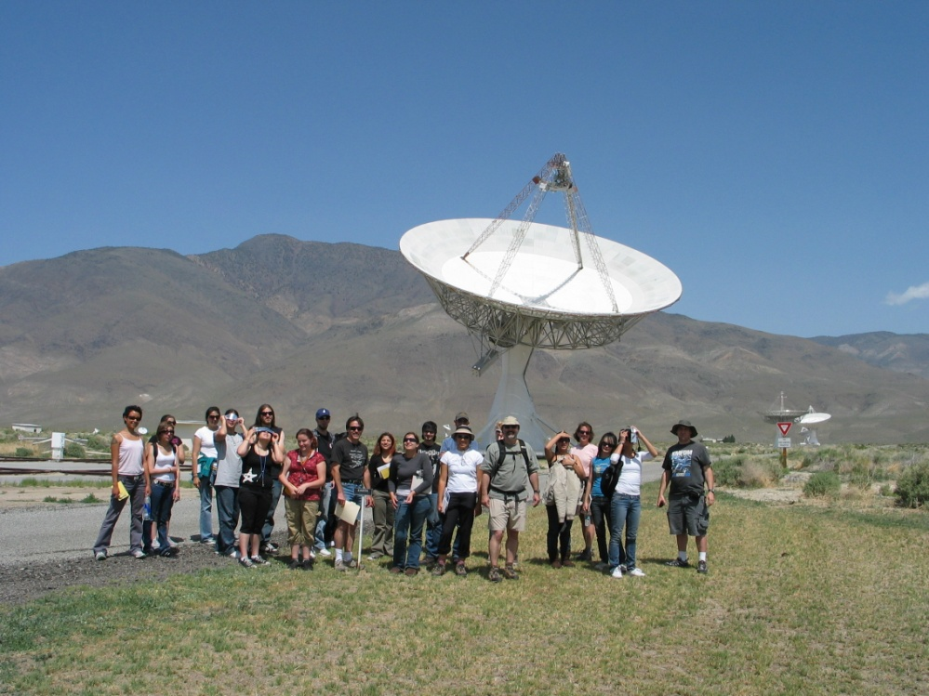
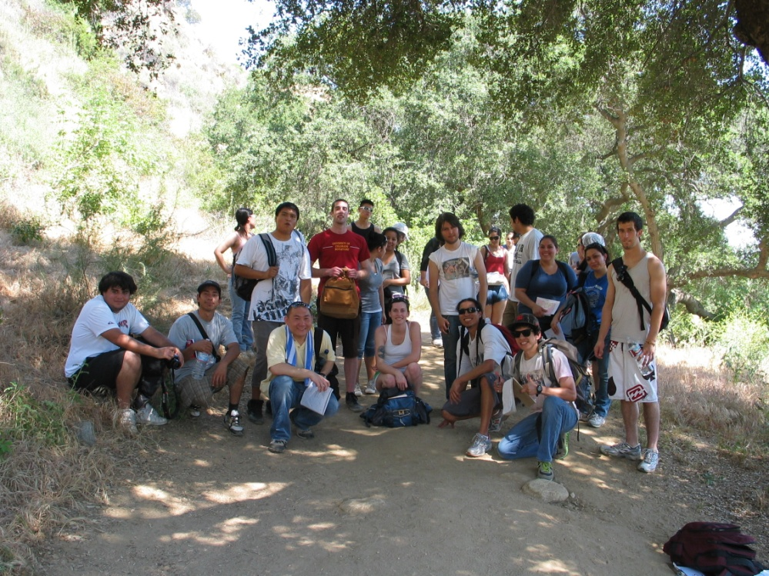
What do I like best about my work?
Elizabeth Nagy-Shadman, Pasadena City College
I TEACH THE STUDENTS AND THE STUDENTS TEACH ME!

Slide 16

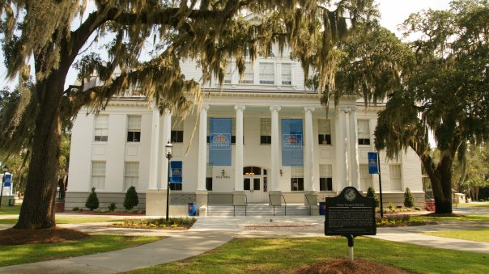
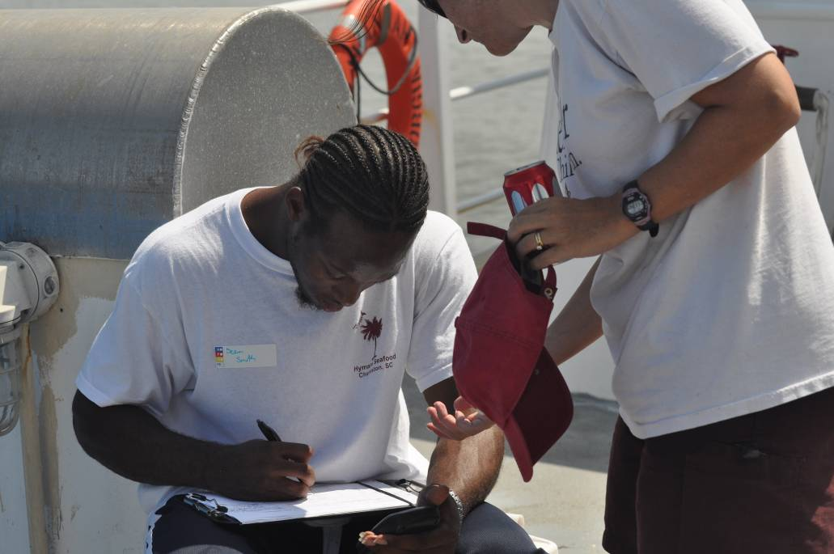
Job responsibilities
Carol Pride
Minority Serving Institution
Bachelor’s/Master’s Degrees
Savannah, GA
Teaching upper-level undergraduate and graduate courses (4-9 cr./sem. depending on release time in grants)
Managing grant programs (NSF GK-12 and OEDG)
Supervising undergraduate and master’s level research
Committee work

Slide 17
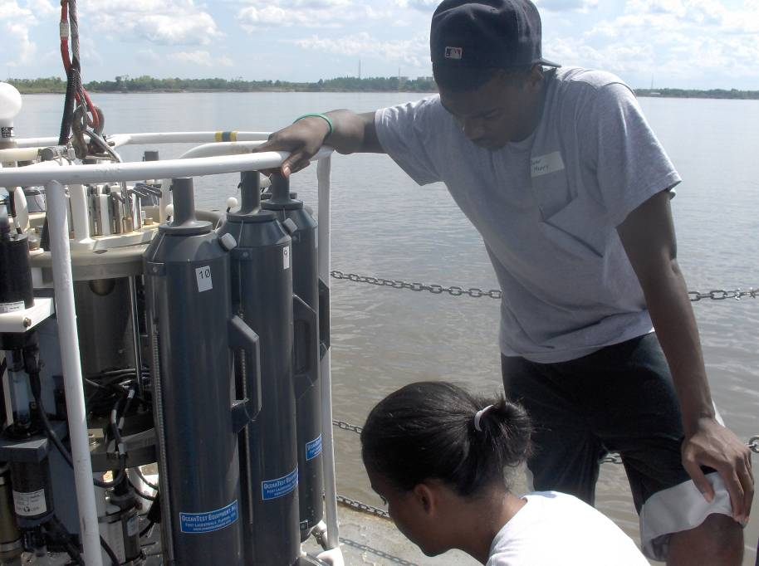
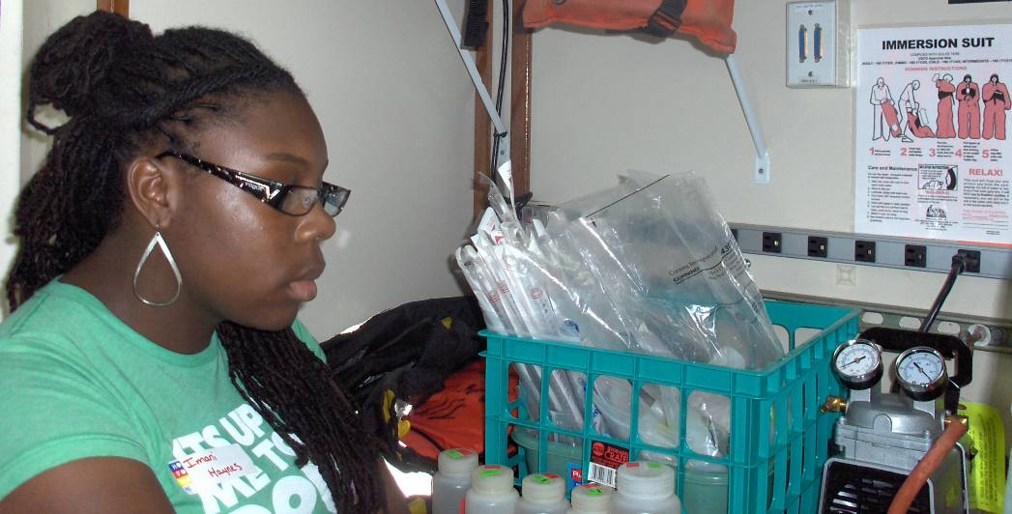
Favorite parts of job
Carol Pride
Minority Serving Institution
Bachelor’s/Master’s Degrees
Savannah, GA
Engaging undergraduates in research
Seeing students make connections between data they collected and what they learned in the classroom
Providing internship opportunities for hard-working students

Slide 18
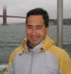
Current Job Responsibilities
1. Research
write grant proposals
write and co-author papers
discuss research with graduate students and postdoctoral fellows
research and purchase laboratory equipment
attend and give conference presentations and seminars
2. Teaching
1-2 courses per semester (pre-tenure and baby breaks)
advise undergraduate research interns (counts as teaching)
development of new courses
(try to) keep abreast of current literature – also for research
office hours and guest lectures
3. Advising and service
peer-review papers and grants
department service (undergraduate advisor, safety committee, host speakers)
outreach activities (work with Lawrence Hall of Science)
Robert Rhew, UC Berkeley, PhD granting institution

Slide 19
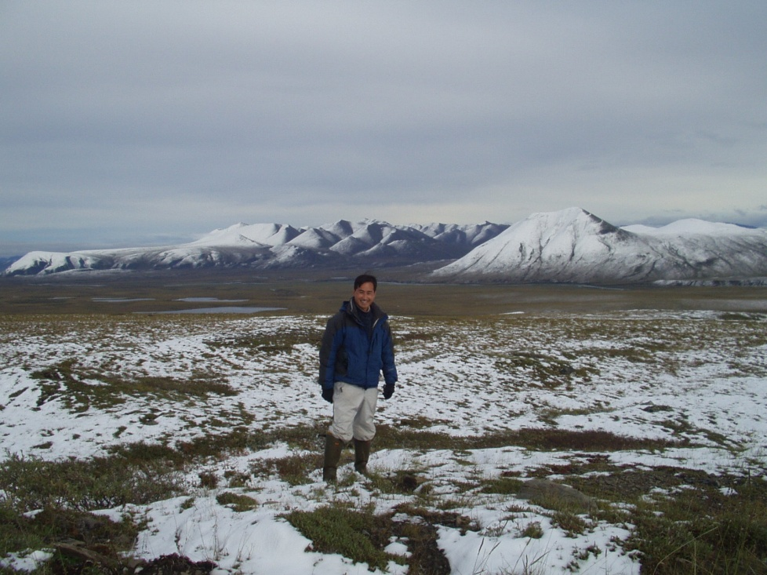
What I like best about my work
Exploring places off the beaten track, continually learning about the world around me, and interacting with bright, energetic and interesting people – as part of the job!
Robert Rhew, UC Berkeley

Slide 20
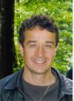
Faculty Responsibilities in a Community College
Heavy teaching load (3 full courses –Lecture and Labs per semester)
Expected involvement in student success initiatives.
Participation in institutional service through serving in college committees, community events and college wide cultural and academic events.
Interaction with students through serving as faculty sponsor of student organizations and other student life programs.
Sergio Sarmiento
Lone Star College-CyFair
Texas
2-year college

Slide 21
What I like best about my Job
Working one to one with students. Small classes
Opportunity to help, guide and motivate students to think big and plan for the careers. Many of community college students arrive without a clear direction and motivation of what they want to pursue.
Flexibility to create and modify course content to expose as many students as possible to the value of science in society.
Summer time off to rest and reflect about my work activities and teaching methodologies.
Community colleges are the best of the two worlds between the “publish or perish” tenure expectations of Universities and the discipline issues associated with High School teaching.
Sergio Sarmiento

Slide 22
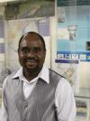
Current job responsibilities
Teaching (~ 60%)
Research (~ 40%)
Service
  University service
  Community service
  Professional service
Joseph Zume
Shippensburg University
Pennsylvania
Bachelor’s: Geography and Earth Science
MS: Geoenvironmental Studies

Slide 23
What do I like best about my job?
Engaging students in the classroom
Flexibility of the job/academic freedom
Joseph Zume

Slide 24
How do you find balance with your work and life?
“I find it very helpful to participate regularly in exercise activities that don't allow me to think about work owing to the nature of the activity. For me this has recently been mountain biking. Rock climbing, squash, and martial arts come to mind as viable options.”
“I make compromises on both the family and work end of things. For example, I may have to be away from family for several days preparing for and participating in a conference of research cruise, but when there are no major events or due dates looming, I have more flexibility in my schedule than most people and can leave work a little early on occasion to get the kids to an after school event or whatever is needed.”
“Each person is different and all depends on what one values (time, career, family, travel, etc). Always be truthful to yourself.”
“I don’t. The balance tips in various directions at different times.”
CP, ES, RR

Slide 25
What is the most challenging aspect of your work?
“The demands on my time during the semester are challenging. Sometimes the juggling of activities feels very much meta-stable.”
“Adjusting my teaching to a very academic and cultural diverse environment.”
“Management of personnel, of time, and of short and long-term goals.”
“Balancing the important long-term goals like paper writing against the immediate needs of students, grants management, and committees.”
CP, SS

Slide 26
What are the tenure requirements for different institutions?
“They vary greatly and it is critical to learn what the expectations are for your particular situation. It is also important to realize that as a committee process the details can be more fluid than you might expect.” - Undergrad Institution
“We have to be strong teachers and excel in either service (to university and community) or scholarship (grantsmanship, research, publishing, conference presentations). Publishing does not necessarily have to be at an extremely high level or rate, but you need to be active. The emphasis is on engaging students in research and preparing them for graduate school and employment in the sciences.” – M.S. institution
“At an R1 university, research activity is the most important, and you are judged not only at your department and university level, but also by a group of anonymous external reviewers who write letters of assessment on your case.”
JL, RR

Slide 27
What did you find most surprising when you started your position?
“The amount of time required to prepare for classes was more than I had expected.”
“Not all students are interested in the subject. Some students just take the course to fulfill a science requirement.”
“That the department chair and other administrators weren’t going to look out for me in terms of time to participate in and facilitate student research. Instead, they immediately volunteered me for committee work and other time consuming tasks.”
“No guidance / total independence. Here is an empty lab, an empty office, and a bundle of startup. Now go do great things.”
JL, CP

Slide 28

What additional questions do you have about faculty positions?
If you have a question,
please raise your hand to ask by phone
or type your question in the chat box.
Unmute your phone (*6) to ask a question,
then re-mute (*6) afterwards.

Slide 29
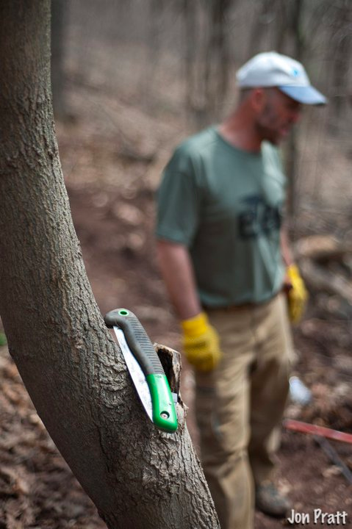
Advice
It is tragic to train for many years only to wind up in a work situation that is miserable. To guard against this, the interview process should be as open and sincere as possible.
Jon Lewis

Slide 30
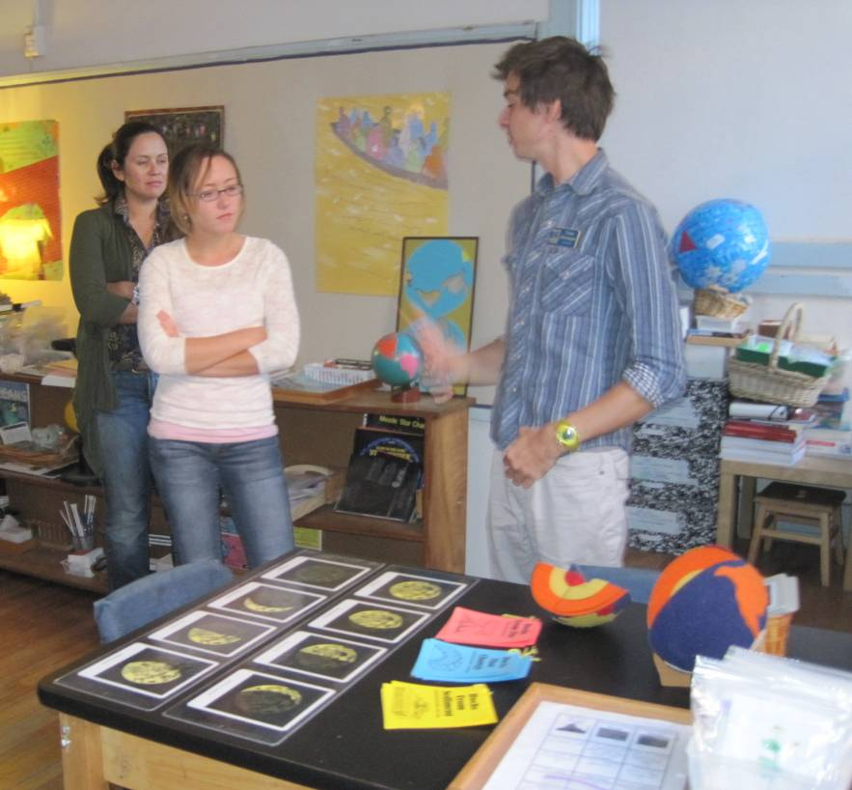
Advice
Carol Pride
Minority Serving Institution
Bachelor’s/Master’s Degrees
Savannah, GA
Observe and practice the skills needed for the job responsibilities that you didn’t get a PhD in:
  teaching,
  leading committees,
  managing a lab,
  proposal writing,
  mentoring,
  managing staff,
  assessment,
  program management.
You never know what role you might be asked to take on next in the campus setting.
There are many valuable models and sources of information among your colleagues and university staff.
Make connections on and off campus to maximize opportunities for you and for your students

Slide 31
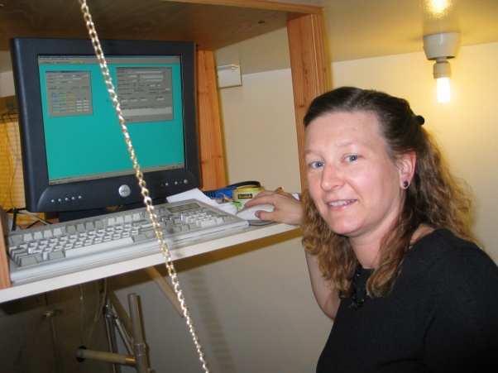
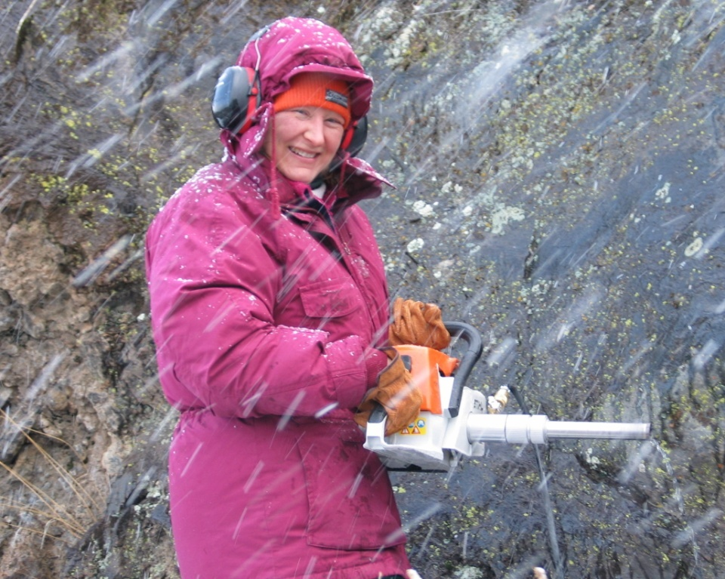
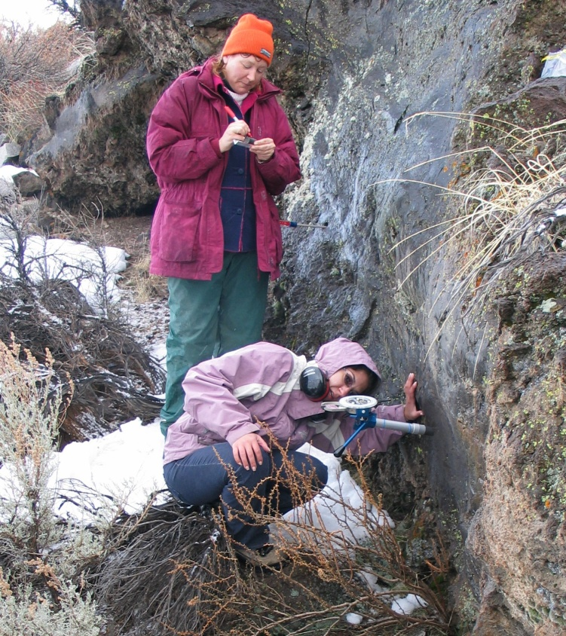
One piece of advice…
Elizabeth Nagy-Shadman, Pasadena City College
…be Open-Minded when unexpected opportunities present themselves…a career path is not necessarily linear!

Slide 32
Advice if you plan to teach at a community college
Keep on mind you are teaching to a very academic and cultural diverse audience. The challenge is to realize not all students have the same goal. Many of them just want to get the science credit, others want to learn the content and a smaller group plan to major in the geosciences. One has to be adaptive to gain all the student’s attention and interest and at the same time not loose motivation in pursuing our own academic research even with the time and funding constrains associated to a teaching job.
One has to enjoy teaching and also be open to work with the issues associated to non-traditional college students. This means students who work, have families, have been away from college from many years, etc.
Sergio Sermiento

Slide 33
What is one piece of advice that you most wish to share with participants as they embark on their academic careers?
Early preparation is a must (familiarize yourself with the teaching, research, and service requirements at universities and colleges)
When employed, hit the ground running!!!!
Joseph Zume

Slide 34
Piece of advice (practical)
You’ll never have more time to deal with the ever increasing stream of information, so develop effective techniques to manage your time and data.
Examples of dealing with firehose of information/ saving time:
* Get journal table of contents emailed to you (e.g. Nature Geoscience).
* Have a system for creating useful file names. For example, after downloading journal article “ngeo1009.pdf”, change name to: “Craine_2010_NatureGeoscience_temperature_sensitivity_organic_matter_decay.pdf” and file immediately in appropriate folder.
* Find useful programs to save you time: Dropbox instead of thumb drives, TimeMachine instead of manual backups, Endnote or other reference manager.
* Update your CV when it happens, not when the job review is due.
* Create templates for your presentations/classes
* When coming across useful web-based images, add website address to Info page.
* Don’t waste time on emotionally charged emails.
* Do the hardest things in the morning when you have the most mental energy.
submitted by Robert Rhew, UC Berkeley

Slide 35
Piece of advice (perspective)
Mentally prepare for being unprepared.
You cannot predict who will apply to work with you.
You cannot (and should not) be exactly like your advisor.
You will need to teach things that you were never taught.
You (and people you know) will have personal crises.
You (and people you know) will have professional crises.
Work on BOTH long-term and short-term projects.
(Some will fail or never come to fruition)
Having a positive attitude actually deflects real problems.
Robert Rhew, UC Berkeley

Slide 36
Thank you!
We’re glad you were able to join us today.
Please help us by completing an evaluation form
http://serc.carleton.edu//NAGTWorkshops/careerdev/AcademicCareer2011/june_eval.html

