Slide 1
Pursuing an Academic Career
Virtual Event Series
Developing Yourself as a Teacher:
Teaching Philosophies, Teaching Styles, & Teaching Statements
April 22, 2011
Audio access: Call in 1-800-704-9804
Access code:
Please mute your phone by pressing *6
Alternate number: 1-404-920-6604 (not toll-free)
Technical problems? Contact Monica at mbruckne@carleton.edu
Program begins at:
2 pm Eastern | 1 pm Central | 12 pm Mountain | 11 am Pacific
You can find information about the event at
http://serc.carleton.edu/NAGTWorkshops/careerdev/AcademicCareer2011/april_2011.html

Slide 2
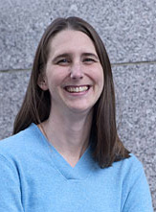
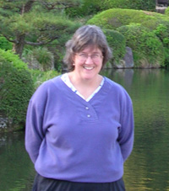

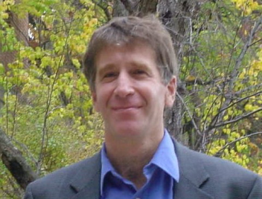
Developing Yourself as a Teacher
Pursuing an Academic Career Virtual Event Series
Rachel Beane
Bowdoin College
Heather Macdonald
College of William and Mary
Monica Bruckner
SERC
Tim Bralower,
Pennsylvania State University

Slide 3
Overview
Icebreaker
Teaching Philosophies & Styles
Teaching Statements
  Small group discussions
  Take-away points
Questions
Evaluation of event

Slide 4
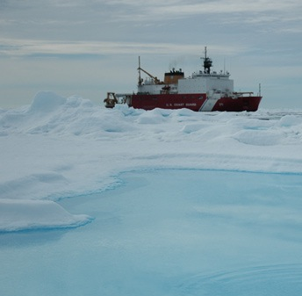
Icebreaker
LuAnn Dahlman; http://serc.carleton.edu/details/images/11673.html

Slide 5
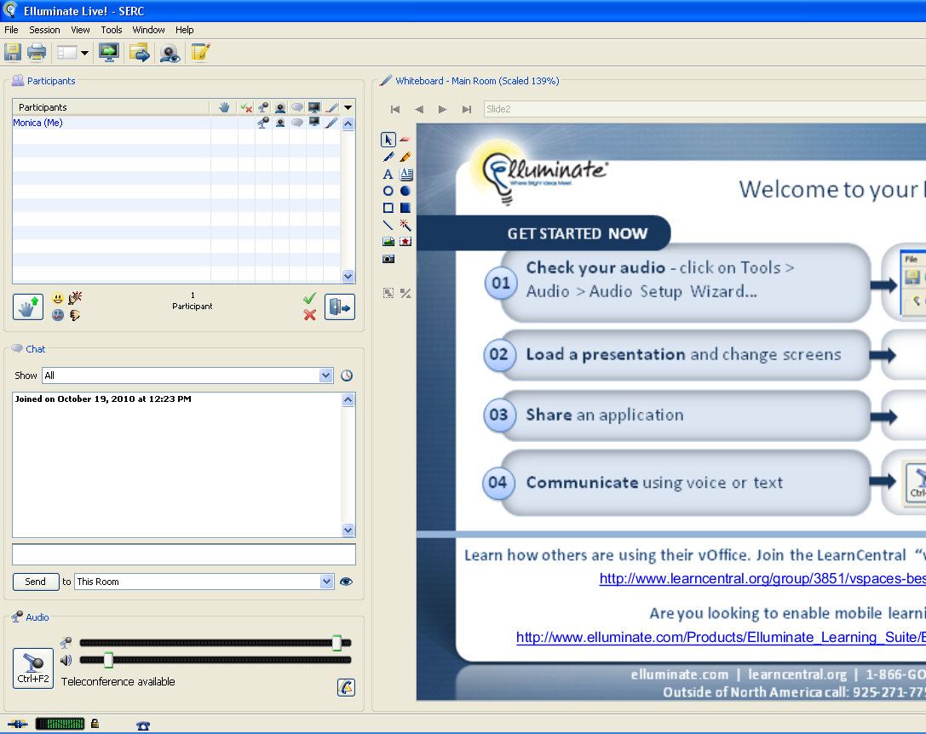
Elluminate

Slide 6
Question 1
In what type of setting are you most looking forward to teaching?
Advanced seminar
Introductory class
Field-based course
Research student mentoring
Click A, B, C, or D to record your answer

Slide 7
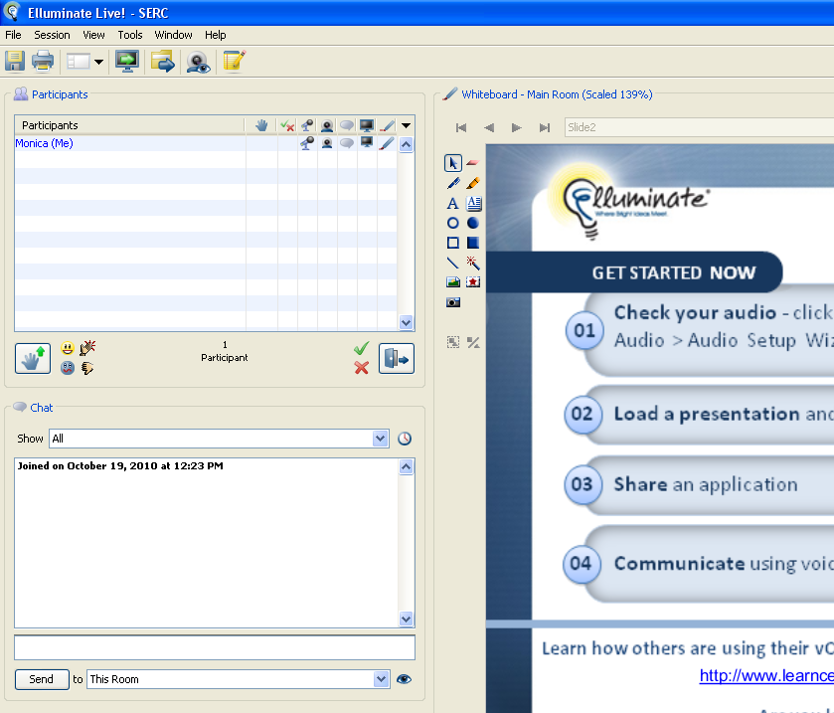
Type something

Slide 8
Question 2
When I teach I…

Slide 9
Elluminate
Notes:
On to the presentation, if you have comments or questions you can type them here

Slide 10
Teaching Philosophies
What are your goals as a teacher?
  What do you hope to accomplish when you teach?
  What do your goals say about you as a teacher?
How does this relate to student learning?
These questions are adapted from pages 27-35 of Mastering the Teaching of Adults, J. Apps, 1991, Kreiger Publishing, Malabar, FL.

Slide 11
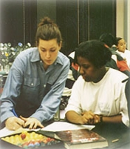
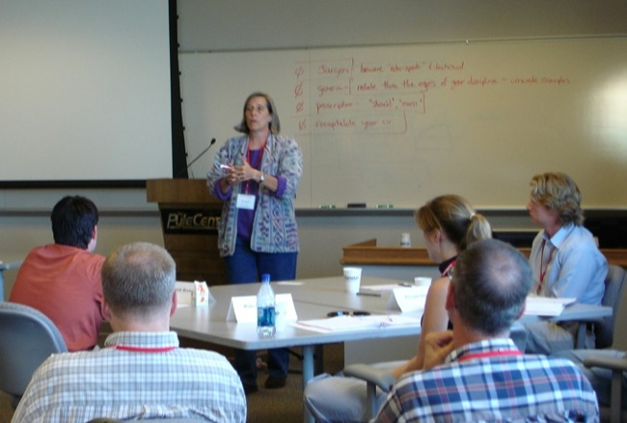
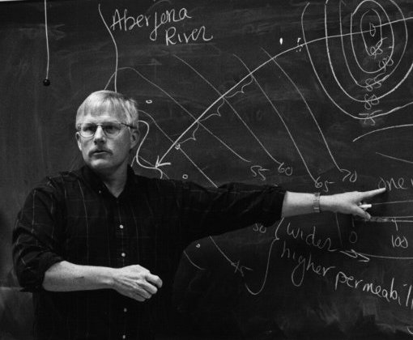
Teaching Styles
How do you want to interact with your students?
What do you find most satisfying when you teach?
Does how you teach fit with who you are?
All images from serc.carleton.edu
Notes:
New photo? Change to color photo at Giant Stairs helping teach Brunton compass

Slide 12
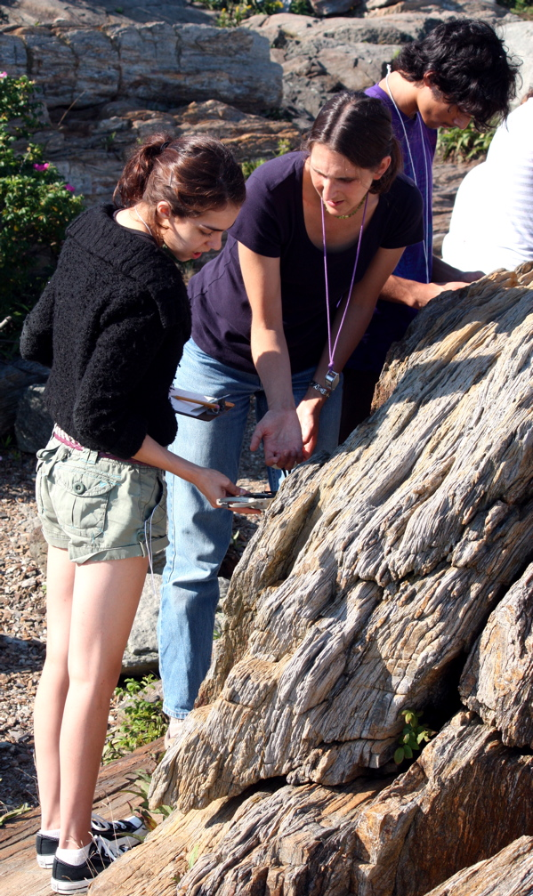
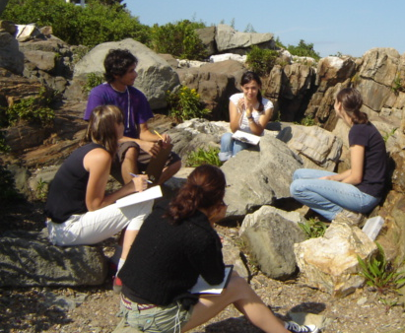
Teaching Philosophies and Styles
Notes:
Rachel – work to write but then will revise for probationary review, tenure review and promotion.

Slide 13

Teaching Philosophies and Styles
Notes:
Heather

Slide 14
Teaching Philosophies and Styles
Large versus small classes
Classroom design often limits teaching
Large general education courses in a state university setting
    Entertainment is key
    Powerpoint is generally unpopular
    Blackboard/smartboard lectures popular
    Engage students using questions, short think-pair crucial
    Cannot engage reach everyone
    Make coming to class worthwhile
Notes:
Heather

Slide 15

Teaching Statements
A reflective statement about your teaching (approach, philosophy, goals, experience, effectiveness, interests, and/or courses)
A persuasive essay with concrete examples to support your statements
http://serc.carleton.edu/sp/carl_ltc/wacn/index.html

Slide 16
Getting Started
Using course examples
as a way to add specifics to a teaching statement
Course goals
  Could you state goals for a specific course you teach or will be asked to teach in a way that they could be included in your teaching statement? Would some goals be true of all courses you teach?

Slide 17
Getting Started
Using course examples
as a way to add specifics to a teaching statement
Course goals
  Could you state goals for a specific course you teach or will be asked to teach in a way that they could be included in your teaching statement? Would some goals be true of all courses you teach?
Course activities
  In a few sentences, could you summarize an assignment or activity to use as an example in your teaching statement?

Slide 18
Some Possible Prompts
The Self-Reflective Interview *
  What is a “personal best” achievement for you as a teacher? Who is the best teacher you have known? What qualities made that person a great teacher? How do those qualities appear in your teaching?
Critical Moments **
  … when a learning opportunity opens up … for your students (e.g., first day of class, or first time the class really understands a complex concept)
A good metaphor for your teaching
Transformative experience as a student
Experience as a teacher or professional
* These questions are from Teaching with Style , Anthony Grasha (1996).
**This is from Good Talk about Teaching, Parker Palmer (1999)

Slide 19
Discuss Teaching Statements
Phone 1.800.704.9804 or 1.404.920.6604
Rachel Beane’s discussion group
Access Code:
Tim Bralower’s discussion group
Access Code:
Heather Macdonald’s discussion group
Access Code:
At end of discussion, call phone number above Access code:
Notes:
Add call in #s; how to divide into groups (or take care of this in email) any specific directions…
Imagine you are a faculty member teaching courses you developed. What kinds of comments would you like students to be making about you as a teacher to their roommate?

Slide 20
Key Points from Teaching Statement Discussions
Rachel’s group
Tim’s group
Heather’s group
Notes:
Report out: Robyn, Heather and Rachel summarize points from small group discussions, key points typed on white board . Expect one of key points to be about having some specifics in statement to lead to next section. Also expect some discussion on institution type, courses would like or would be expected to teach, …

Slide 21
Key Points
Vivid picture of you as a teacher (vs “generic” teaching statement)
Evidence of effectiveness
Avoid negatives and “red flags”
First paragraph is important
Easy-to-read format
Review and proofread

Slide 22
What is one strength I would bring … ?

Slide 23

What additional questions do you have about teaching philosophies, styles, or statements?
If you have a question, please type your question in the chat box.

Slide 24
Places to go for more ideas
Developing Your Teaching Statement
http://serc.carleton.edu/NAGTWorkshops/careerprep/jobsearch/teaching_statement.html
Assembling Your Application http://serc.carleton.edu/NAGTWorkshops/careerprep/jobsearch/application.html
Ellis, D.E. & Griffin, G.A. (2000) Developing a teaching philosophy statement: A special challenge for graduate students. Journal of Graduate Teaching Assistant Development, v. 7, pp. 85-92.
Grasha, A. (1996) Teaching with Style. Alliance Publishers: Pittsburgh, PA.
Palmer, Parker (1993) Good Talk About Teaching. Change, v.25 (6), pp. 8-13.

Slide 25
Pursuing an Academic Career Virtual Event Series
May, 11 2011, (Wednesday): Strategic Early Career Planning, Leader: Rachel O'Brien, Allegheny College
June 21, 2011 (Tuesday): Faculty Positions: Exploring the Range of Possibilities, Leaders from a variety of academic institutions.
Notes:
, advertise career prep workshop and other events in Pursuing series

Slide 26
Thank you!
We’re glad you were able to join us today.
Please help us by completing an evaluation form at
http://serc.carleton.edu//NAGTWorkshops/careerdev/AcademicCareer2011/april_eval.html

